Slide 1
VIRTUAL CRASH COURSE IN DESIGN THINKING
February 15,
2018
Conn & Caitlin
McQuinn

Slide 2
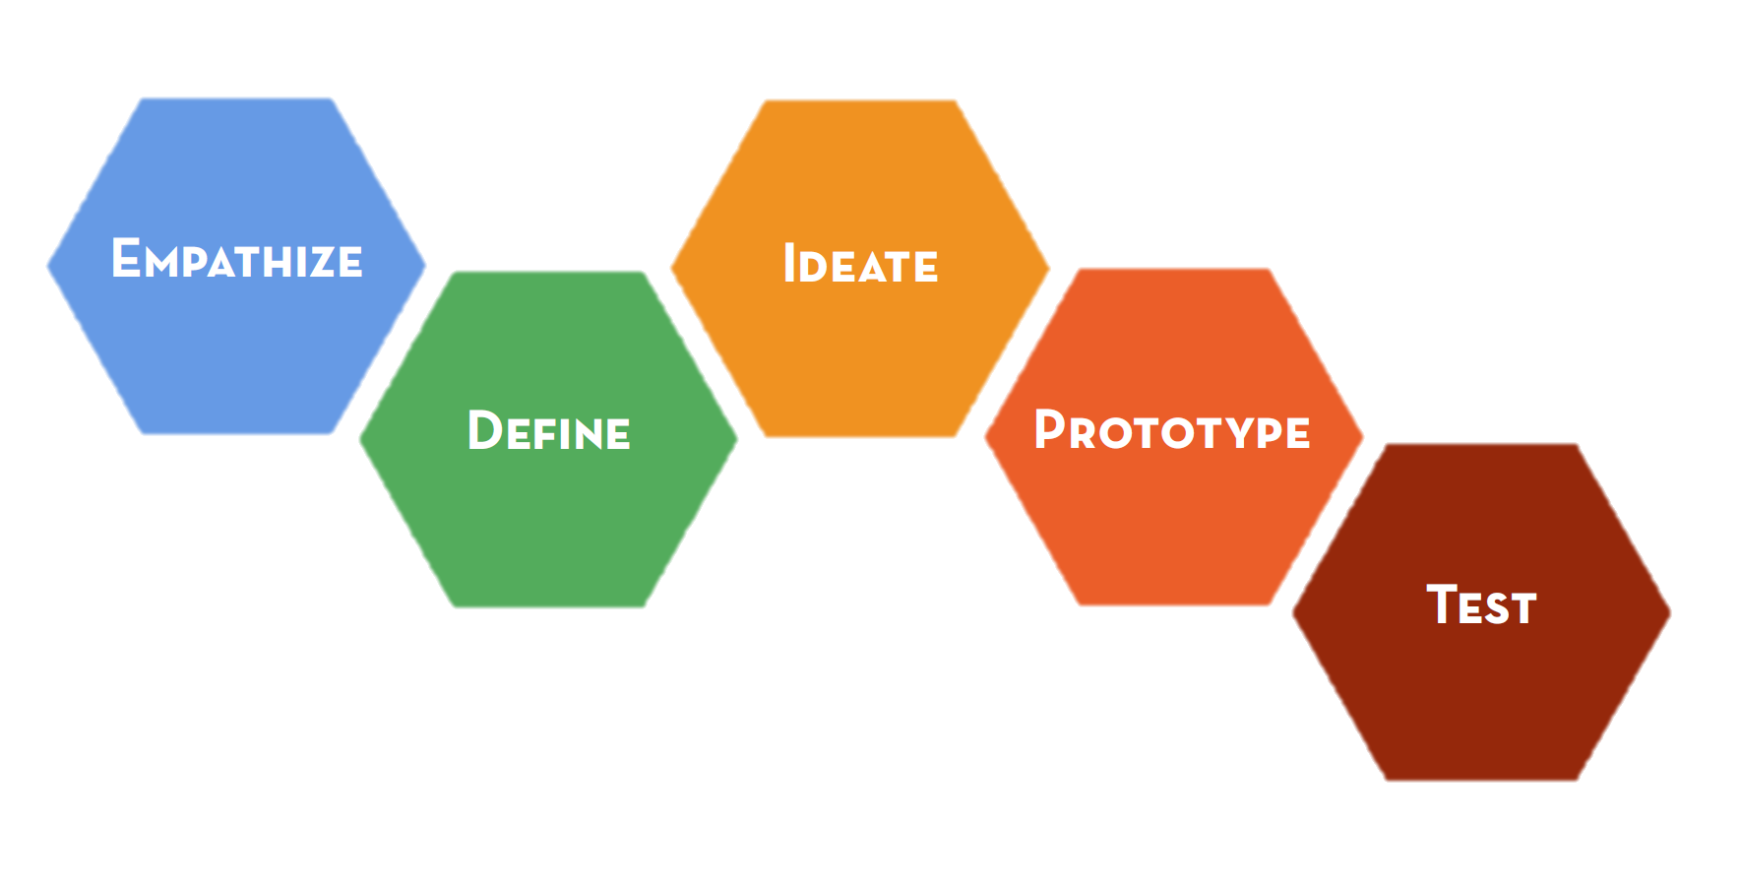
DESIGN THINKING
Notes:
Conn

Slide 3
EMPATHIZE
Notes:
Conn

Slide 4
DEFINE
Notes:
Conn

Slide 5
IDEATE
Notes:
Conn

Slide 6
PROTOTYPE
Notes:
Conn

Slide 7
TEST
Notes:
Conn

Slide 8
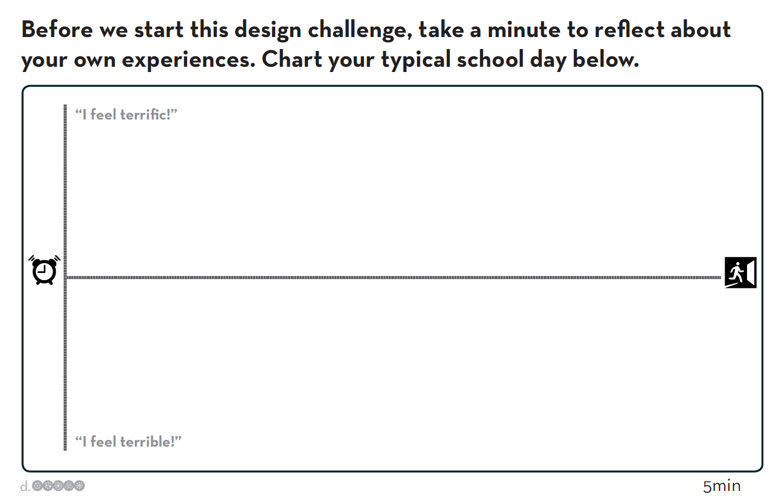
Chart your School Day
Notes:
Art

Slide 9
Chart your School Day
Notes:
Art

Slide 10
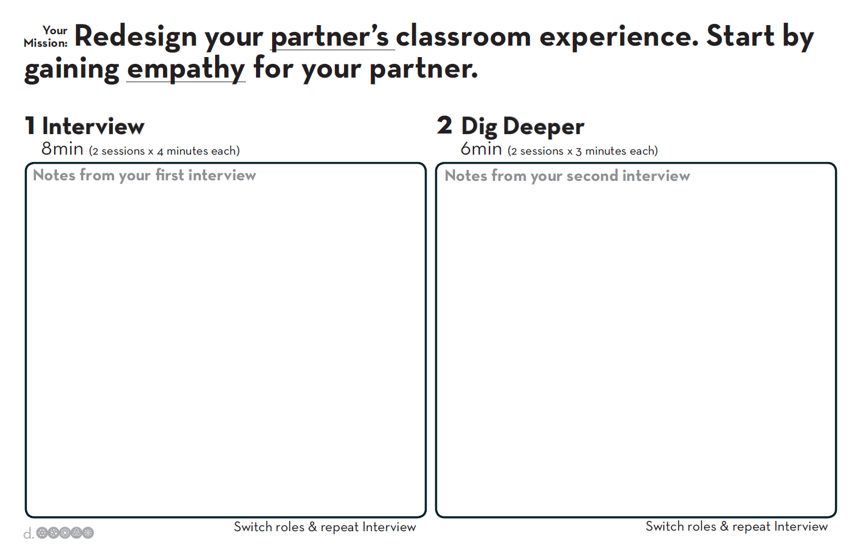
Empathy
Notes:
Art

Slide 11
A INTERVIEWS B
EMPATHIZE
Notes:
Art

Slide 12
B INTERVIEWS A
EMPATHIZE
Notes:
Art

Slide 13
Empathy
Notes:
Art – be sure to include the line “Probe deeply into what caught your attention – it’s ideal if you can make your partner cry!”

Slide 14
A INTERVIEWS B
EMPATHIZE
Notes:
Art

Slide 15
B INTERVIEWS A
EMPATHIZE
Notes:
Art

Slide 16
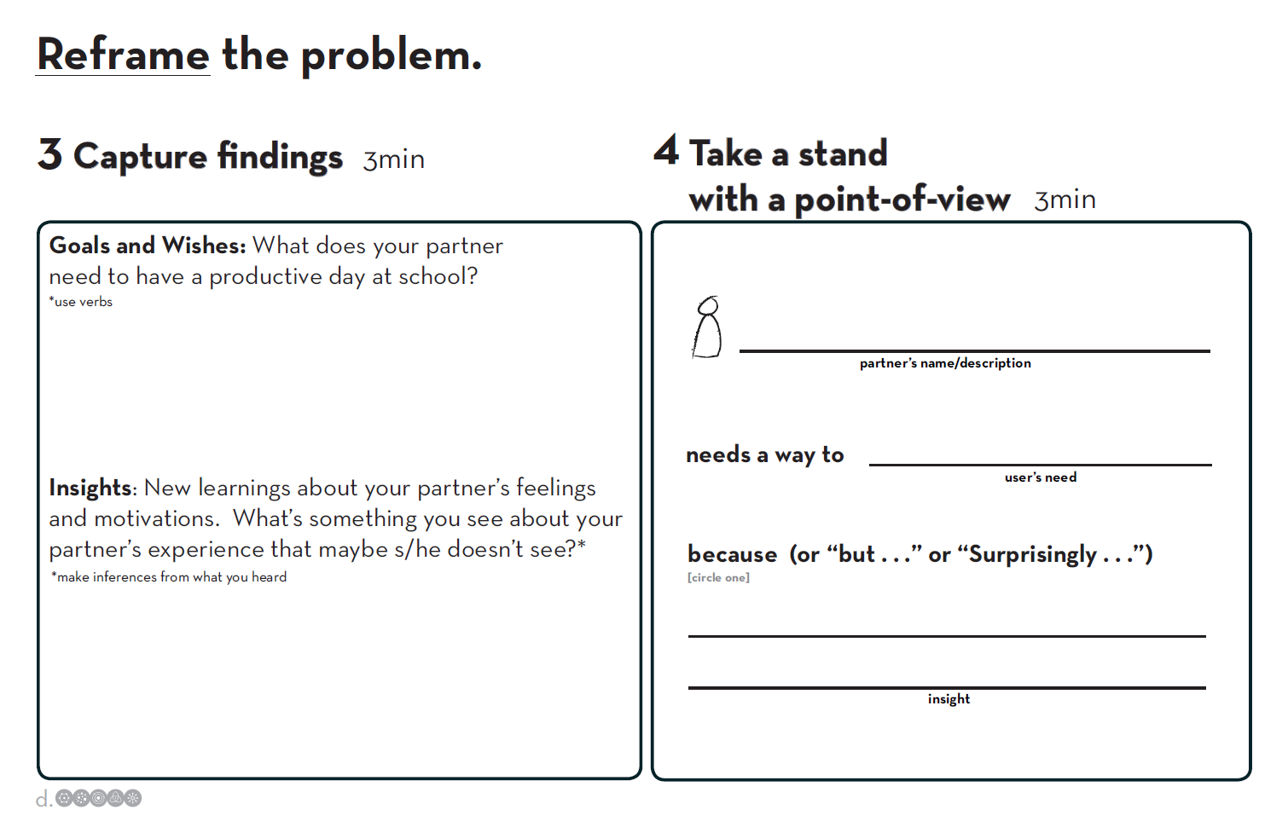

Slide 17
CAPTURE FINDINGS
DEFINE

Slide 19
TAKE A STAND WITH A POINT OF VIEW
DEFINE

Slide 21
5 RADICAL WAYS
IDEATE

Slide 23
A SHARES WITH B
IDEATE

Slide 24
B SHARES WITH A
IDEATE

Slide 25
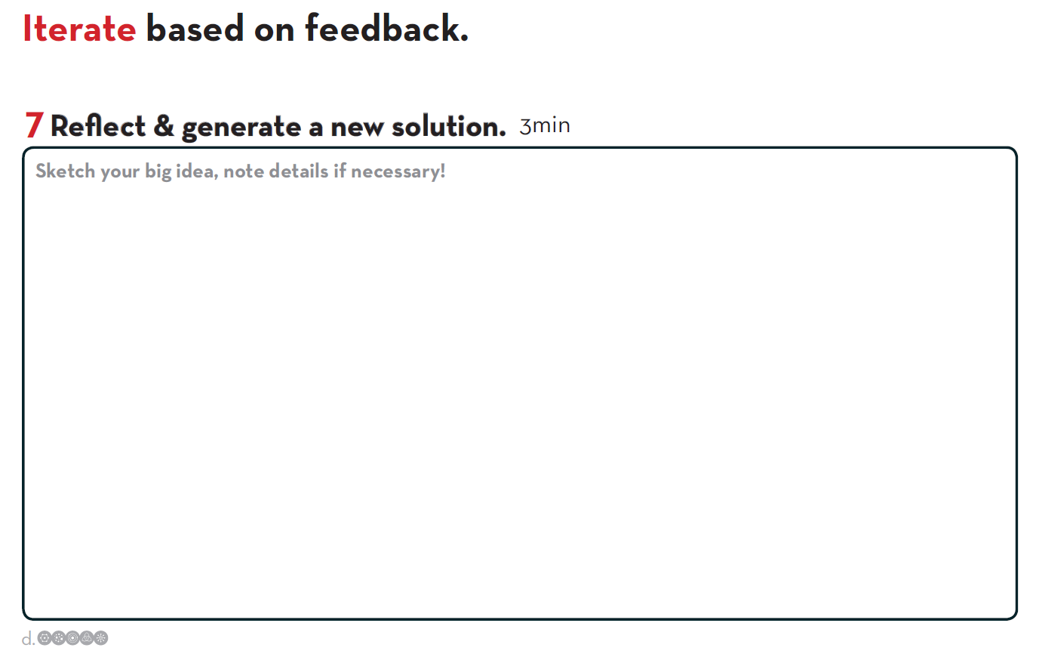
Notes:
Conn

Slide 26
GENERATE A NEW SOLUTION
IDEATE
Notes:
Conn

Slide 27
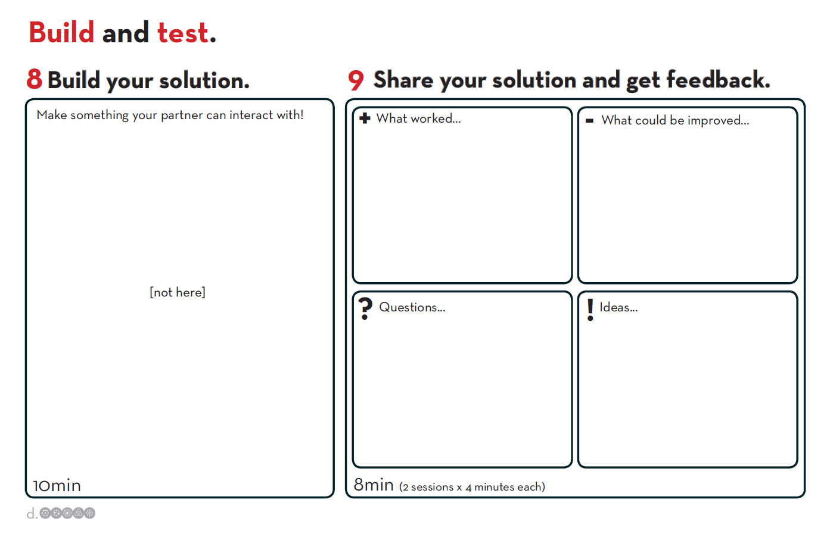
Notes:
Conn

Slide 28
BUILD YOUR SOLUTION
PROTOTYPE
Notes:
Conn

Slide 29
Notes:
Conn

Slide 30
A SHARES WITH B
TEST
Notes:
Conn

Slide 31
B SHARES WITH A
TEST
Notes:
Conn

