Slide 1
The Neuroscience of Story
conn mcquinn November 4, 2017
Notes:
Book Image: http://disney.wikia.com/wiki/Once_Upon_a_Time_(Book)
Opening activity: Have each person write down three favorite books, then discuss with two-three people around them why these books were meaningful. It will often be a theme that the books made a deep emotional connection to the reader, and provided them a powerful insight into people of different backgrounds or communities. This illustrates how narrative can actually change our thinking, or how the new stories we encounter can alter the stories we already inhabit.

Slide 2
Notes:
https://upload.wikimedia.org/wikipedia/commons/1/16/Sam_Houston_at_San_Jacinto.jpg
In Texas in the early 1930s, Miss Dorothy Jean Guy taught Texas state history by describing the events in engaging stories. I know this because my father was one of her young students, and can still remember some of the stories – and because my dad has told the stories of Miss Dorothy Jean Guy to our family. Stories preserving stories.

Slide 3
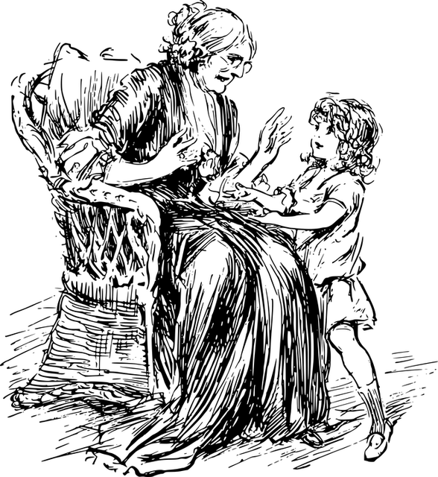
There have been great societies that did not use the wheel, but there have been no societies that did not tell stories.
Ursula K. Le Guin
Notes:
Image: https://pixabay.com/en/child-girl-grandma-grandmother-1293438/
Stories are so central to our lives and our thinking that all cultures have them. All families have them. Each of us as individuals have them. We are hard-wired at the neurological level for story.

Slide 4
Notes:
There’s a reason for this. The human brain is a pattern-seeking missile. We are driven to recognize patterns, and make predictions based on those patterns.

Slide 5
Notes:
There’s an image hidden under here, and I’m going to reveal it one square at a time. Raise your hand when you think you know what the picture is.

Slide 6
Notes:
Image: https://upload.wikimedia.org/wikipedia/commons/thumb/0/0c/Cow_female_black_white.jpg/1280px-Cow_female_black_white.jpg
It’s a cow! Did you feel a jolt of excitement when you first recognized it? Did you feel another little jolt when I completely uncovered it and it showed you were right? That’s the reward system in your brain encouraging you to look for patterns and make successful predictions. Think about the silly animated hydroplane races we see at things like Mariner games. It’s just cartoon boats, but we all go wild when we’ve picked the right color boat and it wins. It’s just a cartoon boat!

Slide 7
Notes:
Page 62, Scott McCloud Understanding Comics (If you have kids who love graphic novels, this book needs to be in your library!)
Comic strips, graphic novels, movies all work because of our pattern/prediction system. We fill in the blank between these two panels and make all sorts of assumptions about what has happened. Even though nothing is illustrated, we are pretty sure we know what happened. (It’s also a trick that movie makers/graphic novelists do to play with those assumptions and surprise us – perhaps in the next panel we see that the axe-wielding menace has tripped and fallen out the window. Psych!)

Slide 8
Notes:
The stories or narratives in our minds are the maps by which we navigate our lives. They are critically important.

Slide 9
Notes:
If you are interested in going more deeply into the topic of storytelling, I highly recommend this book. It looks at both the Hero’s Journey model developed by Joseph Campbell and the archetypes of the characters in stories, and does so with examples from popular books and movies. It’s also very insightful in looking at how these stories and characters impact our views of ourselves and the world around us.

Slide 10
Brain food
Notes:
Book Image: http://disney.wikia.com/wiki/Once_Upon_a_Time_(Book)

Slide 11
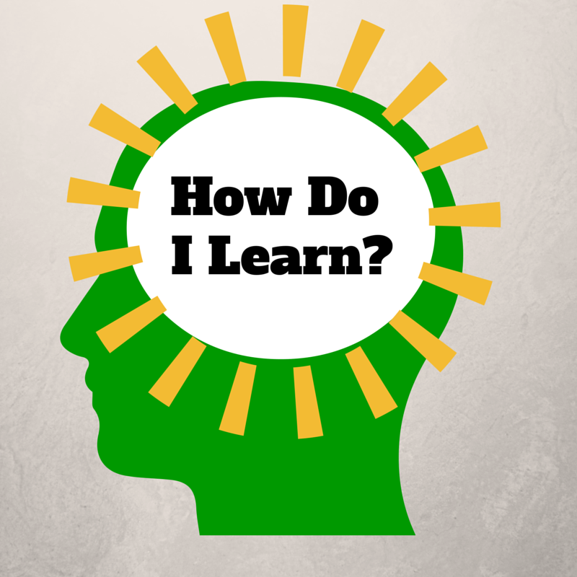
Notes:
The “How Do I Learn” grant was funded by the NIH Blueprint for Neuroscience Research and administered by National Institute on Drug Abuse (NIDA), part of the National Institutes of Health.
This presentation is based on work that we did for six years in the grant program How Do I Learn? Our project was a partnership between various schools and departments at the University of Washington and Puget Sound ESD. It was supported by a grant from the Blueprint for Neuroscience Research and is administered by the National Institute on Drug Abuse, part of the National Institute of Health. The underlying concept was that if parents, students and teachers have a basic understanding of neuroscience and learning, they can use that knowledge to improve theirs and others’ learning

Slide 12
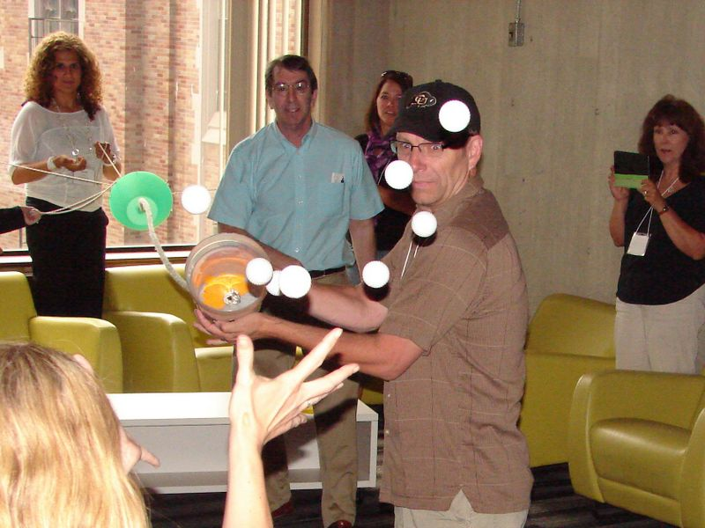
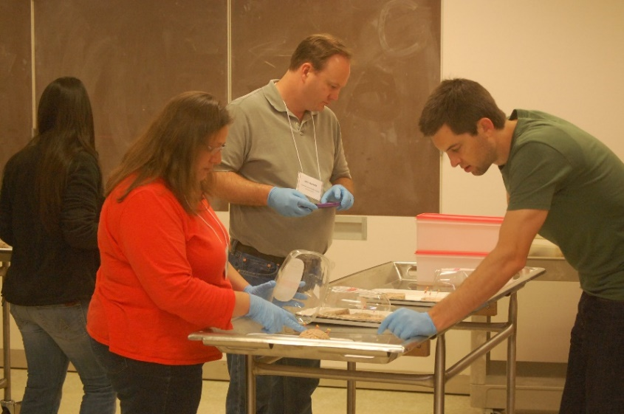
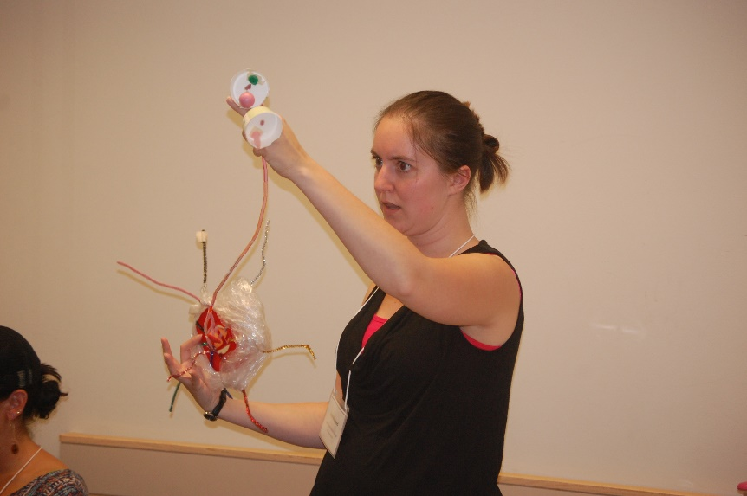
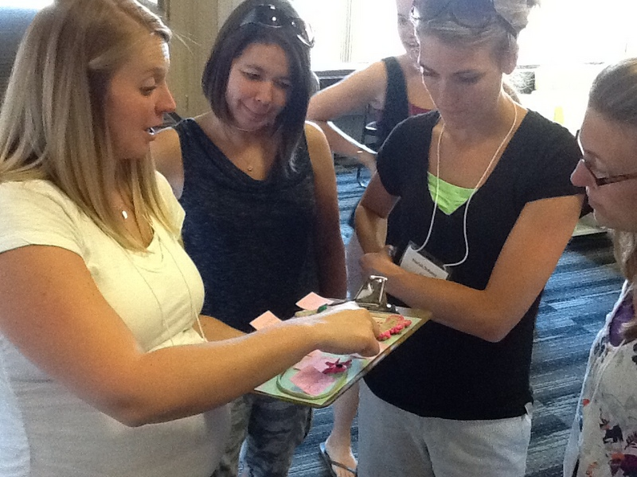
Notes:
During the grant, we worked with teams of middle school teachers in a five-day institute at the University of Washington, working with neuroscientists such as Dr. Eric Chudler, visiting anatomy labs, and working with education experts such as Dr. Kieran O’Mahony from the UW LIFE Center. Over 125 teachers participated in the program.

Slide 13
We’ve learned more about the brain in the last 25 years than we did in the previous 2,500.
Dr. Eric Chudler, University of Washington
Notes:
A big part of why this is area of study has become so important is that our knowledge in this area has increased so dramatically. Research in neuroscience has exploded in the recent past due to dramatic advances in technology. We as educators need to keep pace with this information to be our best at working with kids (and each other).

Slide 14
Notes:
http://static.pexels.com/wp-content/uploads/2014/07/astronomy-constellation-dark-2150.jpg
The human brain is the most complex structure in the known universe, and there is still a lot that hasn't been figured out yet. There are roughly 85 billion neurons in the average brain, and somewhere over a quadrillion connections between them. Obviously one presentation is only a bare skim of the surface, but what we are going to go over are a few key concepts that our participating teachers have found useful and that are fundamental to understanding any application of neuroscience to learning, and how those concepts tie directly to important ideas around narrative and story.

Slide 15
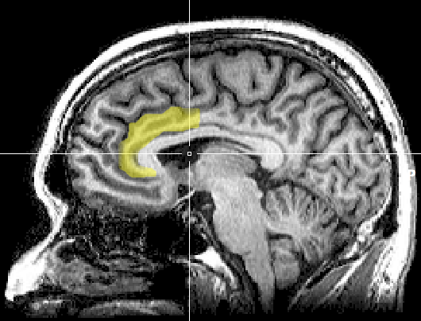
Notes:
https://upload.wikimedia.org/wikipedia/commons/1/10/MRI_anterior_cingulate.png
A note of caution right up front, however. There has been a lot of misapplication of neuroscience, or misinterpretation, to outright myths that have sprung up around this area of study. Often a minor research result gets blown up into a complex model of application that is touted as being "proven by science," when the original research might only have suggestive implications. And according to one study, just by putting an image of a brain scan into my presentation, you’ll score it more credible!
Original image caption: There is evidence suggesting that the more the anterior cingulate cortex signals conflict, the more dissonance a person experiences and the more their attitudes may change.

Slide 16
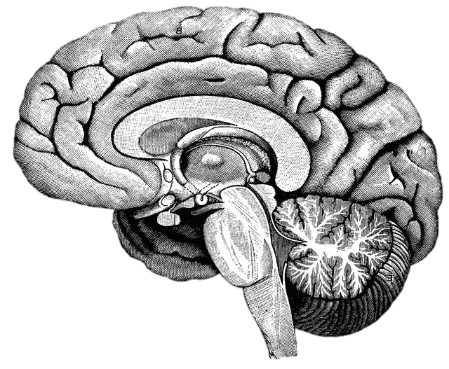
What happens in the brain when you learn?
Notes:
http://upload.wikimedia.org/wikipedia/commons/f/fe/14th-century_painters_-_Diagram_of_the_brain_-_WGA15761.jpg
Without discussing with anyone, write down what you already know about what happens in the brain when you learn. You will not need to share this with anyone.
After the one minute: This is from an instructional model called the NED Learning model, designed by Dr. Kieran O’Mahony. (You can read more about it at http://k12.nedlearning.com/index.html#free_printable_kit_details) By stating this fairly open question, I’m getting you to pull up your prior knowledge on the topic, which is important because all new knowledge has to be connected to prior knowledge. It’s also an emotional hook, since I have in essence asked you to guess what I’m going to tell you next, so you are more attentive to what I’m going to say. It’s like the silly cartoon hydroplane races at the Mariners games. Why should we care if the red, green, or yellow boat actually wins? But once we’ve picked a color we get really invested in the outcome and cheer or moan at the outcome.

Slide 17
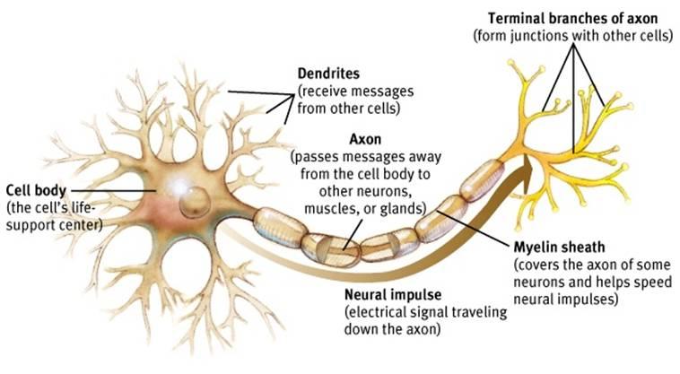
Neuron
Notes:
http://www.appsychology.com/Book/Biological/Biologypics/clip_image002.jpg
This is the basic model of a neuron. The branches on the left of this image are dendrites, where the neuron receives messages from from other neurons. This results in a electrical signal that travels down the axon to the terminals on the other end. There are actually many kinds of neurons in many shapes and arrangements, but they all have these basic parts.

Slide 18
Notes:
When the signal reaches the terminal, it turns out that neurons don’t directly touch. There is a tiny, tiny gap called a synapse, and the “upstream” neuron will release chemicals called neurotransmitters into this gap. On the dendrites of the “downstream” neuron are small sites that can receive individual molecules of the neurotransmitter. When enough receptor sites have been filled with the neurotransmitters, it will trigger an electrical pulse in the downstream neuron that will travel down to its terminals. The neurotransmitters will then float back into the synapse, and be reabsorbed by the original neuron. This is called “reuptake,” as in Sustained Serotonin Reuptake Inhibitor, or SSRI. Serotonin is a neurotransmitter that is part of many things, including depression, and SSRIs slows how quickly it is reabsorbed from the synapse, causing it to have a longer effect.

Slide 19
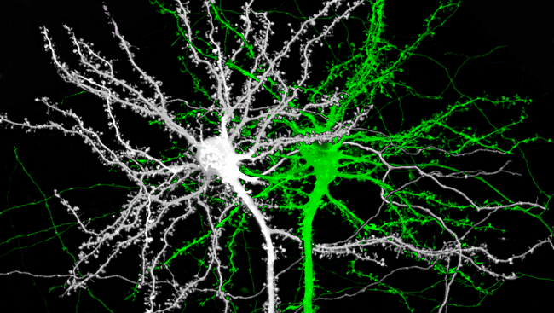
Notes:
Image source: http://www.brainfacts.org/thinking-sensing-and-behaving/learning-and-memory/2014/image-of-the-week-the-structure-of-memory
This is an image of two mouse neurons, and you can see the branches of the dendrites are covered with little knobs. They’re called spines, and they are where the dendrites grow to reach the terminals of other neurons.

Slide 20
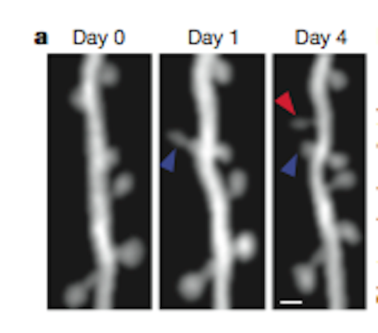
Notes:
Image source: http://blogs.scientificamerican.com/observations/files/2012/04/Screen-shot-2012-04-16-at-5.06.35-PM.png
Here is a real, live neuron growing new spines. They are growing toward neurotransmitter molecules. Notice that the spine by the blue arrow starts out long and thin, but then thickens over time. The neuron is building bridges to reach another active neuron, which is what happens in our brains when we learn. We are literally building learning connections.

Slide 21
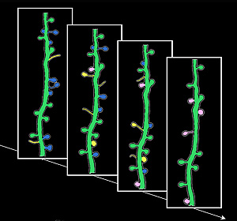
Notes:
Image source: http://news.ucsc.edu/2009/11/3413.html
Learning is not just about building new connections, though. The yellow spines are new ones growing and developing; the blue spines show the opposite, existing spines that disappear. This is called pruning, and they are going away because they aren’t being used. Neural connections are a literal “use it or lose it” proposition. One of the heaviest times of pruning is adolescence, with young teenagers starting out with twice as many connections as they will retain as adults. That’s why the patterns established as teenagers are so profound.

Slide 22
Notes:
Growing new spines on a dendrite provides more receptor sites for neurotransmitters to land. The triggering of the downstream neuron happens not from a single molecule of neurotransmitter, but from a certain quantity of sites being triggered. By having more sites, it is easier to reach that trigger point.

Slide 23
Reflection
What was surprising?
What did you already know, but now see in a new way?
What new questions do you have?

Slide 24
Notes:
Individual neurons don’t really do much by themselves. It’s the vast networks they create that make our brains what they are.

Slide 25
Notes:
The networks of connections between neurons is increasingly recognized as the fundamental framework of brain function. In the same way that understanding the genome of our DNA has led to leaps in understandings of genetics and health, understanding the "Connectome" is now seen as key to understanding the brain.
With new sensing and imaging technologies, it is now possible to view the connectome in action, in real time. [https://youtu.be/dAIQeTeMJ-I] How complex is this? The brain contains roughly 86 billion neurons, and somewhere around one quadrillion synapses.

Slide 26
What are the major brain systems involved in learning?
Notes:
http://upload.wikimedia.org/wikipedia/commons/f/fe/14th-century_painters_-_Diagram_of_the_brain_-_WGA15761.jpg

Slide 27
Notes:
The pre-frontal cortex is where you do your basic thinking. It's the part of your brain that is (hopefully) engaged now with your awareness. It's the part of the brain we want the students using when they think, plan, and make choices. We know now that this is the last part of the brain to finish developing, often not until 23 or 24 years old. (Even older with some males, which will surprise no female.) There’s a reason kids don’t seem to think like us. They don’t.
It does not always perform at the same level. The PFC (as neuroscientists like to call it) is sensitive to a variety of factors. We’ll come back to this.
This and the following images are from the iPad App 3D Brain from Cold Spring Harbor Labs. There is a free and an HD pay version. (99 cents!)

Slide 28
Notes:
Another major system to understand is the limbic system. This is the part of the brain that deals with emotion and - interestingly enough - memory formation. Two critical parts are the amygdala and the hippocampus, one of each on opposite sides of the brain. The amygdala is one of the parts of the brain that manages your emotions.. The hippocampus is involved in the storage and retrieval of long-term memories, as well as routing information to the PFC. Learning is a function of the emotional part of our brain!

Slide 29
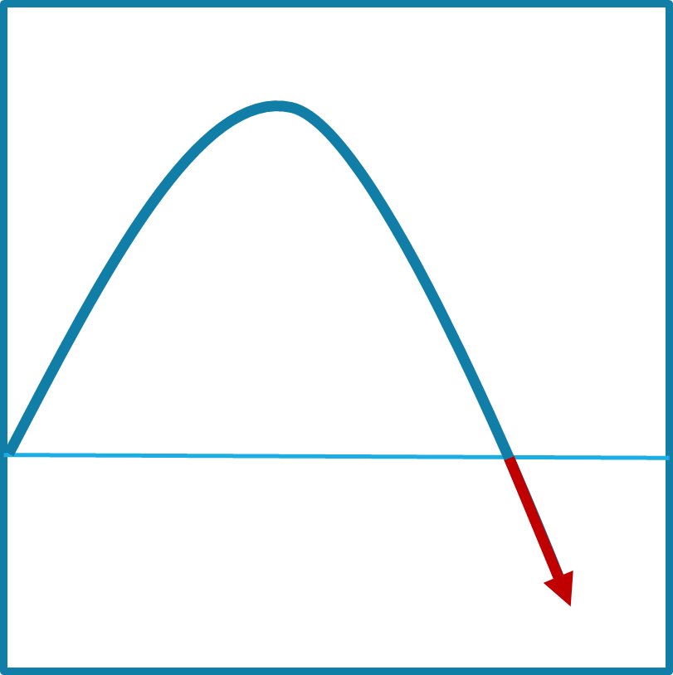
Notes:
On the front part of the stress curve, the function of the pre-frontal cortex is enhanced. If your limbic system is mildly engaged, it makes you more alert and focused. The neurotransmitters and hormones that are released enhance memory formation and cognitive function. This is what is happening with students when they are engaged and challenged.

Slide 30
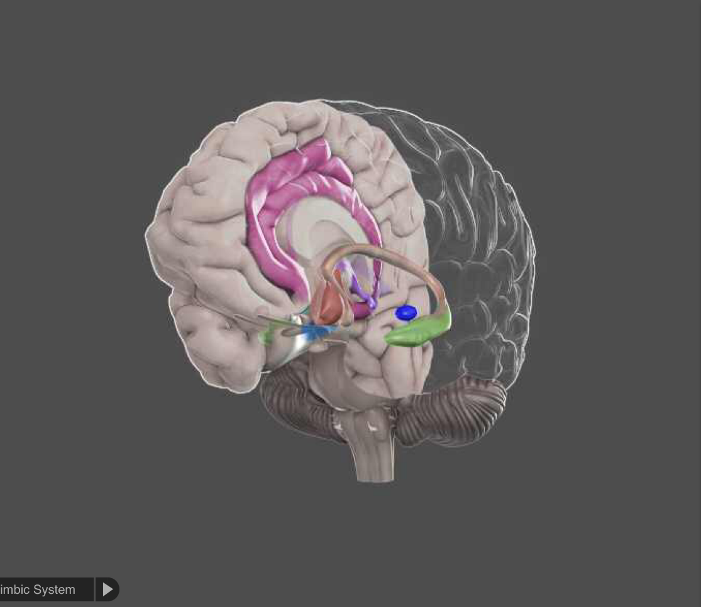
Notes:
On the down side, the limbic system dominates and other reactive parts of the brain take over. Whenthe amygdala gets overstimulated, particularly by stress or fear, the neurotransmitters and hormones that are released in the system are the type that engage your automatic body systems - heart rate, breathing, eye dilation, blood flow - to get you ready for fight, flight, or freeze. They are not the same kinds of neurotransmitters used by your pre-frontal cortex, and the sending of information to the PFC from the hippocampus is blocked, as is access to memory. When you are really upset, the thinking part of your brain is shut down, and the reacting part of your brain is powered up.
Have you (or your students) ever done anything when you were really upset and afterward thought "What was I thinking?" That's the problem. You weren't. You were reacting, and you were reacting at a time when your thinking ability was very limited. Drs. John and Julie Gottman of the University of Washington, experts in how couples relate to each other, say quite directly that when you are in that kind of upset state, it’s simply impossible to be rational. Some researches call that the amygdala hijack. The only rational choice is to step away until you can calm down.
There’s a reason for this. From a strictly biological perspective, when you see that lion hiding in the grass, it’s not a time to be contemplative. It’s a time to act, and act quickly. But stressing students (and teachers, for that matter) puts their brain in the least effective mode for learning.
And it gets worse. Cortisol is one of the hormones that is released in your system when you are stressed, and one of the effects it has is to dissolve the little spikes that grow on your dendrites when they are trying to build new synapses. It melts your learning away.

Slide 31
Performance
Stress
Notes:
To complicate our lives as teachers, each student has a different curve profile. What may be a positive challenge for one student can push another student under water.

Slide 32
Notes:
There is another network of structures in the brain stem called the reticular activating system, or thankfully RAS for short. This system is one of the core mechanisms for filtering sensory input. We can’t attend to all of the information flooding our senses at any one moment, and the RAS helps to decide what we are consciously aware of and what we aren’t.

Slide 33
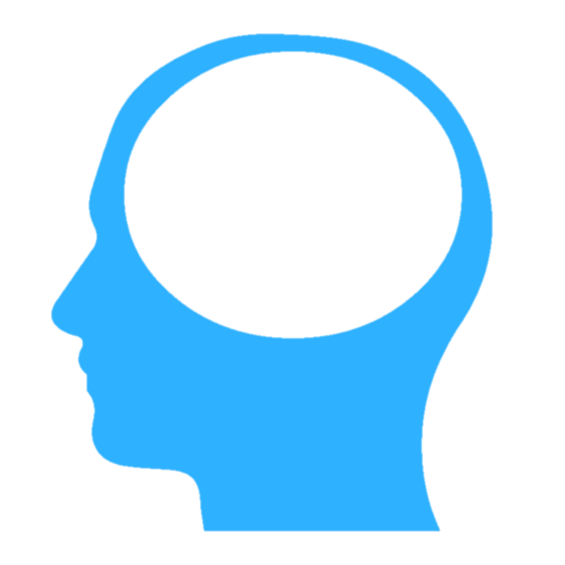
Notes:
There are three primary kinds of information that the RAS will prioritize.

Slide 34
!
NEW!
Notes:
Novelty is one. New things grab out attention quickly. (A new kid in class is always the center of attention, for good and bad.) That’s part of the dreadfully addictive nature of smart phones – they are bottomless pits of novelty.

Slide 35
!
Notes:
Things that we care about are also a high priority. When you are in a crowd of thousands of people, you can spot the face of a friend or family member, yet not be able to describe a single other face around them.

Slide 36
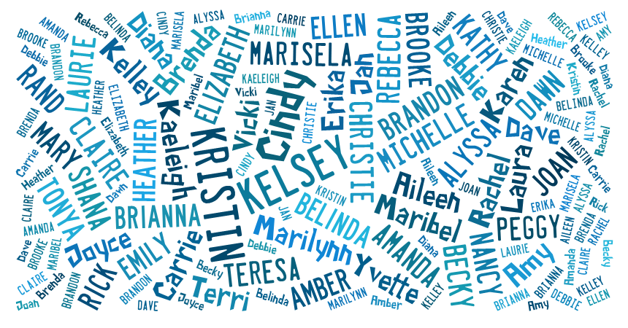
Notes:
How many times have you been at a party, and all of the background discussion is simply a blur of white noise – until someone says your name, which will pop out of that meaningless buzz. That’s your RAS at work.

Slide 37
It is literally neurologically impossible to learn deeply about something you don’t care about.
Dr. Mary Helen Immordino-Yang
Notes:
This is one of the core challenges of education. The question that always pops up here is “How do you get them to care?” If I knew an easy answer, I’d be wealthy. The not-so-easy answers are through relationships (if I feel a connection to you, then your interests take on new importance to me) and through stories the invoke curiosity, empathy, or a sense of identification with the story’s protagonists. Many people can look at the path to the career they work in and point to a book, story, movie, or television show that engaged their interest in the field. It is not by giving them facts (“You’ll need to know this to get a job.”)

Slide 38
!
Notes:
Image from https://en.wikipedia.org/wiki/Semi-automatic_firearm
The highest priority is threat. Our brain’s first job is survival, so threat is always put at the top of the list. There is a psychological observation called the ”Weapons Effect,” which describes the observation that someone who has been held up at gunpoint can often describe the gun in greater detail than the person holding it.

Slide 39
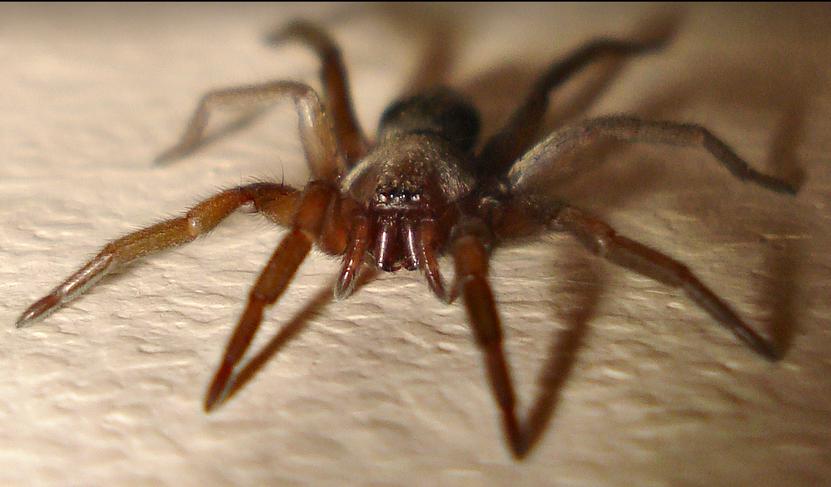
Notes:
http://www.flickr.com/photos/micks-wildlife-macros/
Some of these things that we react to are innate, but many are learned and highly individual. Some of you are not happy with the image I’ve put on the screen, while others don’t particularly care. And yes, it was mean of me to put it on the slow zoom.

Slide 40
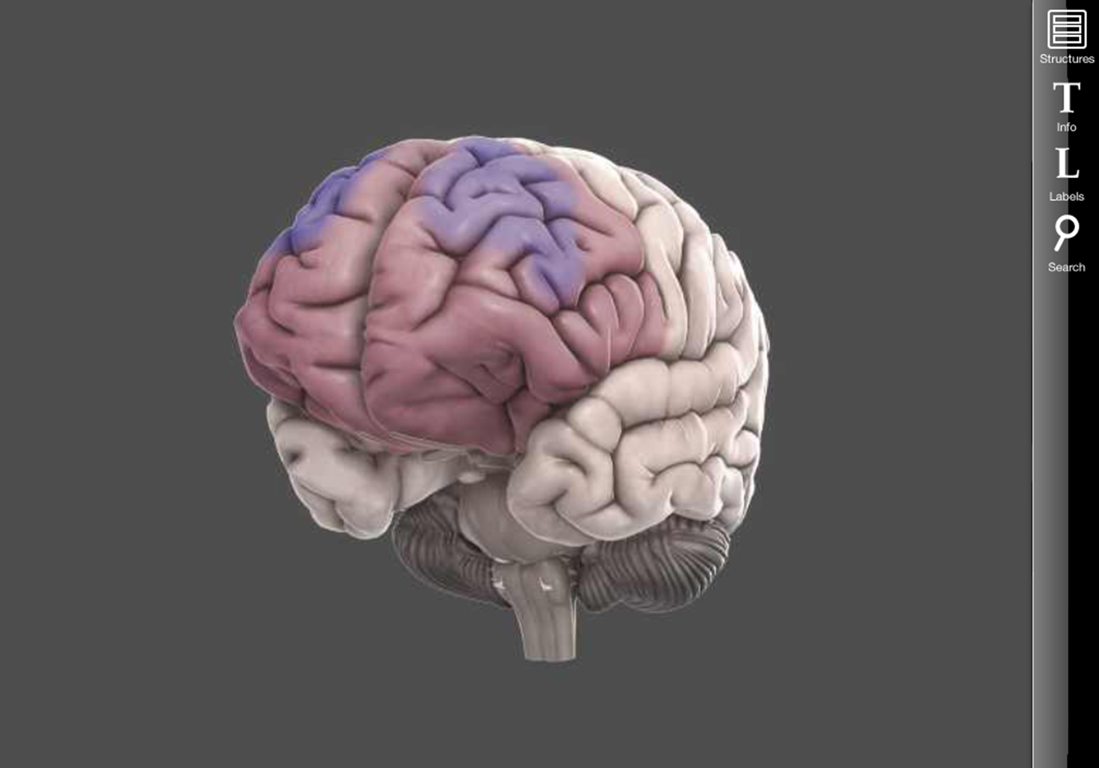
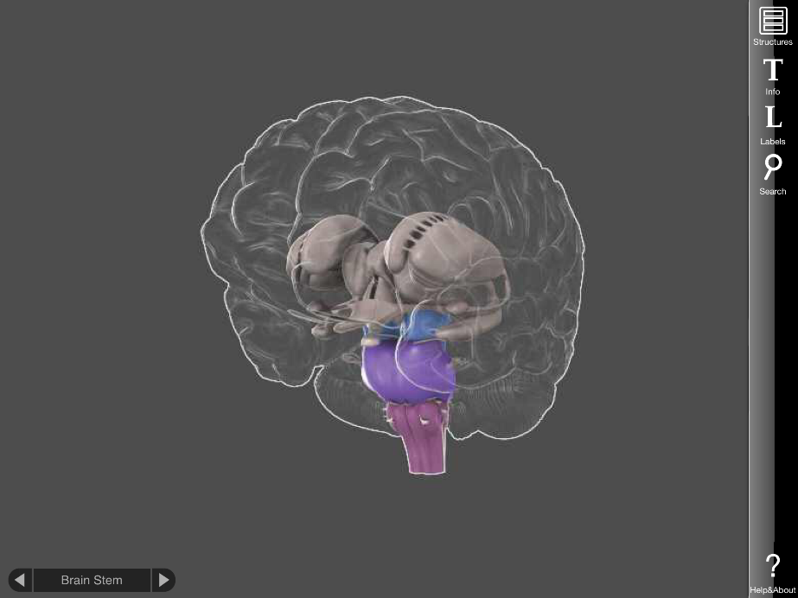
Notes:
What gets through the RAS in turn is what drives the PFC and the limbic system. If the information getting through is perceived as something interesting, or exciting, or desirable, or new, or surprising, your amygdala will be mildly stimulated, and you will pay more attention. And your pulse rate will rise slightly, your eyes will dilate, and other mild physical responses. If it’s perceived as a threat, depending on the severity of the threat, your limbic system may become so active as to cause the negative emotional and cognitive consequences we discussed earlier. The three systems work in a very complex, ever-changing dance. The important thing to remember is that there are modes of dance that result in much better learning (and happiness) than others.
The other key takeaway is that for many of the situations we face, whether or not we perceive it as a threat is up to us. Most of the triggers we experience are learned – which means they can be unlearned. And we as teachers can do our best to avoid creating and maintaining those triggers.

Slide 41
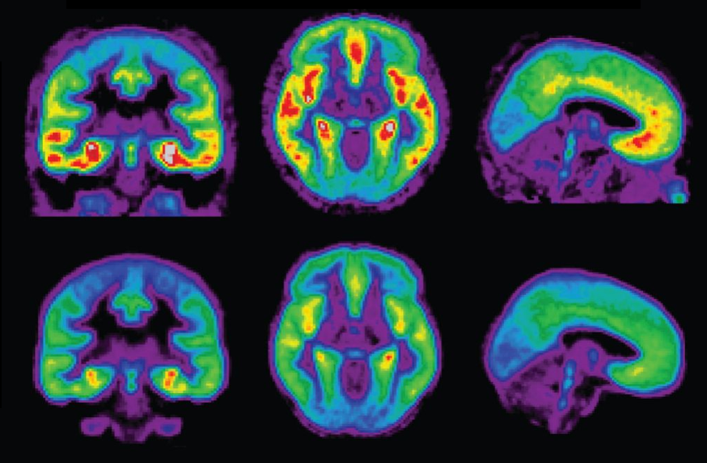
Notes:
https://upload.wikimedia.org/wikipedia/commons/9/9a/Default_mode_network-WRNMMC.jpg
https://etc.usf.edu/clipart/19900/19909/girlread_19909.htm
We use stories to help us figure out our lives, and to understand who we are. We can learn from the experiences of others by experiencing what they have experienced.

Slide 42
Reflection
What was surprising?
What did you already know, but now see in a new way?
What new questions do you have?
Notes:
Turn and share with three or four people around you.

Slide 43
What does your brain spend most of its time working on?
Notes:
http://upload.wikimedia.org/wikipedia/commons/f/fe/14th-century_painters_-_Diagram_of_the_brain_-_WGA15761.jpg

Slide 44
Notes:
https://upload.wikimedia.org/wikipedia/commons/9/9a/Default_mode_network-WRNMMC.jpg
On to another set of structures. It turns out that when your brain isn’t busy doing a specific task (counting, making a shopping list, doing a spelling test, etc.), there is a set of structures that becomes active. It’s very unpoetically called the Default Network. When you’re daydreaming, that’s where your brain is active.

Slide 45
Notes:
Image: https://pixabay.com/p-1488213/?no_redirect
One of the key functions of the Default Network is to process your social world and your place within it. This is such a critical part of our survival that it is literally the default mode of operation.

Slide 46
Notes:
https://upload.wikimedia.org/wikipedia/commons/f/fb/Mind-reading-Russell-Morgan.jpeg
One of the goals of all this processing is trying to make you into a mind reader. We are always trying to figure out what other people are thinking and feeling – especially about ourselves. Scientists call it Theory of Mind.

Slide 47
Notes:
Image: https://pixabay.com/en/advert-advertising-banner-blank-84406/
For instance, most of us can look at this woman and feel pretty confident about how she’s feeling about us.

Slide 48
Notes:
And it’s not too hard to interpret this expression, either!

Slide 49
Notes:
Image: https://upload.wikimedia.org/wikipedia/commons/7/7b/Paul_Brook_Mind_Reader.jpg
But what is he thinking? Just exactly how is he feeling about you? Who wants to volunteer their response?

Slide 50
Notes:
Remake of the Heider-Simmel video
https://vimeo.com/36847727
This is a remake of an animation originally done in the 1940s. After watching the video, describe the characters and their motivations. How can we do that? They’re just cartoon dots and a triangle! But your brain is determined to ascribe motivation.

Slide 51
Notes:
Image: https://upload.wikimedia.org/wikipedia/commons/1/12/Flickr_-_moses_namkung_-_The_Crowd_For_DMB_1.jpg
Because we are so wired to interpreting and responding to the feelings of other people, emotions are quite contagious, particularly in crowds. That’s why happy crowds get really happy, and why concerts are so much fun.

Slide 52
Notes:
https://upload.wikimedia.org/wikipedia/commons/0/01/Radically_oriented_protesters_throwing_Molotov_cocktails_in_direction_of_Interior_troops_positions._Dynamivska_str._Euromaidan_Protests._Events_of_Jan_19,_2014-5.jpg
It’s also why unhappy crowds can get really unhappy, and why something as meaningless as the outcome of a sporting event can quickly turn to violence.

Slide 53
Notes:
My daughter and I watched the gold medal hockey game between Canada and the United States in an outdoor crowd of 5,000 Canadians during the 2010 Winter Olympics in Vancouver. It was a very dramatic game – the Canadians were ahead until just before the end, when the U.S. tied the game. The mood of the crowd went from energetic to dead almost instantly. There was a fifteen minute break before the overtime period, and the crowd was almost completely silent. We were standing in the far back of the crowd, and from the small visitors’ help center behind us a small woman in an orange vest walked quietly out into the sidewalk, carrying a megaphone. She put it up to her face, turned it on, and with an unsure voice starting to sing “Oh, Canada, our home and native land…” By the second line, the entire crowd was singing with her. It was an amazing moment, and the mood of the crowd was completely changed. Tension still filled the air, but not the palpable dread that had existed just moments before. When the game resumed, Canada scored the winning goals just 30 seconds into overtime, and the eruption of ecstatic joy was so overwhelming that my daughter and I were completely swept up in it, celebrating and cheering as if we had lived there all our lives. We spent the next two hours walking through the crowded streets of downtown Vancouver, exchanging so many high fives with total strangers that our hands ached.

Slide 54
Notes:
https://upload.wikimedia.org/wikipedia/commons/9/9a/Default_mode_network-WRNMMC.jpg
And your Default Network is active is when we listen to (or read or watch) stories. You personal set of stories is being reprogrammed.

Slide 55
Notes:
Image: Personal collection

Slide 57
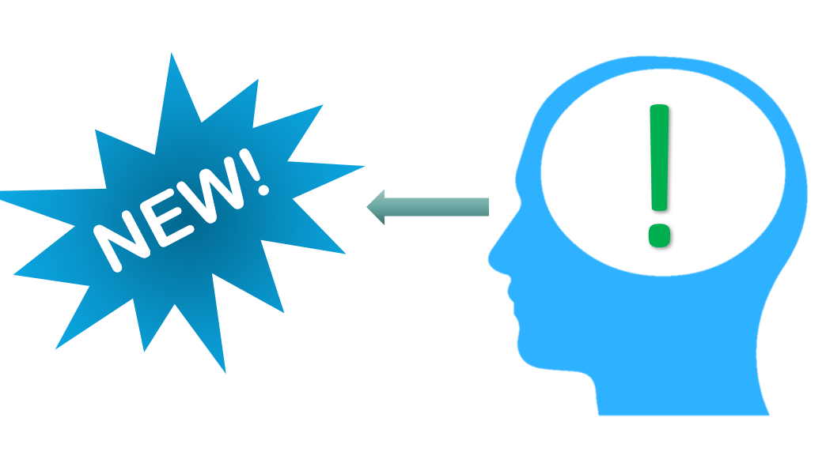
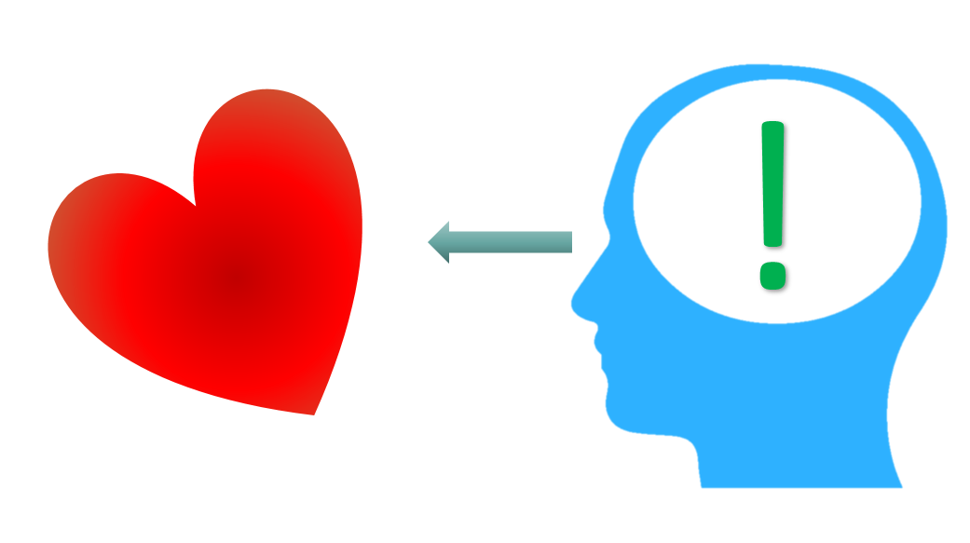
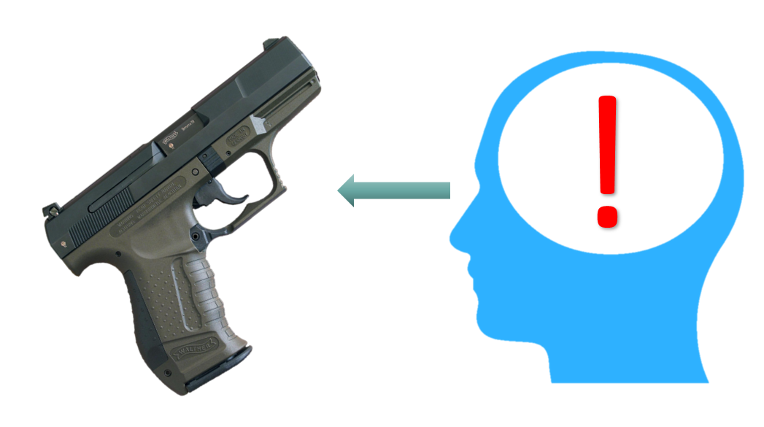
Notes:
The stories we inhabit determine whether something is new, important, or threatening

Slide 58
Reflection
What was surprising?
What did you already know, but now see in a new way?
What new questions do you have?
Notes:
Turn and talk.

Slide 59
Notes:
https://upload.wikimedia.org/wikipedia/commons/0/0b/Grevys_zebra.jpg
Spencer Holst – the Zebra Storyteller: http://www.archipelago.org/vol3-1/holst.htm

Slide 60
Notes:
Image source: https://commons.wikimedia.org/wiki/File:Stanley_Tools_toolchest_-_New_Britain_Industrial_Museum_-_DSC09848.JPG
The more stories we know, from the most diverse sources, the more sophisticated our thinking can be.

Slide 61
Notes:
https://upload.wikimedia.org/wikipedia/commons/thumb/3/39/SLNSW_9499_Smiling_study_of_Don_Bradman.jpg/1024px-SLNSW_9499_Smiling_study_of_Don_Bradman.jpg
These stories can have major consequences in our lives. Doe the stories of these two individuals interact in the same way as…

Slide 62
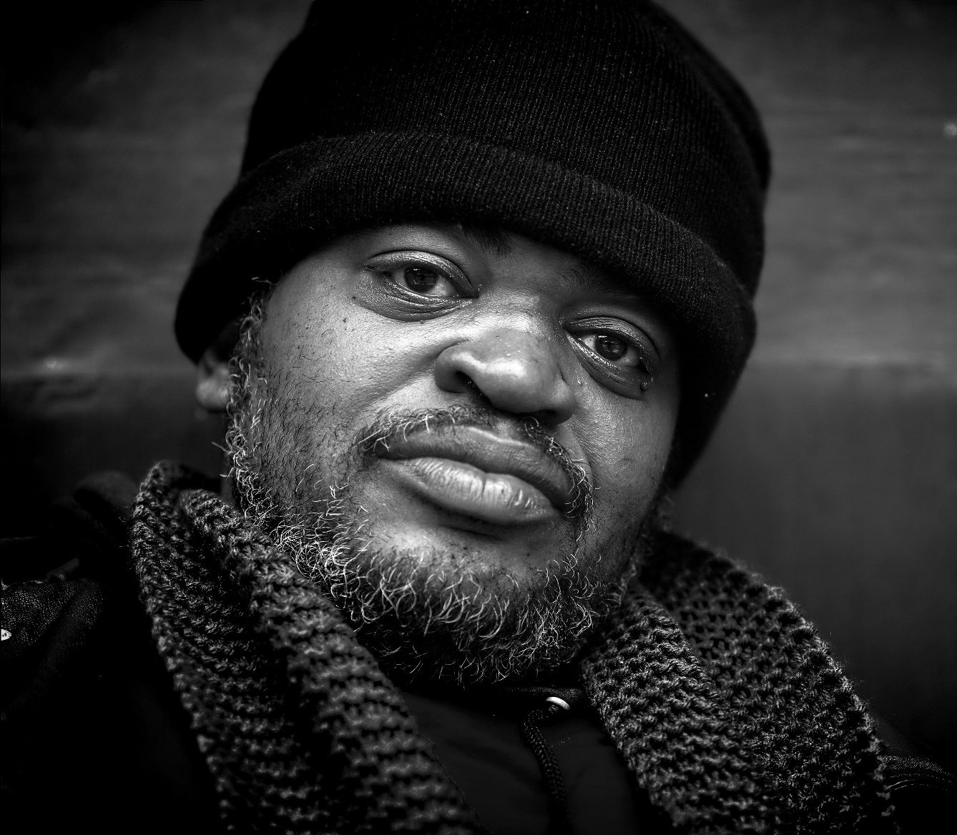
Notes:
https://static.pexels.com/photos/35597/homeless-male-b-w-poverty.jpg
…these two individuals?

Slide 63
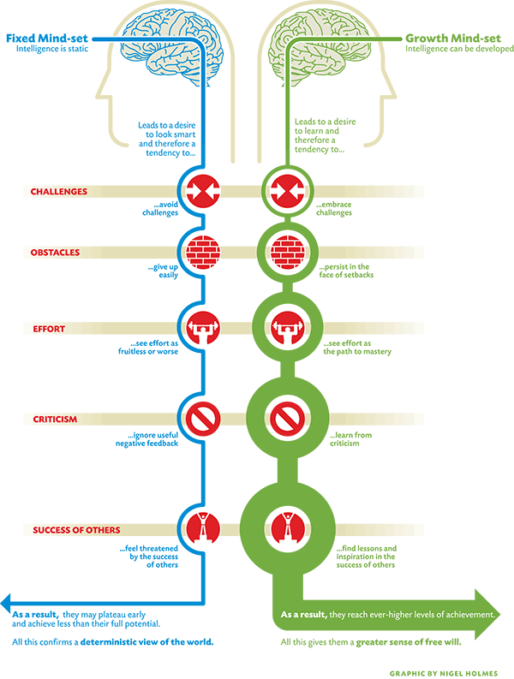
Notes:
Image source: http://lavendaire.com/knowing-mindset-fixed-vs-growth/
And lastly, the Growth vs. Fixed Mindset is really two conflicting stories.

Slide 64
THREAT
THREAT
THREAT
Notes:
Image source: http://lavendaire.com/knowing-mindset-fixed-vs-growth/
Someone with a Fixed Mindset sees challenges, obstacles, effort as threats.

Slide 65
THREAT
THREAT
Notes:
Image source: http://lavendaire.com/knowing-mindset-fixed-vs-growth/
Criticism and the success of others as threats. Threats put them into fight, flight, or freeze mode, and the narrative in their mind becomes self-fulfilling.

Slide 66
Visible and
Invisible?

Slide 67
Visible and
Invisible?
Notes:
And one last prompt. Everything a child experiences in our classroom or school becomes part of the story in their mind. Our classrooms have an overarching story. Our schools each have an overarching story. What are the stories we are telling? Because we are always creating or contributing to a story, and if we aren’t doing it intentionally, we are doing it unintentionally.

Slide 68
Contact Information
Conn McQuinn
McQuinnable Educational Services
conn@mcquinnable.com
www.mcquinnable.com

