Slide 1
Neuoroscience and Learning
August 30 Firgrove Elementary Schools
Notes:
Neuron Image: http://cdn1.collective-evolution.com/assets/uploads/2012/11/FEATURE.jpg

Slide 2
Notes:
You’re brain is buzzing right now from all of the excitement and stimulation of this conference. We’re going to start this session with sixty seconds of quiet to help you focus. For the next minute just close your eyes and take slow, deep breaths, concentrating just on the sensation of the air entering and leaving. I’ll set a timer.

Slide 3
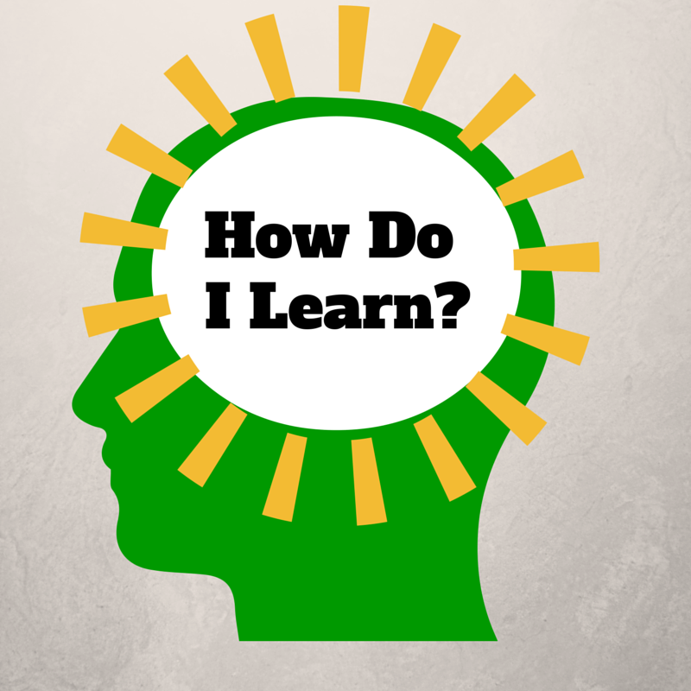
Notes:
The “How Do I Learn” grant is funded by the NIH Blueprint for Neuroscience Research and administered by National Institute on Drug Abuse (NIDA), part of the National Institutes of Health.
This presentation is based on work that we have done for the last five years in the grant program How Do I Learn? Our project is a partnership between various schools and departments at the University of Washington and Puget Sound ESD. It is supported by a grant from the Blueprint for Neuroscience Research and is administered by the National Institute on Drug Abuse, part of the National Institute of Health. The underlying concept is that if parents, students and teachers have a basic understanding of neuroscience and learning, they can use that knowledge to improve theirs and others’ learning. I have been doing grant work that focuses on neuroscience since the decade of the brain, some 20 years ago. The new technologies that allow for imaging and measuring activity in the brain have allowed us to learn more about the brain in the last twenty years than in the previous twenty centuries.
The “How Do I Learn” grant is funded by the NIH Blueprint for Neuroscience Research and administered by National Institute on Drug Abuse (NIDA), part of the National Institutes of Health.

Slide 4
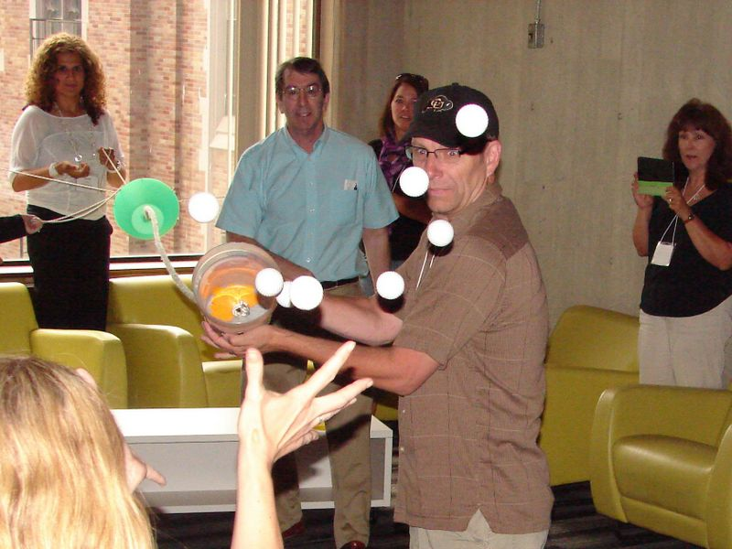
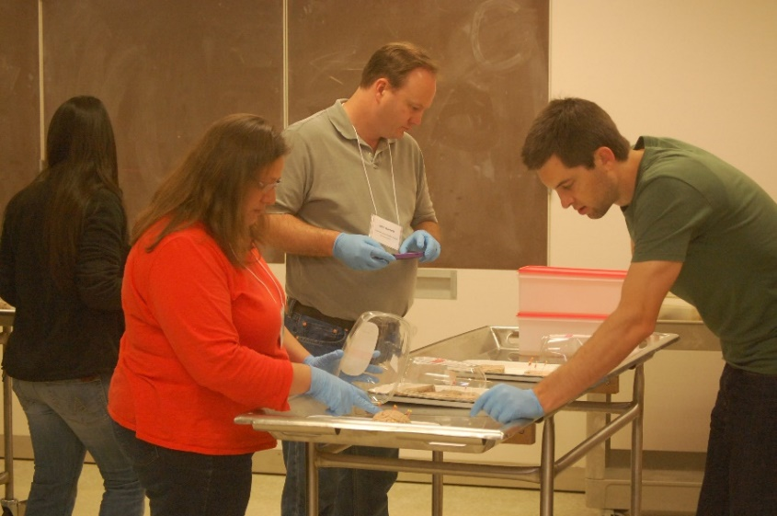
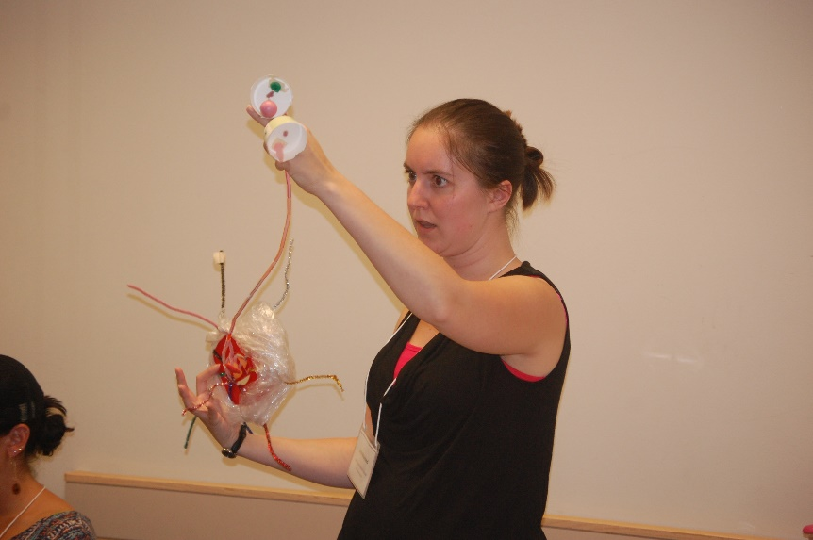
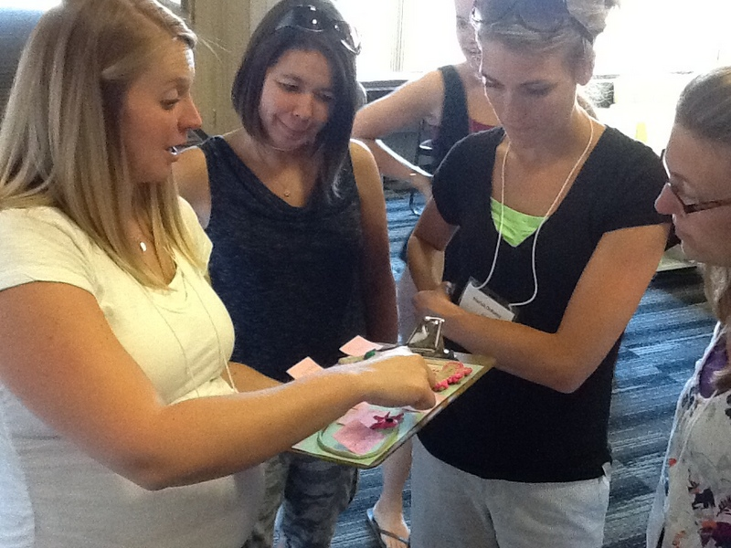

Slide 5
We’ve learned more about the brain in the last 25 years than we did in the previous 2,500.
Dr. Eric Chudler, University of Washington

Slide 6
Notes:
http://static.pexels.com/wp-content/uploads/2014/07/astronomy-constellation-dark-2150.jpg
We are not going to try to jam everything about neuroscience and learning into this presentation. (That would be dreadfully wrong from a neuroscience perspective!) The human brain is the most complex structure in the known universe, and there is still a lot that hasn't been figured out yet. What we are going to go over are a few key concepts that our participating teachers have found useful and that are fundamental to understanding any application of neuroscience to learning, and how those concepts tie directly to important ideas around mindset, technology, and stress.

Slide 7
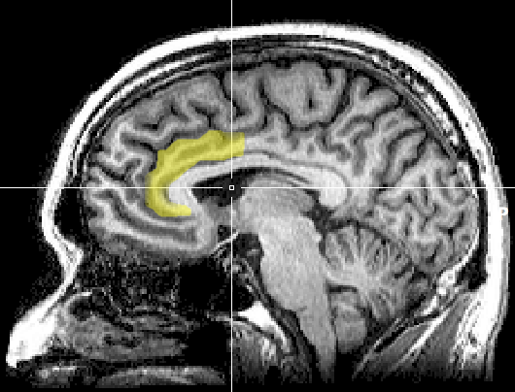
Notes:
https://upload.wikimedia.org/wikipedia/commons/1/10/MRI_anterior_cingulate.png
A note of caution right up front, however. There has been a lot of misapplication of neuroscience, or misinterpretation, to outright myths that have sprung up around this area of study. Often a minor research result gets blown up into a complex model of application that is touted as being "proven by science," when the original research might only have suggestive implications.
Original image caption: There is evidence suggesting that the more the anterior cingulate cortex signals conflict, the more dissonance a person experiences and the more their attitudes may change.

Slide 8
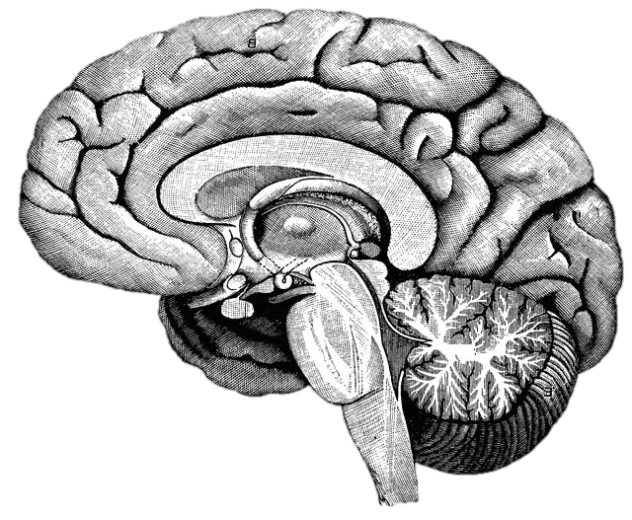
What happens in the brain when you learn?
Notes:
http://upload.wikimedia.org/wikipedia/commons/f/fe/14th-century_painters_-_Diagram_of_the_brain_-_WGA15761.jpg

Slide 9
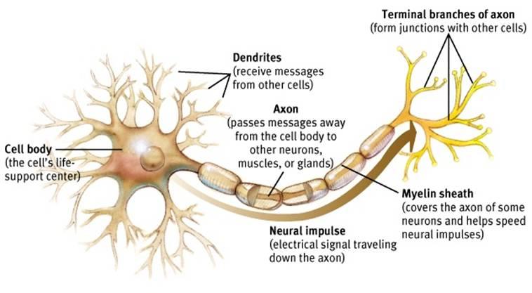
Neuron
Notes:
Dendrites receive signals from other neurons – like a baseball glove catches a ball. And axons and their axon terminals send the message to other neurons – just like a baseball player throwing a ball to another player.
http://www.appsychology.com/Book/Biological/Biologypics/clip_image002.jpg

Slide 10
Notes:
https://www.youtube.com/watch?v=PQcmw15rzkA

Slide 11
Notes:
When a neuron receives a signal at the dendrite end, the chemical message is changed to an electrical pulse. At the beginning of the axon, all these electrical pulses are summed up, and if it reaches a critical threshold, it fires a signal that travels down the axon. The myelin increases the speed of this electrical signal. (It’s important to know that brains are not fully myelinated until you’re in your early 20s!) When that pulse reaches the terminal, it causes the release of neurotransmitters that diffuse across the space between the two neurons. When enough excitatory neurotransmitters dock on dendrite on the post synaptic neuron, it triggers electrical pulses that shoots down the next axon. After docking on the post synaptic neuron, neurotransmitters then float away and are recycled back into the pre-synaptic neuron’s axon terminals. Communication between neurons is an chemical process.
ASK FOR 3 VOLUNTEERS TO DRESS UP AS NEURONS! Have volunteers demo this after explanation.

Slide 12
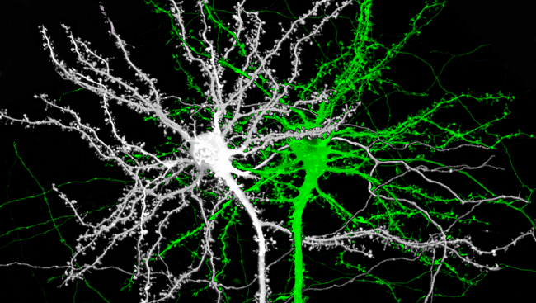

Slide 13
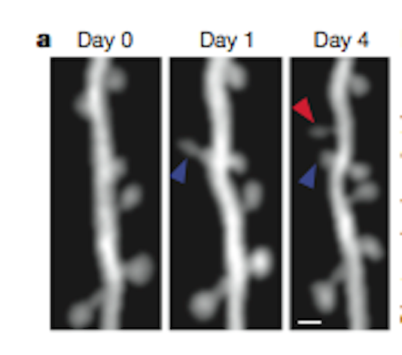
Notes:
Image source: http://blogs.scientificamerican.com/observations/files/2012/04/Screen-shot-2012-04-16-at-5.06.35-PM.png

Slide 14
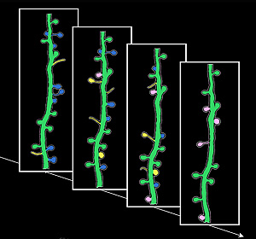
Notes:
Image source: http://news.ucsc.edu/2009/11/3413.html

Slide 17
Neuron
Notes:
Dendrites receive signals from other neurons – like a baseball glove catches a ball. And axons and their axon terminals send the message to other neurons – just like a baseball player throwing a ball to another player.
http://www.appsychology.com/Book/Biological/Biologypics/clip_image002.jpg

Slide 18
Notes:
Image from https://upload.wikimedia.org/wikipedia/commons/4/48/Saltatory_Conduction.gif showing how myelin improves electrical transmission down the axon.

Slide 19
Notes:
https://commons.wikimedia.org/wiki/File:Dog.in.sleep.jpg

Slide 20
Repetition
Repetition
Repetition

Slide 23
Notes:
Image source: https://www.flickr.com/photos/lentzstudios/3884839779

Slide 24
Reflection
What was surprising?
What did you already know, but now see in a new way?
What new questions do you have?

Slide 25
Reflection
What was surprising?
What did you already know, but now see in a new way?
What new questions do you have?

Slide 26
Multitasking is a lie
1 2 3 4 5 6 7 8 9 10 11 12 13 14 15 16 17 18
Notes:
This is adapted from this video by Dave Crenshaw - https://www.youtube.com/watch?v=BCeGKxz3Q8Q

Slide 27
Notes:
Alcohol, cigarettes, medications and drugs are a part of our world. These are substances that change the chemistry of our brains, mimicking some transmitters or impacting the body's ability to process those we make ourselves. It's also why we enjoy things like roller coasters, skydiving, scary or romantic movies - we are triggering our brains and bodies to produce neurotransmitters that make us feel good. We're self-medicating!
Just to make things complicated, not all neurons respond to the same neurotransmitters, and there are dozens and dozens of different types of neurotransmitters. This is important, because not all neurotransmitters come from neurons - they are also present in your bloodstream. The balance of these chemicals in your body at any one moment in time impacts your brain function.

Slide 28
Notes:
Let's go back to those connected neurons. The networks of connections between neurons is increasingly recognized as the fundamental framework of brain function. In the same way that understanding the genome of our DNA has led to leaps in understandings of genetics and health, understanding the "Connectome" is now seen as key to understanding the brain.
With new sensing and imaging technologies, it is now possible to view the connectome in action, in real time. [https://youtu.be/dAIQeTeMJ-I] How complex is this? The brain contains roughly 86 billion neurons, and somewhere around one quadrillion synapses.

Slide 29
Notes:
https://www.youtube.com/watch?v=6Sz-l6RDrvU

Slide 30
What are the major brain systems involved in learning?
Notes:
http://upload.wikimedia.org/wikipedia/commons/f/fe/14th-century_painters_-_Diagram_of_the_brain_-_WGA15761.jpg

Slide 31
Notes:
The pre-frontal cortex is where you do your basic thinking. It's the part of your brain that is (hopefully) engaged now with your awareness. It's the part of the brain we want the students using when they think, plan, and make choices. We know now that this is the last part of the brain to finish developing, often not until 23 or 24 years old. (Even older with some males, which will surprise no female.) There’s a reason kids don’t seem to think like us. They don’t.
It does not always perform at the same level. The PFC (as neuroscientists like to call it) is sensitive to a variety of factors. We’ll come back to this.
This and the following images are from the iPad App 3D Brain from Cold Spring Harbor Labs. There is a free and an HD pay version. (99 cents!)

Slide 32
Notes:
Another major system to understand is the limbic system. This is the part of the brain that deals with emotion and - interestingly enough - memory formation. Two critical parts are the amygdala and the hippocampus, one of each on opposite sides of the brain. The amygdala is one of the parts of the brain that manages your emotions.. The hippocampus is involved in the storage and retrieval of long-term memories, as well as routing information to the PFC.
If your limbic system is mildly engaged, it makes you more alert and focused. The neurotransmitters and hormones that are released enhance memory formation and cognitive function. This is what is happening with students when they are engaged and challenged.
However, if the amygdala gets overstimulated, particularly by stress or fear, the neurotransmitters and hormones that are released in the system are the type that engage your automatic body systems - heart rate, breathing, eye dilation, blood flow - to get you ready for fight, flight, or freeze. They are not the same kinds of neurotransmitters used by your pre-frontal cortex, and the sending of information to the PFC from the hippocampus is blocked, as is access to memory. When you are really upset, the thinking part of your brain is shut down, and the reacting part of your brain is powered up.
Have you (or your students) ever done anything when you were really upset and afterward thought "What was I thinking?" That's the problem. You weren't. You were reacting, and you were reacting at a time when your thinking ability was very limited. Dr. John Gottman of the University of Washington, an expert in how couples relate to each other, says quite directly that when you are in that kind of upset state, it’s simply impossible to be rational. Some researches call that the amygdala hijack. The only rational choice is to step away until you can calm down.
There’s a reason for this. From a strictly biological perspective, when you see that lion hiding in the grass, it’s not a time to be contemplative. It’s a time to act, and act quickly. But stressing students (and teachers, for that matter) puts their brain in the least effective mode for learning.
And it gets worse. Cortisol is one of the hormones that is released in your system when you are stressed, and one of the effects it has is to dissolve the little spikes that grow on your dendrites when they are trying to build new synapses. It melts your learning away.

Slide 33
Performance
Stress
Notes:
A little stress improves performance, but too much degrades it.

Slide 34
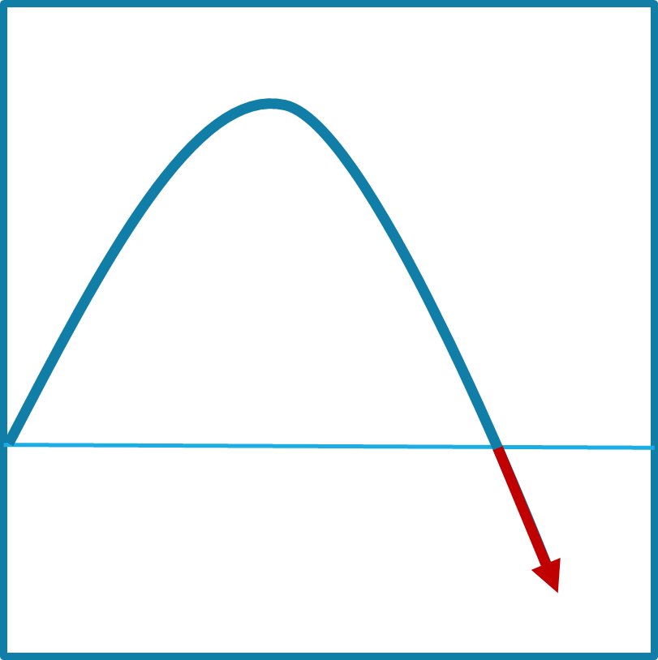
Notes:
On the front part of the stress curve, the function of the pre-frontal cortex is enhanced.

Slide 35
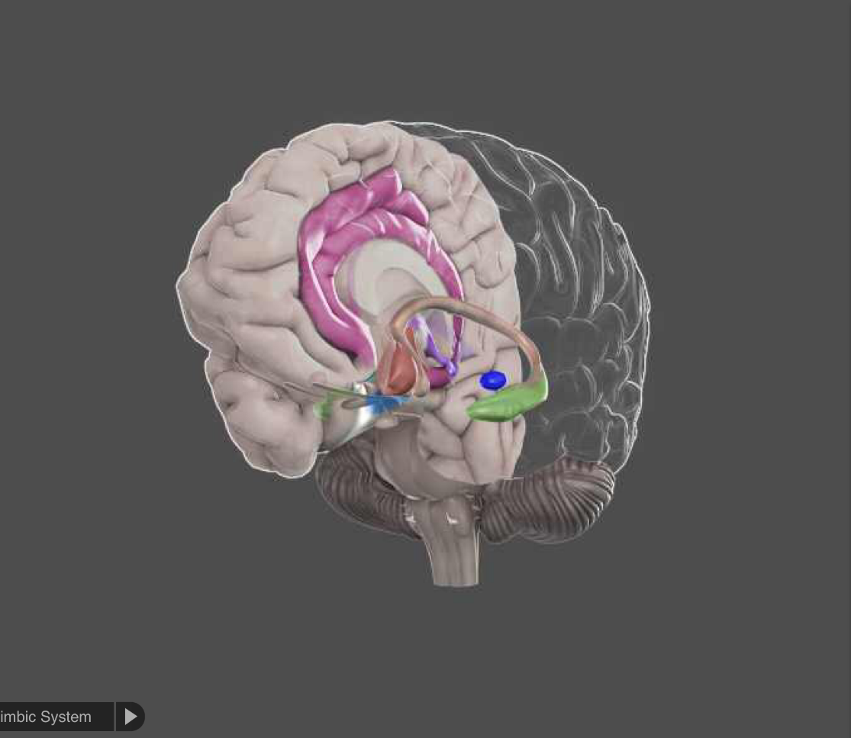
Notes:
On the down side, the limbic system dominates and other reactive parts of the brain take over. The pre-frontal cortex bypassed in favor of more automatic responses.

Slide 36
Where
What were
you thinking?
Notes:
When kids do something (or we do something) mindless when we’re upset, the wrong question to ask is “What were you thinking?” It’s really “Where were you thinking?”

Slide 37
Performance
Stress
Notes:
To complicate our lives as teachers, each student has a different curve profile. What may be a positive challenge for one student can push another student under water.

Slide 38
Notes:
There is a network of structures in the brain stem called the reticular activating system, or thankfully RAS for short. This system is one of the core mechanisms for filtering sensory input. We can’t attend to all of the information flooding our senses at any one moment, and the RAS helps to decide what we are consciously aware of and what we aren’t‘.

Slide 39
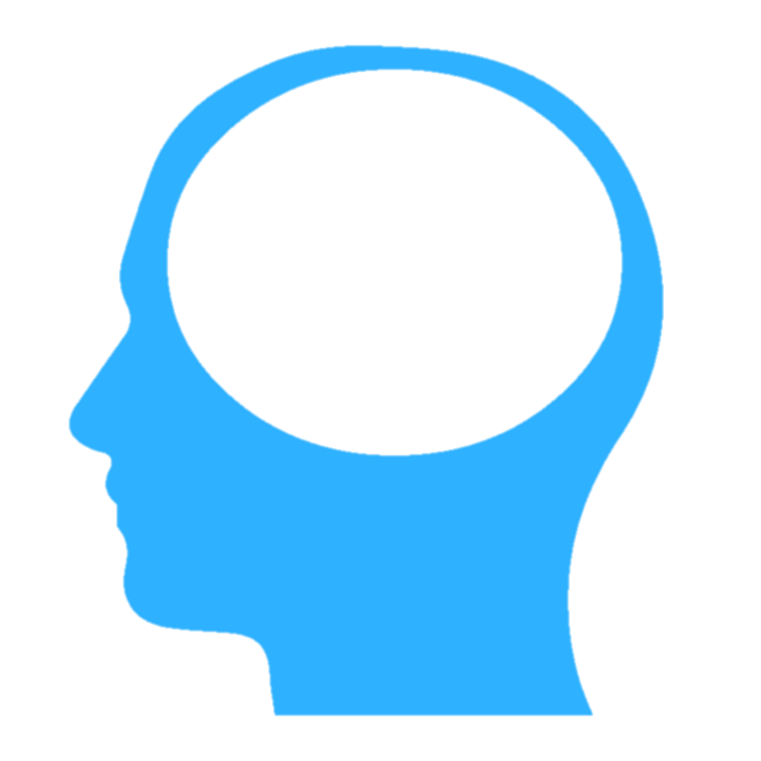

Slide 40
!
NEW!
Notes:
Novelty is one of the things that gets through the filter. New kid in class? Who has everyone’s attention? Some researchers are starting to recommend significantly reducing the amount of decorations, posters, and other distractions in our classrooms as being detrimental to student attention.

Slide 41
!
Notes:
Things you care about will get through the filter.

Slide 42
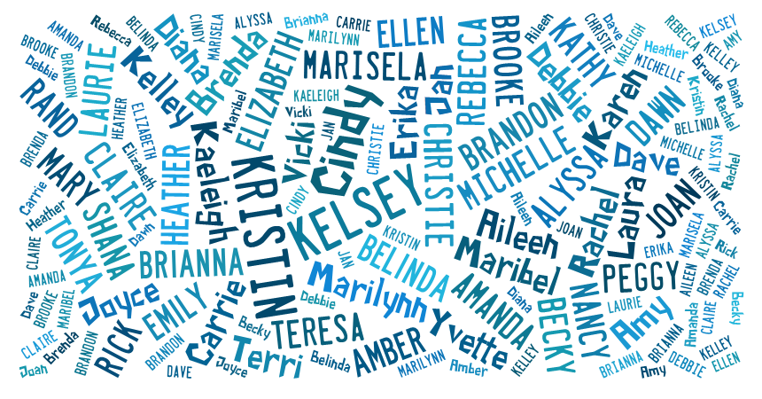
Notes:
How often have you been at a noisy party, and all the other people talking are just background noise – until someone says your name? You’ll hear it loud and clear. That’s your filter at work!

Slide 43
It is literally neurologically impossible to learn deeply about something you don’t care about.
Dr. Mary Helen Immordino-Yang

Slide 44
!
Notes:
Threat is the top priority for getting through the filter. There is something called “The Weapons Effect” that happens when someone is robbed at gunpoint – they can often describe the gun in greater detail than the mugger.
Image from https://en.wikipedia.org/wiki/Semi-automatic_firearm

Slide 45
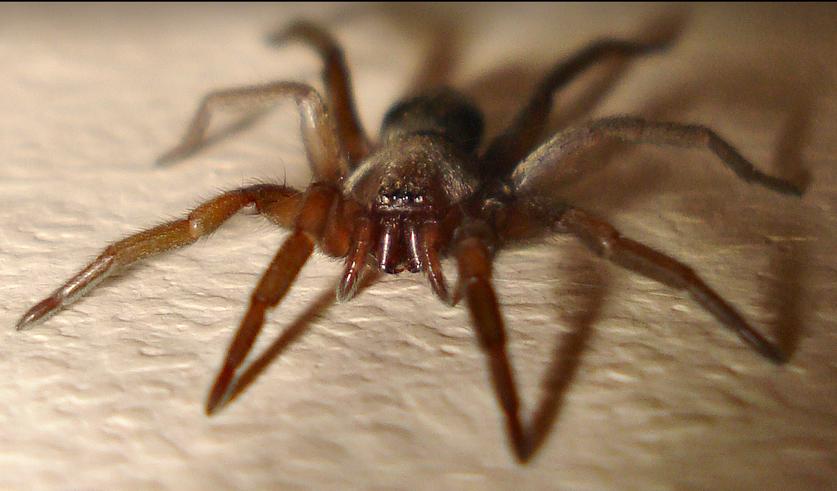
Notes:
http://www.flickr.com/photos/micks-wildlife-macros/
The other set of priorities is learned. Hearing your name spoken in a party, seeing the face of a loved one in a crowd, that certain tone of voice your mother uses when she’s upset, spotting a particular kind of critter you don’t like, or seeing an interesting car/bird/quilt/comic book/insert your favorite interest here. These are different for different people.

Slide 46
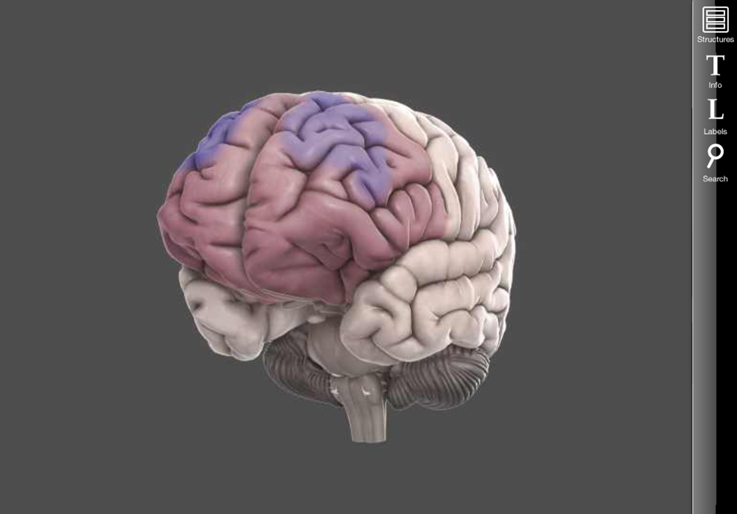
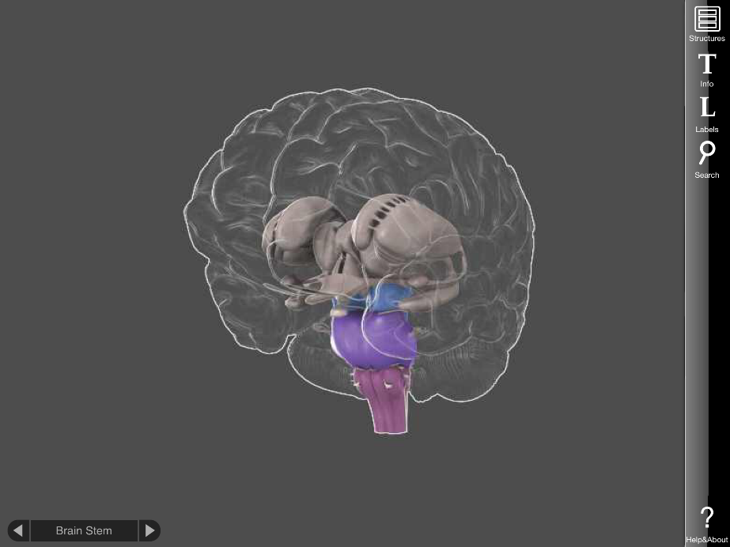
Notes:
What gets through the RAS in turn is what drives the PFC and the limbic system. If the information getting through is perceived as something interesting, or exciting, or desirable, or new, or surprising, your amygdala will be mildly stimulated, and you will pay more attention. And your pulse rate will rise slightly, your eyes will dilate, and other mild physical responses. If it’s perceived as a threat, depending on the severity of the threat, your limbic system may become so active as to cause the emotional and cognitive consequences we discussed earlier. The three systems work in a very complex, ever-changing dance. The important thing to remember is that there are modes of dance that result in much better learning (and happiness) than others.
The other key takeaway is that for many of the situations we face, whether or not we perceive it as a threat is up to us. Most of the triggers we experience are learned – which means they can be unlearned. And we as teachers can do our best to avoid creating and maintaining those triggers.

Slide 47
Student attention
What things in the classroom are getting students’ attention? For what reasons?
What things in their lives are causing them stress? In the classroom?

Slide 48
Stress level
Acute Stress
Time
Notes:
Acute stress is short-term, and we can tolerate it relatively well. (There’s an interesting TED Talk by Jane McGonigal called “How to Make Stress Your Friend” which is good to watch. (https://www.ted.com/talks/kelly_mcgonigal_how_to_make_stress_your_friend) My only quibble is that she doesn’t make it clear that she’s only talking about short-term or acute stress.

Slide 49
Stress level
Chronic Stress
Time
Notes:
Chronic stress is an entirely different animal, and it harmful in many ways.

Slide 50
Notes:
Chronic stress results in decreased volume in the prefrontal cortex and the hippocampus, and increased volume in the amygdala. The brain physically changes in order to be more vigilant and to shift more quickly into fight/flight/freeze.

Slide 51
Notes:
This change happens at the genetic level, and some of the changes have been shown to impact future generations.
Image retrieved from http://www.publicdomainpictures.net/pictures/50000/velka/dna-1370603787LgY.jpg

Slide 52
Notes:
Stress impacts the whole body. Mental stress can harm all of our systems, and physical stress can harm the brain.

Slide 53
Reflection
What was surprising?
What did you already know, but now see in a new way?
What do you want to explore further?

Slide 54
Reflection
What was surprising?
What did you already know, but now see in a new way?
What do you want to explore further?

Slide 55
Environment
Resiliency
Notes:
We can approach dealing with student stress in two ways – try to create environments that meet their needs and avoid unnecessary stressors, and to help them develop their own resiliency to deal with stresses.
://simple.wikipedia.org/wiki/Primary_school#/media/File:Heiwa_elementary_school_18.jpg
https://www.flickr.com/photos/mindfulness/25466002

Slide 56
Notes:
We also have to recognize, in the words of researcher Dr. Bruce McEwen, that some students are born dandelions and will thrive regardless of the conditions. Some students are born orchids, and their innate response to stress is more difficult. One size does not fit all. https://commons.wikimedia.org/wiki/File:Dandelion_flower_Taraxacum.jpg

Slide 57
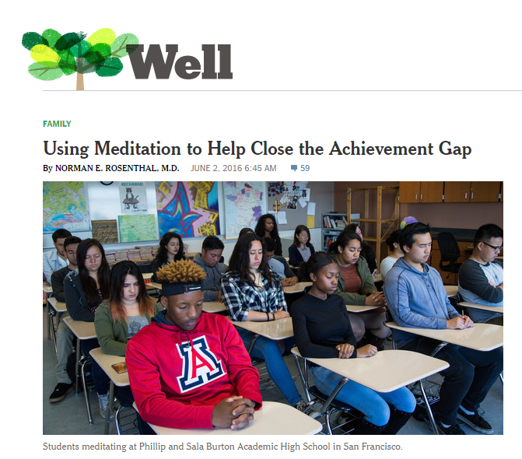
Notes:
There is a growing body of research that shows that meditation and mindfulness activities have very positive impacts on student achievement, attendance, and grades.
http://well.blogs.nytimes.com/2016/06/02/using-meditation-to-help-close-the-achievement-gap/?_r=0

Slide 58
The need to belong and feel connected
Notes:
Stress is not only the presence of something. It can be the lack of something as well. We all share three sets of basic needs. We need to feel that we belong and feel connected to others.

Slide 59
The need for self-determination and autonomy
Notes:
We have a need to have autonomy and ability to make choices. https://commons.wikimedia.org/wiki/File:Boracay_Sailing_Paraw.jpg

Slide 60
The need to feel competent
Notes:
We need to feel a sense of competence, and that what we do has meaning.

Slide 61
Cura personalis
Old news, dude.
Notes:
St. Ignatius of the Jesuit tradition focused on cura personalis, the care of the entire person. Neuroscience is simply confirming what many of us already knew – or suspected.

Slide 62
“How do you know that
InsertYourName
cares about your success?”
Notes:
In the Measures of Effective Teaching study conducted by the Gates Foundation, one of the most powerful predictors of student success was how students responded to two matched questions. Students who answered positively to the question “My teacher cares about my success” and to the question “My teacher has provided me personally with support to be successful” achieved higher levels of success. If I pull one of your students and random and ask this question, what would you hope their answer would be?

Slide 63
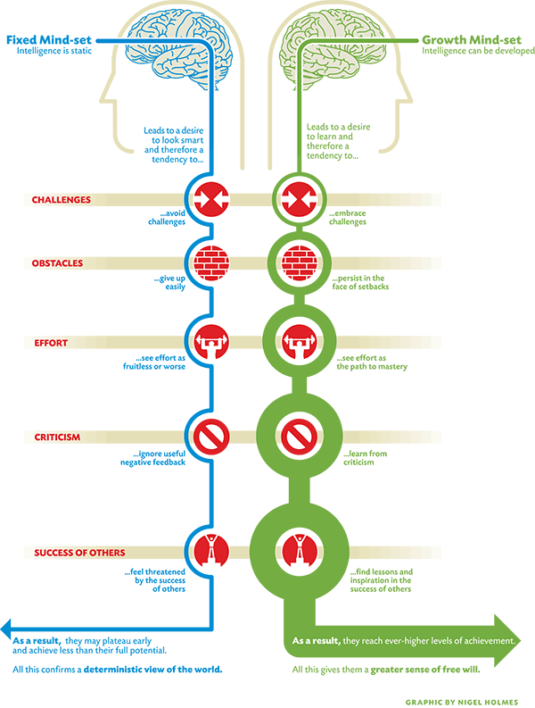
THREAT
THREAT
THREAT
THREAT
THREAT
Notes:
Once you understand the fight/flight/freeze response to stress, the Growth vs. Fixed Mindset suddenly makes sense. To someone with a fixed mindset, Challenges, Obstacles, Effort, Criticism, and the Success of Others are viewed as threats. Theses prompt them to go into fight/flight/freeze, which then in turn prevents them from being able to use their prefontal cortex to try to think through how to respond. It’s a nasty vicious cycle.
Image source: http://lavendaire.com/knowing-mindset-fixed-vs-growth/

Slide 64
P=p-i
Performance
potential
interference
Timothy Gallwey, Inner Game of… books
Notes:
I love this formula for trying to figure out what a student needs. Their Performance equals their Potential minus any Interference. We can seek to increase their potential, held deal with anything that is interfering, or both!

Slide 65
Nemo dat quod non habet
You cannot provide
what you do not have.
Notes:
Finally, we need to take care of ourselves. We cannot provide what we do not have. (Administrators, that means we need to provide the same supports to teachers that we want them to provide for their students.)

Slide 66
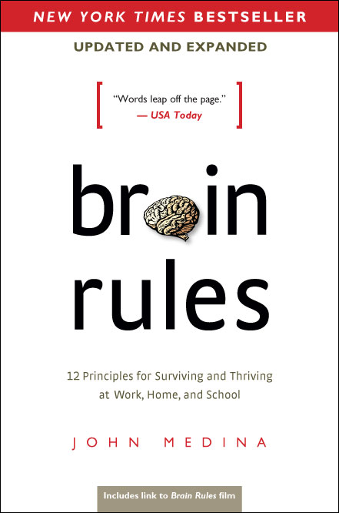
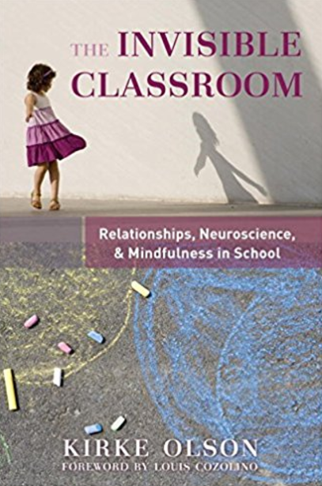
Notes:
Recommended books! These two are at the top of the list. Brain Rules is a great starting point, and The Invisible Classroom looks at much of the same content but specifically for educators, and really emphasizes how neuroscience shows us that relationships are the foundation for good learning.

Slide 74
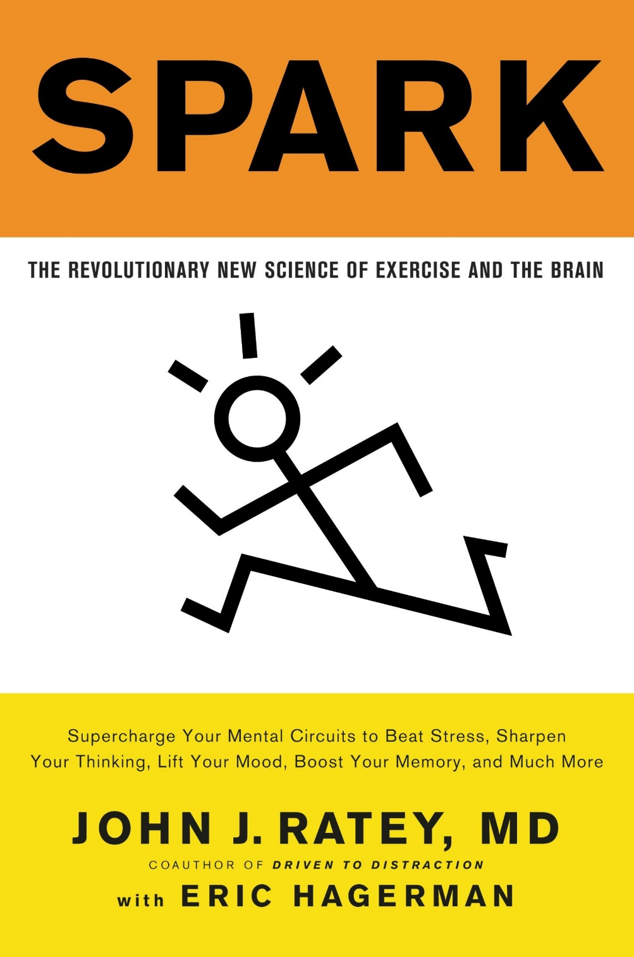
Notes:
Dr. Judy Willis is a fascinating person who started her career as a neurologist and then after seeing a big increase in students being brought in by parents with attention problems, went back to school and became a middle school science teacher. She bridges both worlds very effectively. Dr. John Ratey has done a great deal of research on the importance of exercise to the brain.

Slide 75
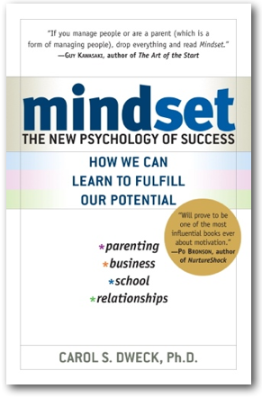
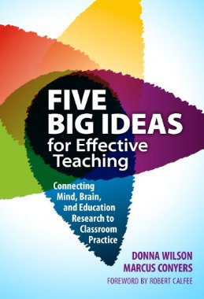
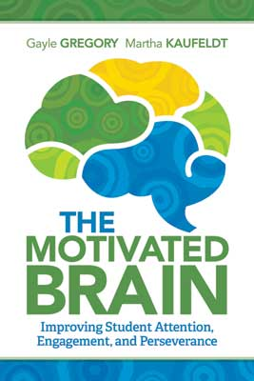

Slide 76
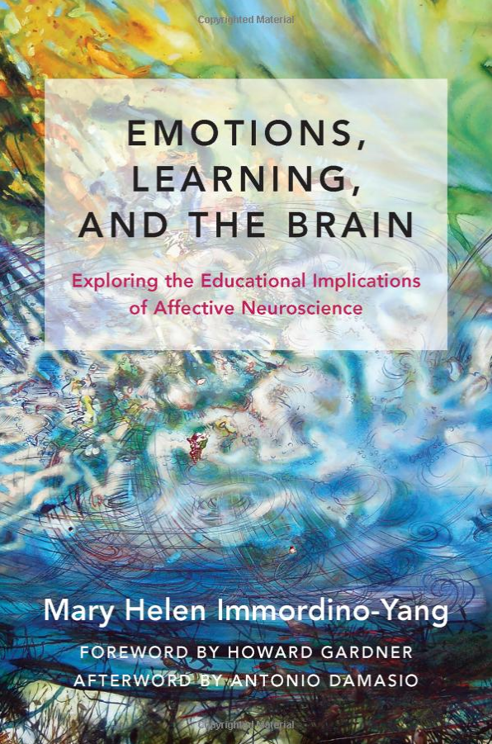

Slide 77
Contact Information
Conn McQuinn
www.mcquinnable.com
conn@mcquinnable.com

