Slide 1
Applying Secrets of Neuroscience to Enhance Your PBIS Implementation
NWPBIS CONFERENCE AMY OKEZE & CONN MCQUINN
Notes:
Neuron Image: http://cdn1.collective-evolution.com/assets/uploads/2012/11/FEATURE.jpg

Slide 2
Notes:
You’re brain is buzzing right now from all of the excitement and stimulation of this conference. We’re going to start this session with sixty seconds of quiet to help you focus. For the next minute just close your eyes and take slow, deep breaths, concentrating just on the sensation of the air entering and leaving. I’ll set a timer.

Slide 3
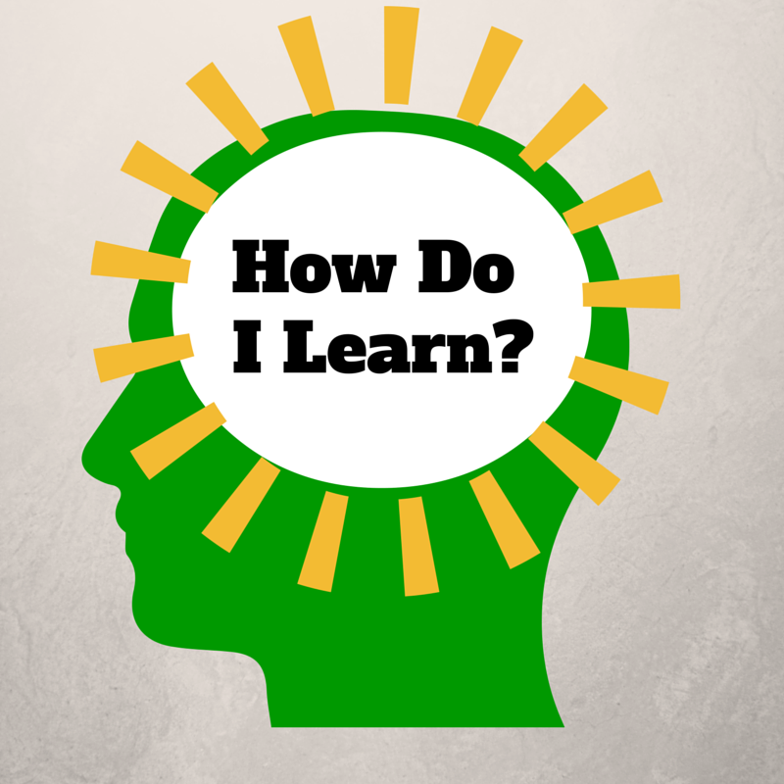
Notes:
The “How Do I Learn” grant is funded by the NIH Blueprint for Neuroscience Research and administered by National Institute on Drug Abuse (NIDA), part of the National Institutes of Health.
This presentation is based on work that we have done for the last five years in the grant program How Do I Learn? Our project is a partnership between various schools and departments at the University of Washington and Puget Sound ESD. It is supported by a grant from the Blueprint for Neuroscience Research and is administered by the National Institute on Drug Abuse, part of the National Institute of Health. The underlying concept is that if parents, students and teachers have a basic understanding of neuroscience and learning, they can use that knowledge to improve theirs and others’ learning. I have been doing grant work that focuses on neuroscience since the decade of the brain, some 20 years ago. The new technologies that allow for imaging and measuring activity in the brain have allowed us to learn more about the brain in the last twenty years than in the previous twenty centuries.
The “How Do I Learn” grant is funded by the NIH Blueprint for Neuroscience Research and administered by National Institute on Drug Abuse (NIDA), part of the National Institutes of Health.

Slide 4
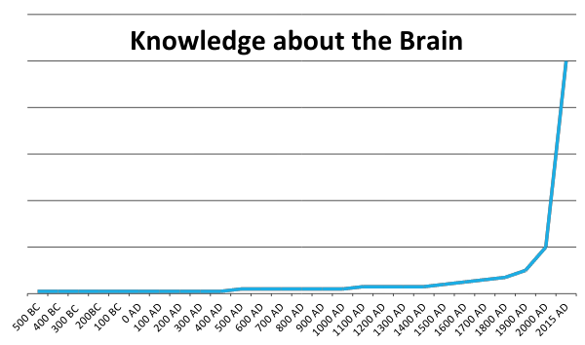
We’ve learned more about the brain in the last 25 years than we did in the previous 2,500.
Dr. Eric Chudler, University of Washington

Slide 5
Notes:
http://static.pexels.com/wp-content/uploads/2014/07/astronomy-constellation-dark-2150.jpg
We are not going to try to jam everything about neuroscience and learning into this presentation. (That would be dreadfully wrong from a neuroscience perspective!) The human brain is the most complex structure in the known universe, and there is still a lot that hasn't been figured out yet. What we are going to go over are a few key concepts that our participating teachers have found useful and that are fundamental to understanding any application of neuroscience to learning, and how those concepts tie directly to important ideas around mindset, technology, and stress.

Slide 6
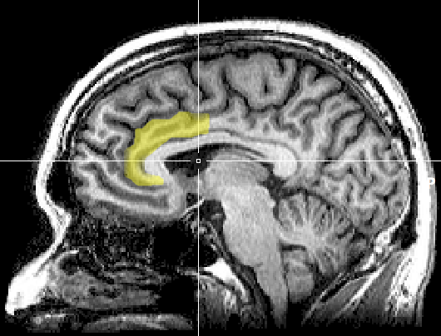
Notes:
https://upload.wikimedia.org/wikipedia/commons/1/10/MRI_anterior_cingulate.png
A note of caution right up front, however. There has been a lot of misapplication of neuroscience, or misinterpretation, to outright myths that have sprung up around this area of study. Often a minor research result gets blown up into a complex model of application that is touted as being "proven by science," when the original research might only have suggestive implications.
Original image caption: There is evidence suggesting that the more the anterior cingulate cortex signals conflict, the more dissonance a person experiences and the more their attitudes may change.

Slide 7
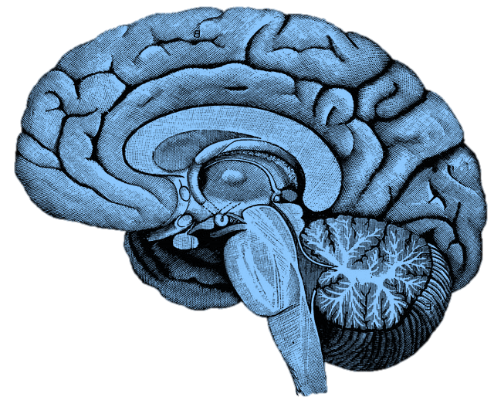
What happens in the brain when you learn?
Notes:
http://upload.wikimedia.org/wikipedia/commons/f/fe/14th-century_painters_-_Diagram_of_the_brain_-_WGA15761.jpg
Without discussing with anyone, write down what you already know about what happens in the brain when you learn. You will not need to share this with anyone.
After the one minute: This is from an instructional model called the NED Learning model, designed by Dr. Kieran O’Mahony. (You can read more about it at http://k12.nedlearning.com/index.html#free_printable_kit_details) By stating this fairly open question, I’m getting you to pull up your prior knowledge on the topic, which is important because all new knowledge has to be connected to prior knowledge. It’s also an emotional hook, since I have in essence asked you to guess what I’m going to tell you next, so you are more attentive to what I’m going to say. It’s like the silly cartoon hydroplane races at the Mariners games. Why should we care if the red, green, or yellow boat actually wins? But once we’ve picked a color we get really invested in the outcome and cheer or moan at the outcome.

Slide 8
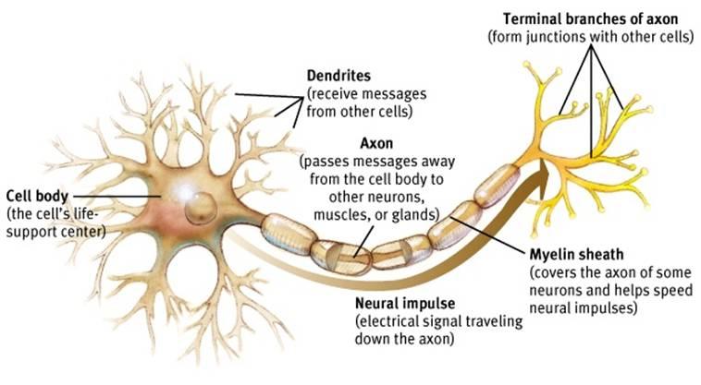
Neuron
Notes:
Dendrites receive signals from other neurons – like a baseball glove catches a ball. And axons and their axon terminals send the message to other neurons – just like a baseball player throwing a ball to another player.
http://www.appsychology.com/Book/Biological/Biologypics/clip_image002.jpg

Slide 9
Notes:
When a neuron receives a signal at the dendrite end, the chemical message is changed to an electrical pulse. At the beginning of the axon, all these electrical pulses are summed up, and if it reaches a critical threshold, it fires a signal that travels down the axon. The myelin increases the speed of this electrical signal. (It’s important to know that brains are not fully myelinated until you’re in your early 20s!) When that pulse reaches the terminal, it causes the release of neurotransmitters that diffuse across the space between the two neurons. When enough excitatory neurotransmitters dock on dendrite on the post synaptic neuron, it triggers electrical pulses that shoots down the next axon. After docking on the post synaptic neuron, neurotransmitters then float away and are recycled back into the pre-synaptic neuron’s axon terminals. Communication between neurons is an chemical process.
ASK FOR 3 VOLUNTEERS TO DRESS UP AS NEURONS! Have volunteers demo this after explanation.

Slide 10
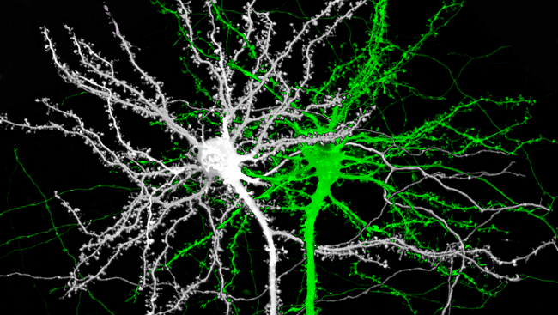
Notes:
Image source: http://www.brainfacts.org/thinking-sensing-and-behaving/learning-and-memory/2014/image-of-the-week-the-structure-of-memory
This is an image of two mouse neurons, and you can see the branches of the dendrites are covered with little knobs. They’re called spines, and they are where the dendrites grow to reach the terminals of other neurons.

Slide 11
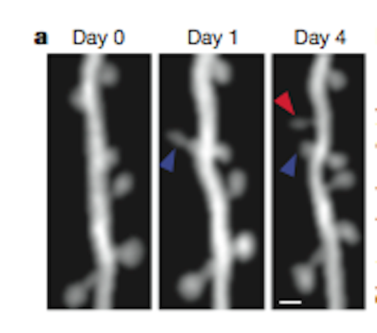
Notes:
Image source: http://blogs.scientificamerican.com/observations/files/2012/04/Screen-shot-2012-04-16-at-5.06.35-PM.png
Here is a real, live neuron growing new spines. They are growing toward neurotransmitter molecules. Notice that the spine by the blue arrow starts out long and thin, but then thickens over time. The neuron is building bridges to reach another active neuron, which is what happens in our brains when we learn. We are literally building learning connections.

Slide 12
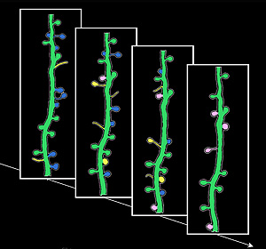
Notes:
Image source: http://news.ucsc.edu/2009/11/3413.html
Learning is not just about building new connections, though. The yellow spines are new ones growing and developing; the blue spines show the opposite, existing spines that disappear. This is called pruning, and they are going away because they aren’t being used. Neural connections are a literal “use it or lose it” proposition. One of the heaviest times of pruning is adolescence, with young teenagers starting out with twice as many connections as they will retain as adults. That’s why the patterns established as teenagers are so profound.

Slide 13
Neuron
Notes:
http://www.appsychology.com/Book/Biological/Biologypics/clip_image002.jpg
One part of the neuron I didn’t mention was the myelin sheath. These are deposits of fat on the axon that act like the insulation on an electrical wire. They increase the speed and strength of the signal that travels down the neuron. The amount of myelin is impacted by diet (it’s one reason that babies have high-fat diets), but most importantly through normal development and repeated firing of the neuron. It’s another part of neurological development enhanced by repetition and practice. (It’s also the “white matter” of the brain.)
We’ll come back to myelin when we talk about the parts of the brain.

Slide 14
Notes:
Image from https://upload.wikimedia.org/wikipedia/commons/4/48/Saltatory_Conduction.gif showing how myelin improves electrical transmission down the axon.
This image shows how dramatically myelin can effect the neuron signal. A myelinated neuron transmits information up to ten times faster! Multiple sclerosis is a disease that attacks the myelin of muscle neurons, which is why it has such devastating impact on mobility.

Slide 15
Notes:
https://commons.wikimedia.org/wiki/File:Dog.in.sleep.jpg
What can we do to improve neuron connections? Sleep is #1. Spines consolidate during sleep, and lack of sleep can seriously impact the learning from the day before.

Slide 16
Repetition
Repetition
Repetition
Notes:
Repetition is critical to learning facts and skills, particularly repetition with good coaching or feedback.

Slide 17
Notes:
Exercise is important as well. Aerobic exercise generates Brain Derived Neurotropic Factor, which enhances neuron growth.

Slide 18
Notes:
Stress damages new neuron spines, or prevents them from forming.

Slide 19
Notes:
Image source: https://www.flickr.com/photos/lentzstudios/3884839779
Boredom is a form of stress! All of the physiological measures of stress are at play when a student is bored.
Boredom can be caused by different things. A person may be bored while they have choices (the child that slouches on the sofa and whines to the parent “I’m bored”). This is called “productive boredom,” where the child needs to develop the capacity to focus, make choices, and solve problems. (Smartphones, computers, and tablets are impediments to learning these skills. They solve boredom with no effort.) A student in class (or a teacher in a professional development workshop) may be suffering from what I call “claustrophobic boredom,” where the person feels trapped in a situation that feels meaningless with no agency to do anything else. It can also be for a struggling student a fight-flight-freeze response, or an indication that they are too stressed or anxious to focus on the current activity.

Slide 20
Reflection
What was surprising?
What did you already know, but now see in a new way?
What new questions do you have?

Slide 21
“It is our responsibility to create the right conditions for optimum learning. We can only do that when we understand how the brain responds to threats...real or perceived.”
Hammond, Z., (2015) Culturally Responsive Teaching & The Brain: Promoting Authentic Engagement and Rigor Among Culturally and Linguistically Diverse Students, Corwin Press

Slide 22
Biology of stress
What happens in
the brain
when it perceives
stress?
What is stress?
Notes:
Stress is a perception that I do not have the skills to manage the situation I’m in. If I have the skills, it’s a mild alert and the brain goes on about its business.

Slide 23
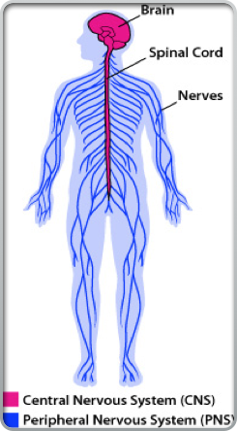
•2,000 bits of information per second enter the brain that have traveled from the receptors throughout the body
•All information comes through the body’s sensory systems connects to the brain stem and passes through an important structure called the Reticular Activating System (RAS) to get to the higher brain.

Slide 24
Notes:
Another major system to understand is the limbic system. This is the part of the brain that deals with emotion and - interestingly enough - memory formation. Two critical parts are the amygdala and the hippocampus, one of each on opposite sides of the brain. The amygdala is one of the parts of the brain that manages your emotions.. The hippocampus is involved in the storage and retrieval of long-term memories, as well as routing information to the PFC.
If your limbic system is mildly engaged, it makes you more alert and focused. The neurotransmitters and hormones that are released enhance memory formation and cognitive function. This is what is happening with students when they are engaged and challenged.
However, if the amygdala gets overstimulated, particularly by stress or fear, the neurotransmitters and hormones that are released in the system are the type that engage your automatic body systems - heart rate, breathing, eye dilation, blood flow - to get you ready for fight, flight, or freeze. They are not the same kinds of neurotransmitters used by your pre-frontal cortex, and the sending of information to the PFC from the hippocampus is blocked, as is access to memory. When you are really upset, the thinking part of your brain is shut down, and the reacting part of your brain is powered up.
Have you (or your students) ever done anything when you were really upset and afterward thought "What was I thinking?" That's the problem. You weren't. You were reacting, and you were reacting at a time when your thinking ability was very limited. Dr. John Gottman of the University of Washington, an expert in how couples relate to each other, says quite directly that when you are in that kind of upset state, it’s simply impossible to be rational. Some researches call that the amygdala hijack. The only rational choice is to step away until you can calm down.
There’s a reason for this. From a strictly biological perspective, when you see that lion hiding in the grass, it’s not a time to be contemplative. It’s a time to act, and act quickly. But stressing students (and teachers, for that matter) puts their brain in the least effective mode for learning.
And it gets worse. Cortisol is one of the hormones that is released in your system when you are stressed, and one of the effects it has is to dissolve the little spikes that grow on your dendrites when they are trying to build new synapses. It melts your learning away.

Slide 25
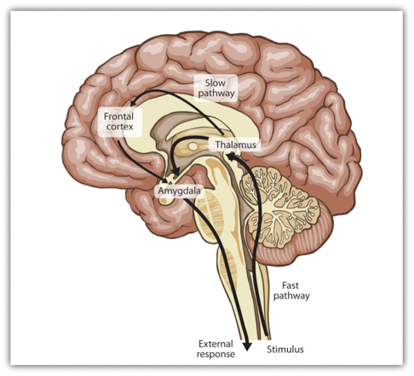
•When in a calm and alert state, information flows freely through the limbic and directly to the frontal lobe for further processing
•In a negative state (anxious, sad, frustrated, or bored) information is sent to the limbic system for filtering.
*It will either ignore it, avoid it or fight against it.

Slide 26
Fight* Flight*Freeze*
Hard wired response-ANS
•Genetic wisdom: ALARM of nerve cells for chemical release to prepare the body to act
•Protects us from a “perceived” attack, harm or a threat to survival
•Will respond to internal and external threats
•Shuts down access to Frontal Lobe (rational thought)

Slide 27
Notes:
The pre-frontal cortex is where you do your basic thinking. It's the part of your brain that is (hopefully) engaged now with your awareness. It's the part of the brain we want the students using when they think, plan, and make choices. We know now that this is the last part of the brain to finish developing, often not until 23 or 24 years old. (Even older with some males, which will surprise no female.) There’s a reason kids don’t seem to think like us. They don’t.
It does not always perform at the same level. The PFC (as neuroscientists like to call it) is sensitive to a variety of factors. We’ll come back to this.
This and the following images are from the iPad App 3D Brain from Cold Spring Harbor Labs. There is a free and an HD pay version. (99 cents!)

Slide 28
THE CEO aka PreFrontal Cortex
Executive Function Skills:
Planning
Cognitive Flexibility
Organization
Self-Monitoring/Self-Regulation
Mental Representation of Tasks
Inhibition
Working Memory
Links Information to Action
Notes:
Why do we need them?
Achieve and sustain conscious control
Solve problems
Reach goals
Learn

Slide 29
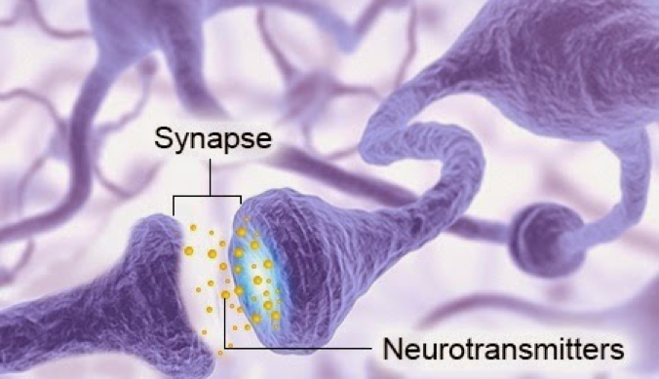
Biochemical dance with the endocrine system
Dopamine, Serotonin and Norepinephrine
Cortisol-”stress hormone”
Oxytocin- “social engagement hormone”

Slide 30
Dopamine
•Chemical of activation
•Facilitates a feeling of motivation “do it now” & “got to have it now”
•Released in the brain stem and sent to multiple locations
•Too much =hyperactivity
•Too little=depressed/distractible
•Released by loving touch, caring looks and the anticipation of positive connections and feelings

Slide 31
Serotonin
•Master modulator that is delivered to every area of the brain
•Sets the firing level of all other neurotransmitters
•Sense of being in control and “all is well”
•Activates working memory in the frontal lobe and the ability to link multiple thoughts
•Released by proprioceptive input (joints and muscles) and sensual pleasures (natural light, waterfalls and contact with animals)

Slide 32
Norepinephrine
•aka...Adrenaline
Provides for selective attention
•Stored in the brain stem…when it is present at the neural junction…the gates stay open and attention is held on the stimuli
•Too little=distractibility, attention shifting too rapidly
•Too much=perseveration, attention gets stuck
•Released by new and novel experiences

Slide 33
Cortisol
Released by the adrenal glands.
A steroid hormone that regulates many processes in the body, including metabolism and the immune response.
Prolonged exposure to high levels of cortisol effects health in many ways
Inhibits neuroplasticity or neuronal cell growth.

Slide 34
Oxytocin
Produced in the hypothalamus and pituitary gland
Connects brain areas involved in processing social information (sights, sounds, smells) and links those areas to the limbic system.
Regulates mother-infant bonding and social engagement.
Laughing, talking and hugging release oxytocin.

Slide 35
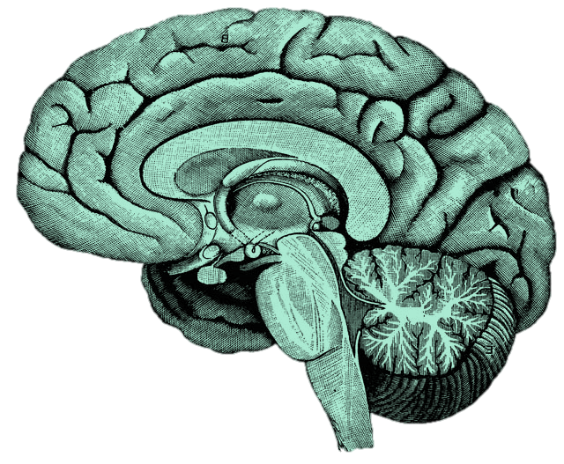
What are the major brain systems involved in learning?
Notes:
http://upload.wikimedia.org/wikipedia/commons/f/fe/14th-century_painters_-_Diagram_of_the_brain_-_WGA15761.jpg

Slide 36
Then what happens….
•Internal process results in an outward observable behavior
•Behavior is anything a person does that can be observed and measured.

Slide 37
•

Slide 38
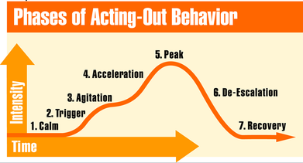
Behavior Cycle Geoff Colvin (2004)
Notes:
DishaviorDisis anything a person does that can be observed and mea

Slide 39
Performance
Stress
Notes:
A little stress improves performance, but too much degrades it.

Slide 40
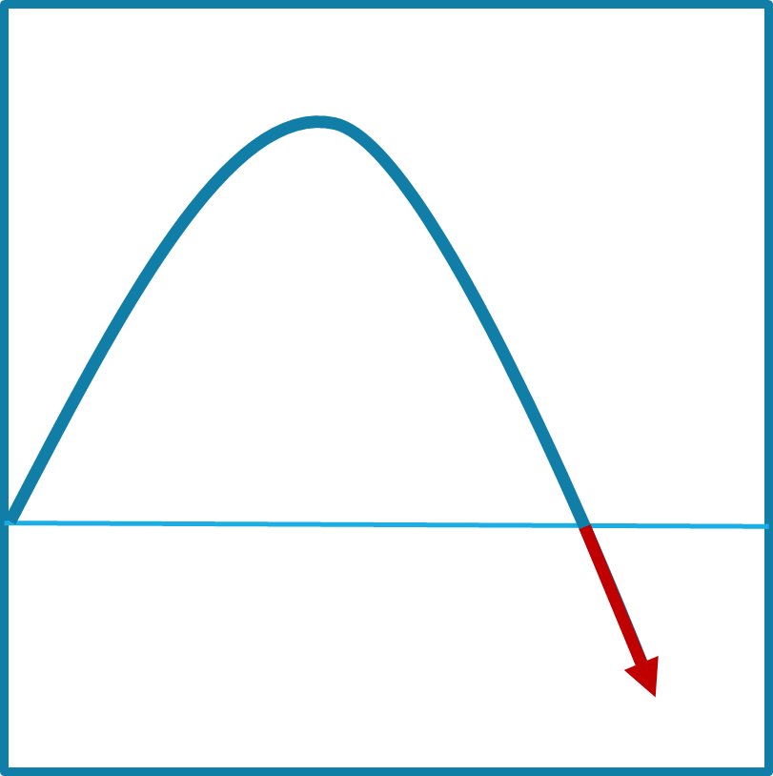
Notes:
On the front part of the stress curve, the function of the pre-frontal cortex is enhanced.

Slide 41
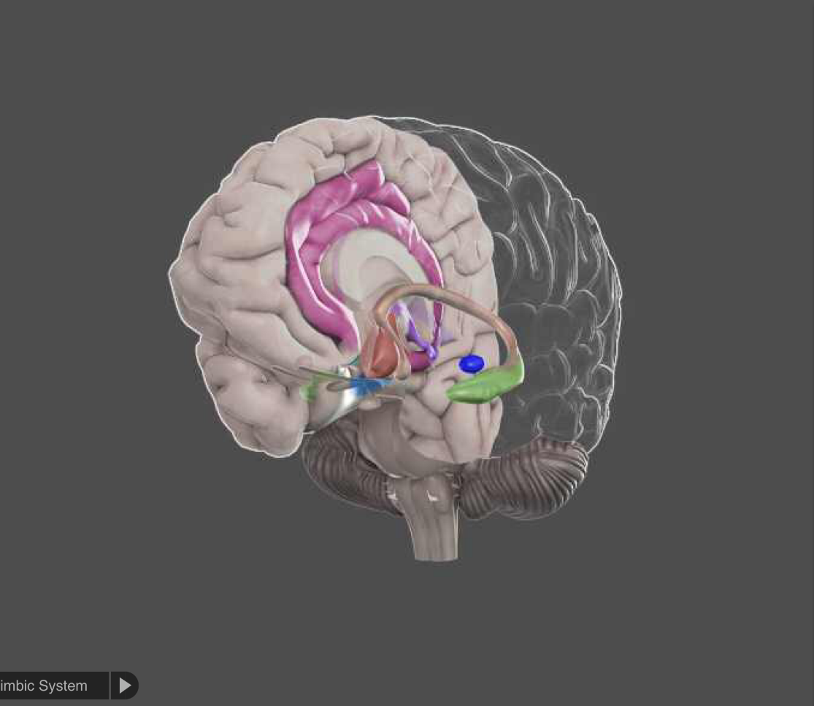
Notes:
On the down side, the limbic system dominates and other reactive parts of the brain take over. The pre-frontal cortex bypassed in favor of more automatic responses.

Slide 42
Where
What were
you thinking?
Notes:
When someone was upset, the right question is “Where were you thinking?”

Slide 43
Performance
Stress
Notes:
To complicate our lives as teachers, each student has a different curve profile. What may be a positive challenge for one student can push another student over the edge.

Slide 44
Stress level
Acute Stress
Time
Notes:
Acute stress is short-lived, and is easier to manage.

Slide 45
Stress level
Chronic Stress
Time
Notes:
Chronic stress is ongoing, and can have widespread toxic effects.

Slide 46
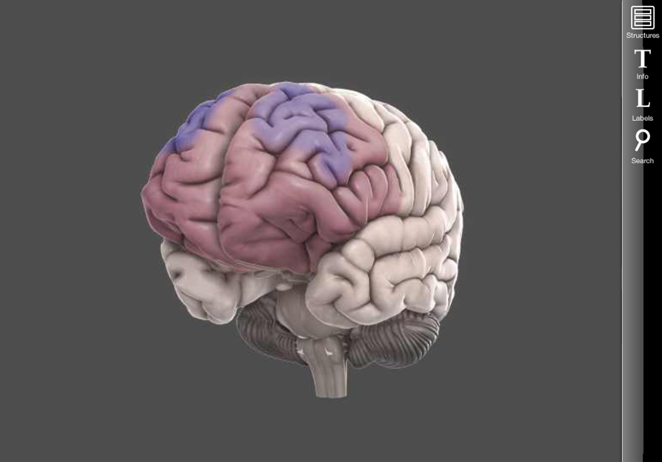
Notes:
The prefrontal cortex and the hippocampi will actually reduce in volume, and the amygdala will increase. The brain wires to be more vigilant.

Slide 47
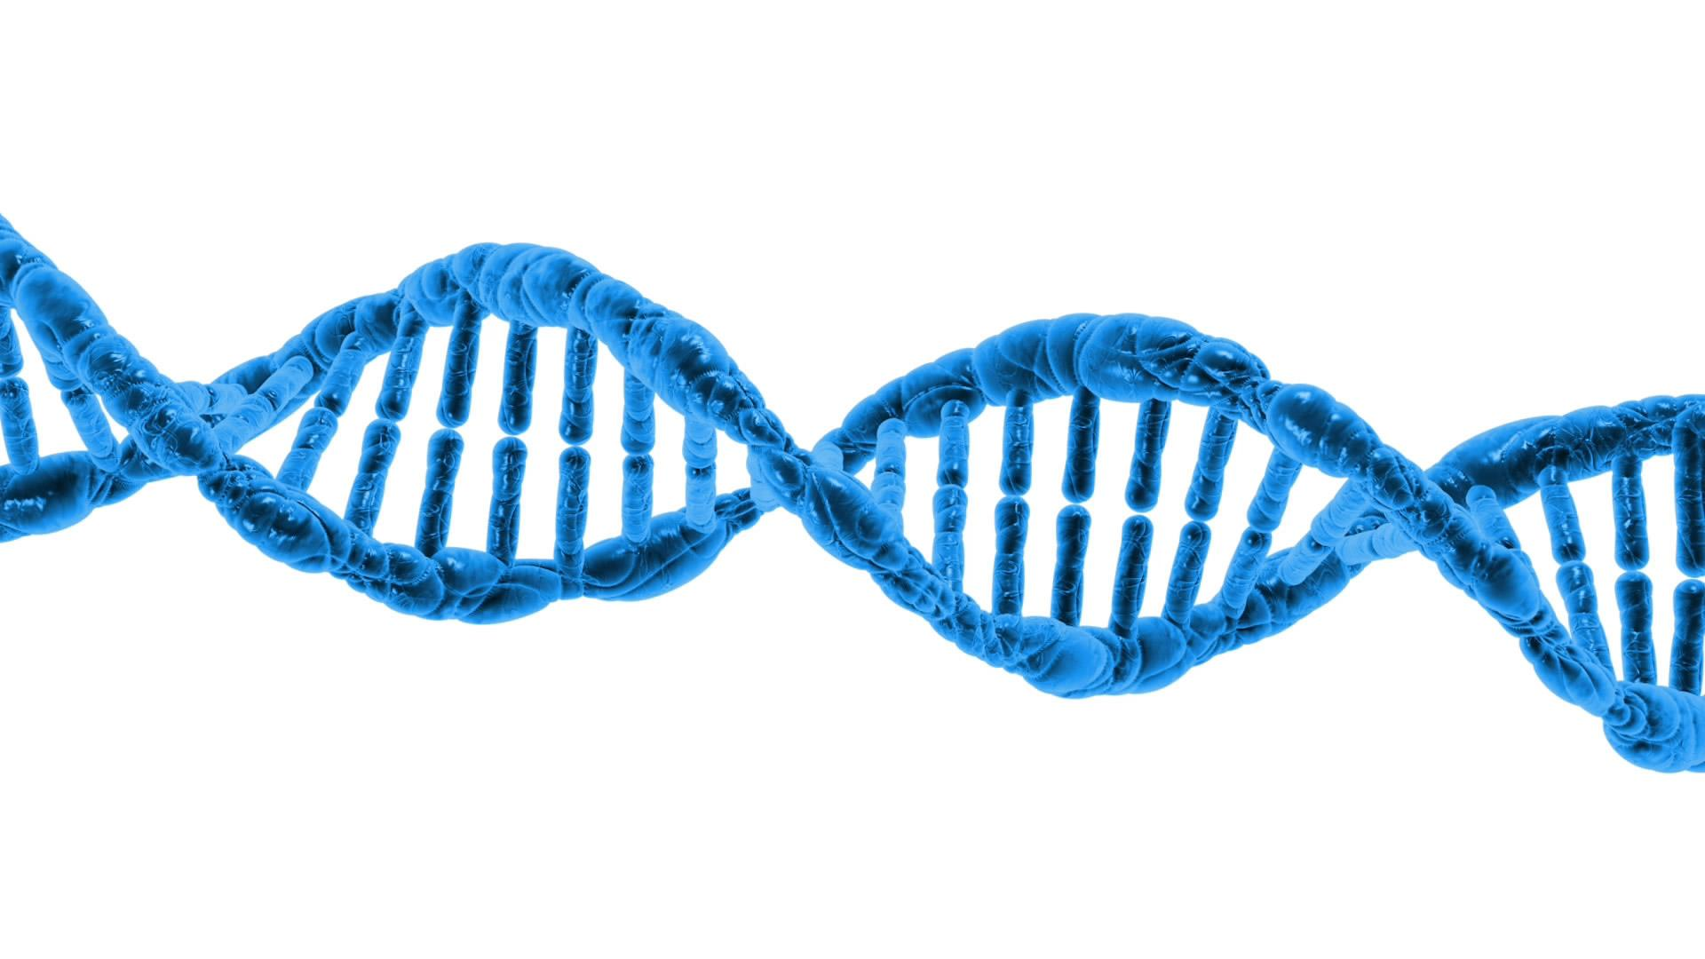
Notes:
Image retrieved from http://www.publicdomainpictures.net/pictures/50000/velka/dna-1370603787LgY.jpg
The change happens at the DNA level. Some changes are inheritable.

Slide 48
Notes:
We think of the brain as being separate from the body, but they’re all part of one big system. Emotional stress (“all in the mind”) can harm the rest of the body; physical stress in the body can harm the brain.
“Keeping students in a neuroplastic sweet spot of arousal is a core element in the art of teaching” Louis Cozolino, The Social Neuroscience of Education (2013)

Slide 49
Reflection
What was surprising?
What did you already know, but now see in a new way?
What do you want to explore further?

Slide 50
What are the primary issues or concerns occupying your brain?
Notes:
http://upload.wikimedia.org/wikipedia/commons/f/fe/14th-century_painters_-_Diagram_of_the_brain_-_WGA15761.jpg

Slide 51
Notes:
There’s a reason for this. The human brain is a pattern-seeking missile. We are driven to recognize patterns, and make predictions based on those patterns.

Slide 52
Notes:
There’s an image hidden under here, and I’m going to reveal it one square at a time. Raise your hand when you think you know what the picture is.

Slide 53
Notes:
Image: https://upload.wikimedia.org/wikipedia/commons/thumb/0/0c/Cow_female_black_white.jpg/1280px-Cow_female_black_white.jpg
It’s a cow! Did you feel a jolt of excitement when you first recognized it? Did you feel another little jolt when I completely uncovered it and it showed you were right? That’s the reward system in your brain encouraging you to look for patterns and make successful predictions. Think about the silly animated hydroplane races we see at things like Mariner games. It’s just cartoon boats, but we all go wild when we’ve picked the right color boat and it wins. It’s just a cartoon boat!

Slide 54
Notes:
Page 62, Scott McCloud Understanding Comics (If you have kids who love graphic novels, this book needs to be in your library!)
Comic strips, graphic novels, movies all work because of our pattern/prediction system. We fill in the blank between these two panels and make all sorts of assumptions about what has happened. Even though nothing is illustrated, we are pretty sure we know what happened. (It’s also a trick that movie makers/graphic novelists do to play with those assumptions and surprise us – perhaps in the next panel we see that the axe-wielding menace has tripped and fallen out the window. Psych!)

Slide 55
Notes:
https://upload.wikimedia.org/wikipedia/commons/9/9a/Default_mode_network-WRNMMC.jpg
On to another set of structures. It turns out that when your brain isn’t busy doing a specific task (counting, making a shopping list, doing a spelling test, etc.), there is a set of structures that becomes active. It’s very unpoetically called the Default Network. When you’re daydreaming, that’s where your brain is active.

Slide 56
Notes:
Image: https://pixabay.com/p-1488213/?no_redirect
One of the key functions of the Default Network is to process your social world and your place within it. This is such a critical part of our survival that it is literally the default mode of operation.

Slide 57
Maslow was wrong. Our most basic need is to belong and feel connected
Notes:
We all share three sets of basic needs. A lack of those needs can be a source of chronic stress.
We need to feel that we belong and feel connected to others.

Slide 58
Notes:
https://upload.wikimedia.org/wikipedia/commons/f/fb/Mind-reading-Russell-Morgan.jpeg
One of the goals of all this processing is trying to make you into a mind reader. We are always trying to figure out what other people are thinking and feeling – especially about ourselves. Scientists call it Theory of Mind.

Slide 59
Notes:
Image: https://pixabay.com/en/advert-advertising-banner-blank-84406/
For instance, most of us can look at this woman and feel pretty confident about how she’s feeling about us.

Slide 60
Notes:
And it’s not too hard to interpret this expression, either!

Slide 61
Notes:
Image: https://upload.wikimedia.org/wikipedia/commons/7/7b/Paul_Brook_Mind_Reader.jpg
But what is he thinking? Just exactly how is he feeling about you? Who wants to volunteer their response?

Slide 62
Notes:
Remake of the Heider-Simmel video
https://vimeo.com/36847727
This is a remake of an animation originally done in the 1940s. After watching the video, describe the characters and their motivations. How can we do that? They’re just cartoon dots and a triangle! But your brain is determined to ascribe motivation.

Slide 63
Notes:
Image: https://upload.wikimedia.org/wikipedia/commons/1/12/Flickr_-_moses_namkung_-_The_Crowd_For_DMB_1.jpg
Because we are so wired to interpreting and responding to the feelings of other people, emotions are quite contagious, particularly in crowds. That’s why happy crowds get really happy, and why concerts are so much fun.

Slide 64
Notes:
https://upload.wikimedia.org/wikipedia/commons/0/01/Radically_oriented_protesters_throwing_Molotov_cocktails_in_direction_of_Interior_troops_positions._Dynamivska_str._Euromaidan_Protests._Events_of_Jan_19,_2014-5.jpg
It’s also why unhappy crowds can get really unhappy, and why something as meaningless as the outcome of a sporting event can quickly turn to violence.

Slide 65
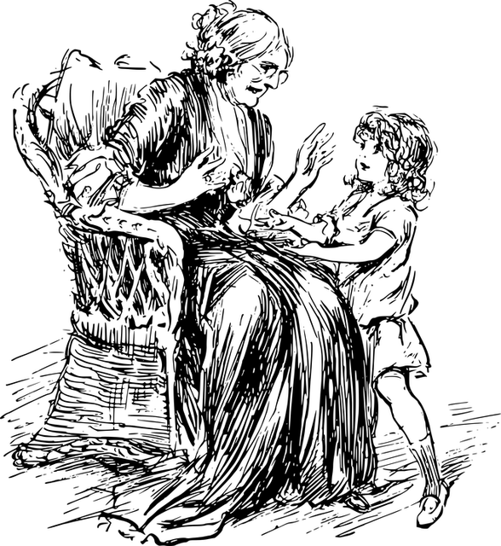
Notes:
https://upload.wikimedia.org/wikipedia/commons/9/9a/Default_mode_network-WRNMMC.jpg
And your Default Network is active is when we listen to (or read or watch) stories. You personal set of stories is being reprogrammed.

Slide 66
Notes:
Image: Personal collection

Slide 67
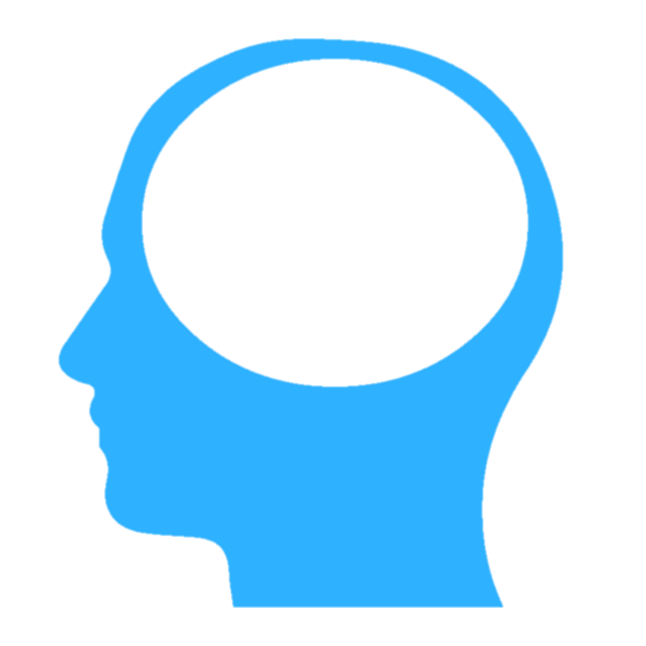
Notes:
There are three primary kinds of information that the RAS will prioritize.

Slide 68
!
NEW!
Notes:
Novelty is one. New things grab out attention quickly. (A new kid in class is always the center of attention, for good and bad.) That’s part of the dreadfully addictive nature of smart phones – they are bottomless pits of novelty.

Slide 69
!
Notes:
Things that we care about are also a high priority. When you are in a crowd of thousands of people, you can spot the face of a friend or family member, yet not be able to describe a single other face around them.

Slide 70
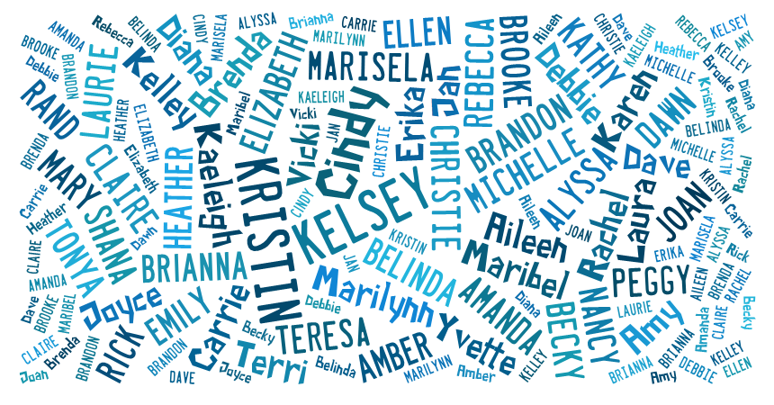
Notes:
How many times have you been at a party, and all of the background discussion is simply a blur of white noise – until someone says your name, which will pop out of that meaningless buzz. That’s your RAS at work.

Slide 71
It is literally neurologically impossible to learn deeply about something you don’t care about.
Dr. Mary Helen Immordino-Yang

Slide 72
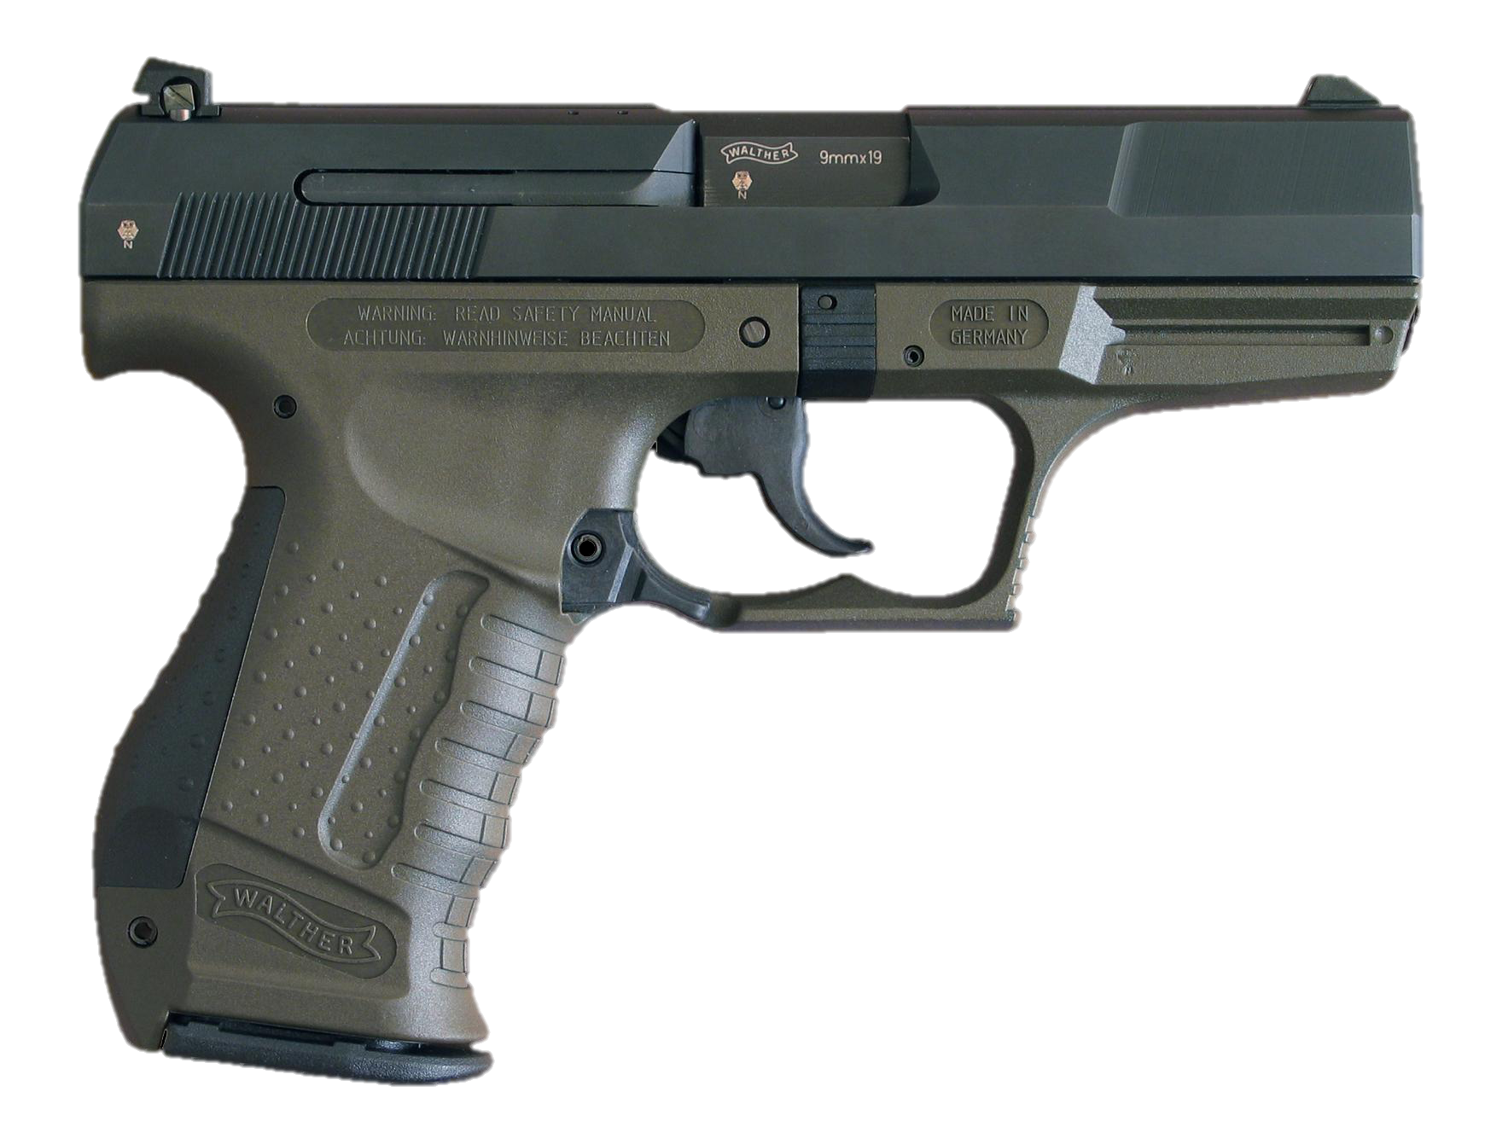
!
Notes:
Image from https://en.wikipedia.org/wiki/Semi-automatic_firearm
The highest priority is threat. Our brain’s first job is survival, so threat is always put at the top of the list. There is a psychological observation called the ”Weapons Effect,” which describes the observation that someone who has been held up at gunpoint can often describe the gun in greater detail than the person holding it.

Slide 73
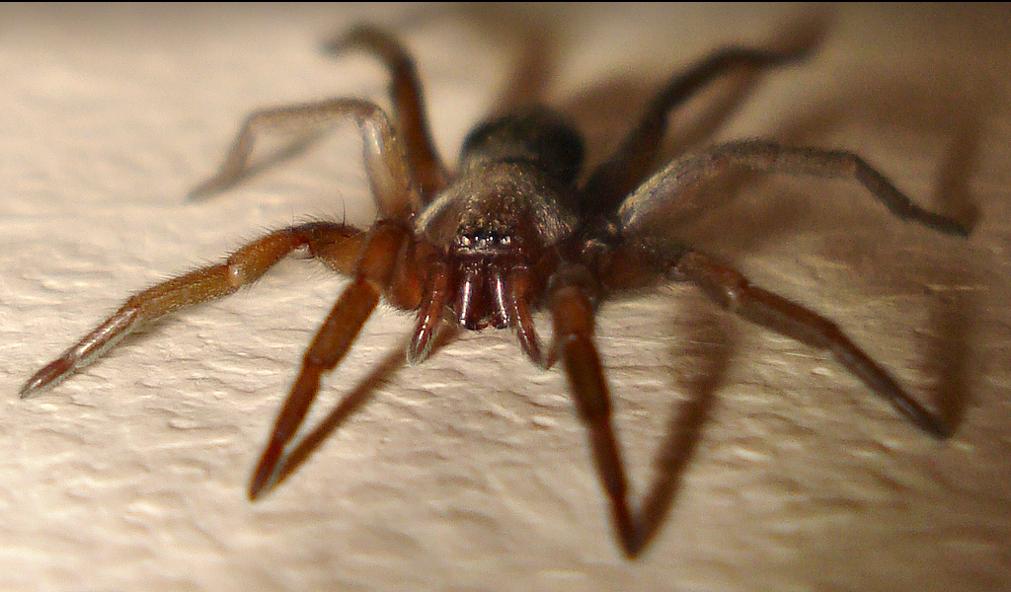
Notes:
http://www.flickr.com/photos/micks-wildlife-macros/
Some of these things that we react to are innate, but many are learned and highly individual. Some of you are not happy with the image I’ve put on the screen, while others don’t particularly care. And yes, it was mean of me to put it on the slow zoom.

Slide 74
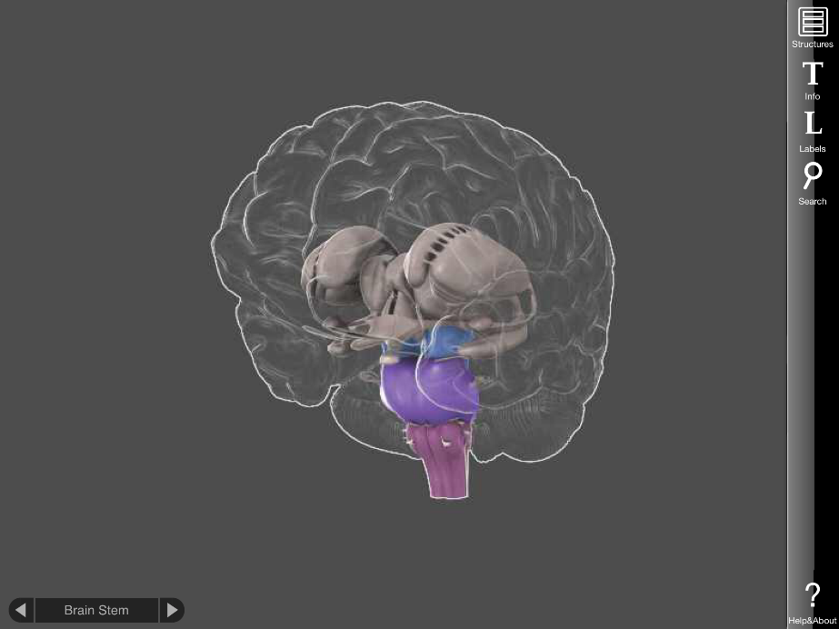
Notes:
What gets through the RAS in turn is what drives the PFC and the limbic system. If the information getting through is perceived as something interesting, or exciting, or desirable, or new, or surprising, your amygdala will be mildly stimulated, and you will pay more attention. And your pulse rate will rise slightly, your eyes will dilate, and other mild physical responses. If it’s perceived as a threat, depending on the severity of the threat, your limbic system may become so active as to cause the emotional and cognitive consequences we discussed earlier. The three systems work in a very complex, ever-changing dance. The important thing to remember is that there are modes of dance that result in much better learning (and happiness) than others.
The other key takeaway is that for many of the situations we face, whether or not we perceive it as a threat is up to us. Most of the triggers we experience are learned – which means they can be unlearned. And we as teachers can do our best to avoid creating and maintaining those triggers.

Slide 75
Reflection
What was surprising?
What did you already know, but now see in a new way?
What new questions do you have?

Slide 76
PBIS Connections
The pattern-seeking brain operates best when there are:
Predictable environments, which are supported through PBIS systems and procedures
Positive social interactions, which are supported through PBIS systems and procedures that reduce, mitigate, or prevent conflict. (Developing a positive culture and good relationships should be the target, not just a well-behaved classroom.)
Challenging activities, which students can pursue more deeply when not distracted by social issues or other perceived threats.
The culture of our classroom is a story, with you and the students characters within it. PBIS strategies can help us act with intentionality to be sure the story they are experiencing is the one we want to be telling.

Slide 77
Environment
Resiliency
Notes:
https://simple.wikipedia.org/wiki/Primary_school#/media/File:Heiwa_elementary_school_18.jpg
https://www.flickr.com/photos/mindfulness/25466002

Slide 78
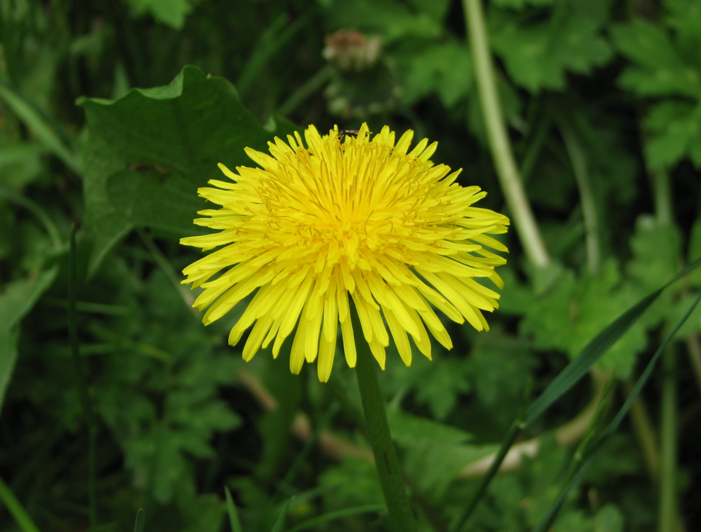
Notes:
https://commons.wikimedia.org/wiki/File:Dandelion_flower_Taraxacum.jpg
Some kids are dandelions, some are orchids. (It’s true of our co-workers, too.)

Slide 79
The need to feel competent
Notes:
We need to feel a sense of competence, and that what we do has meaning.

Slide 80
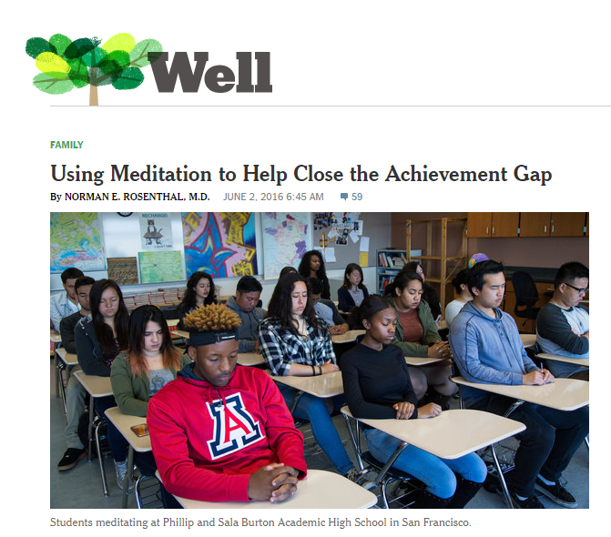
Notes:
http://well.blogs.nytimes.com/2016/06/02/using-meditation-to-help-close-the-achievement-gap/?_r=0
Mindfulness helps. Research says! (But it’s not a silver bullet, and it doesn’t help all people the same.)

Slide 81
“How do you know that
InsertYourName
cares about your success?”

Slide 82
Nemo dat quod non habet
You cannot provide
what you do not have.

Slide 83
“ Education is an art built upon the social relationship between teacher and student that harnesses the neural mechanisms of learning.”
Daniel J. Siegel, M.D.

Slide 84
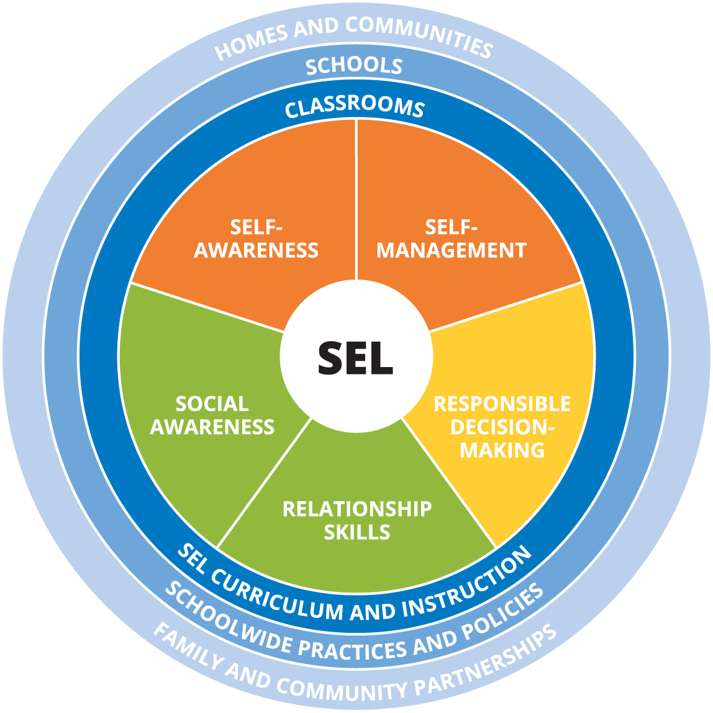
Social Emotional Learning
Integral element of education focusing on five social competency areas:
Self-Management
Self-Awareness
Responsible Decision Making
Relationship Skills
Social Awareness
**CASEL Model : Collaborative for Academic, Social and Emotional Learning https://casel.org/core-competencies/

Slide 85
Research says...
“Compared to controls, SEL participants demonstrated significantly improved social and emotional skills, attitudes, behavior, and academic performance that reflected an 11-percentile- point gain in achievement.”
From: The Impact of Enhancing Students’ Social and Emotional Learning: A Meta-Analysis of School-Based Universal Interventions 3 FEB 2011
Joseph A. Durlak¹, Roger P. Weissberg², Allison B. Dymnicki³, Rebecca D. Taylor³ and Kriston B. Schellinger⁴
Child Development © 2011 Society for Research in Child Development, Inc.

Slide 86
Principles of PBIS
•Every child can learn positive behavior.
•Stepping in early can prevent more serious behavior problems.
•Each child is different and schools need to provide many kinds of behavior support.
•How schools teach behavior should be based on research and science.
•Following a child’s behavioral progress is important.
•Schools must gather and use data to make decisions about behavior problems.

Slide 87
Using leverage of PBIS for SEL
By creating proactive systems of support with clear, explicit expectations and consistent feedback, we are;
Creating a culture of caring- human beings are hard-wired for relationships, trust is built through active caring for students, physically and emotionally
Cultivating learning partnerships anchored in affirmation, mutual respect and validation Increasing opportunities to respond and encourage risk taking
Using data to monitor behavior and inform professional learning

Slide 88
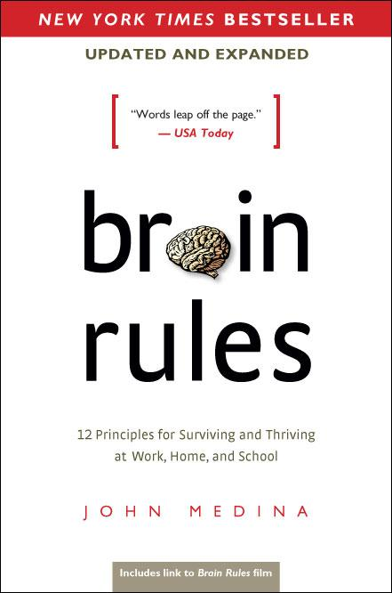
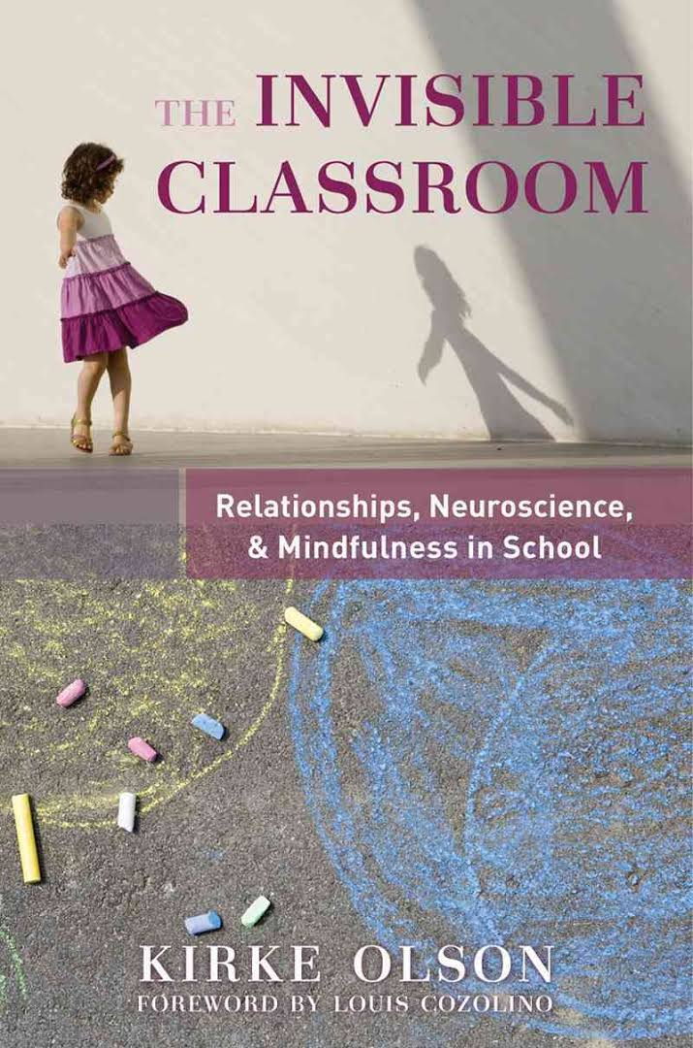

Slide 89
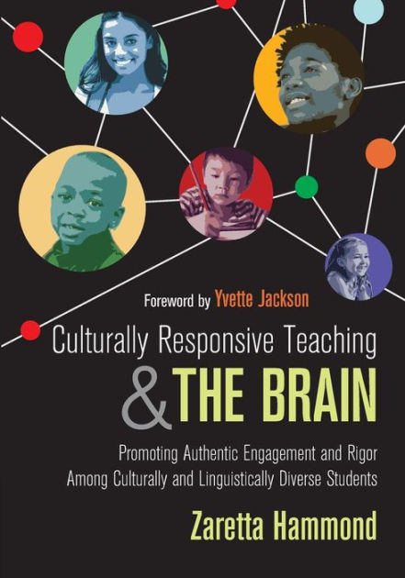
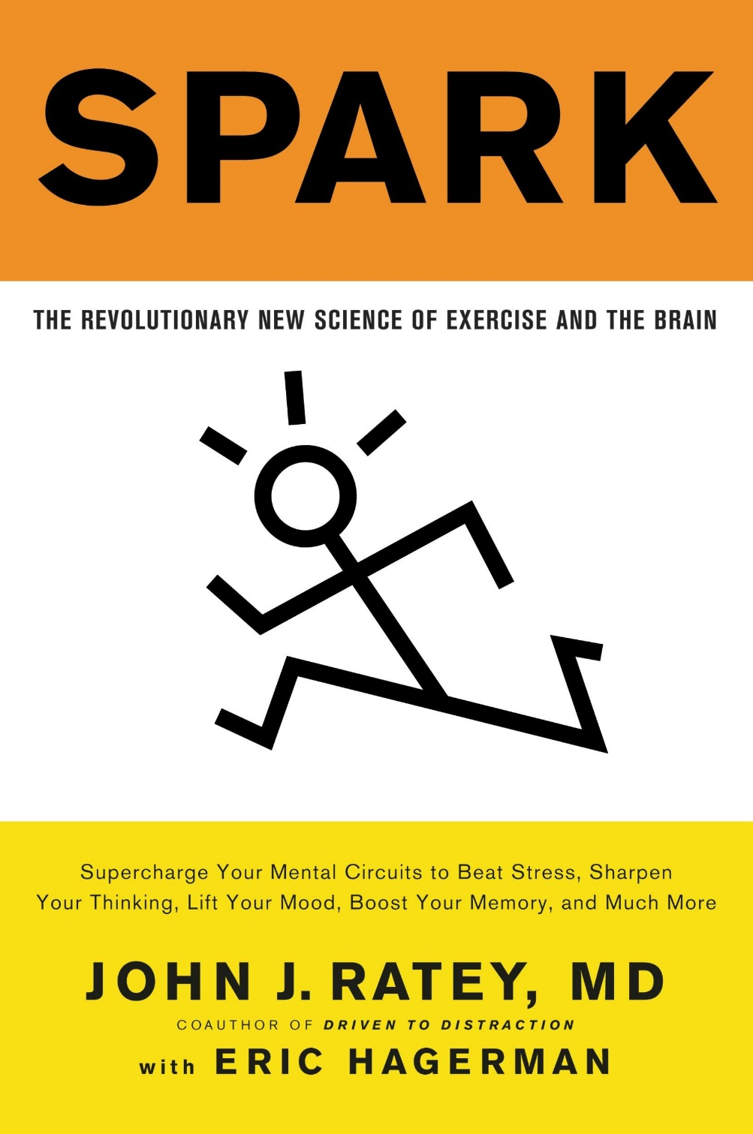

Slide 90
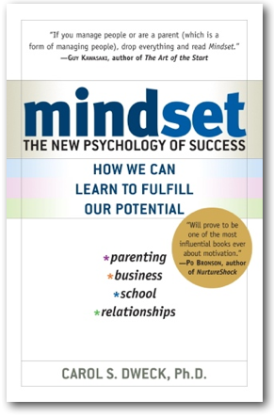
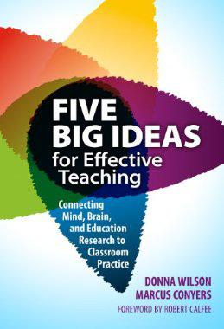
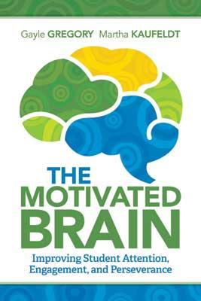

Slide 91
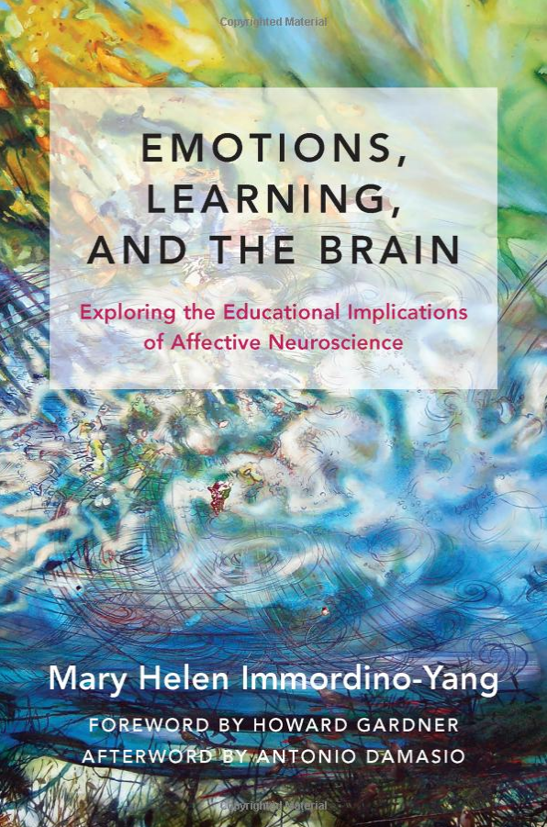

Slide 92
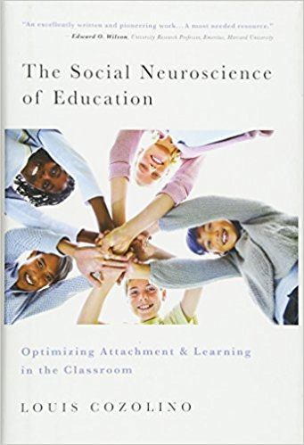

Slide 93
Amy Okeze : okezeal@gmail.com and Puget Sound Educational Service District (PSESD)
aokeze@psesd.org
Conn McQuinn :
McQuinnable Educational Services
conn@mcquinnable.com
Download presentation: http://www.mcquinnable.com

