Slide 1
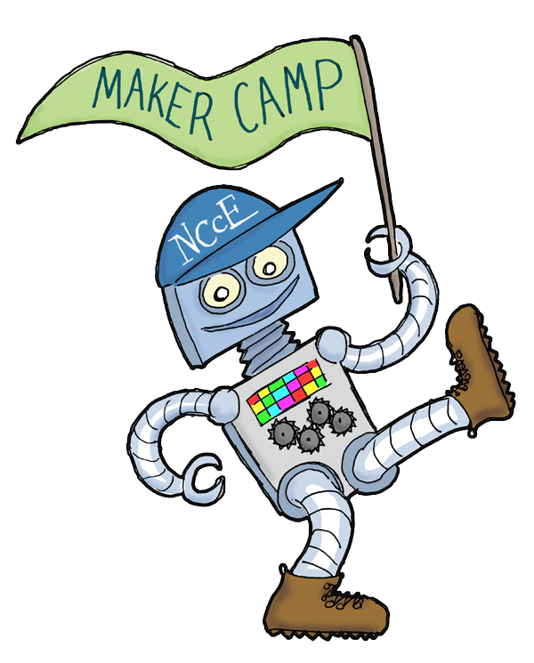

Introduction to Makerspaces

Slide 2
Introduction to Makerspaces
Camp resources:
http://www.mcquinnable.com
#NCCEchat #NCCE_EdTech

Slide 3
Introduction to Makerspaces
Introductions

Slide 4
Introduction to Makerspaces

Slide 5
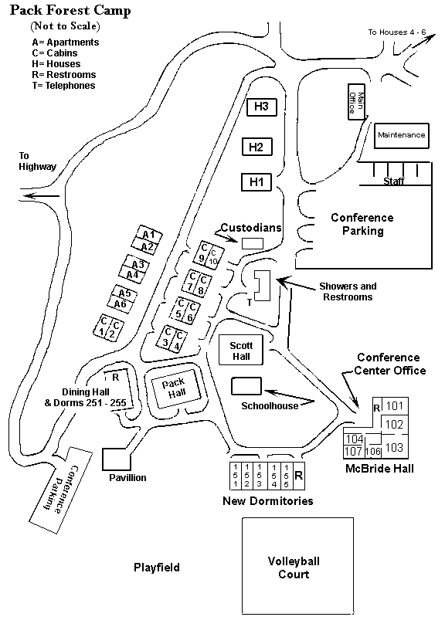

Slide 6
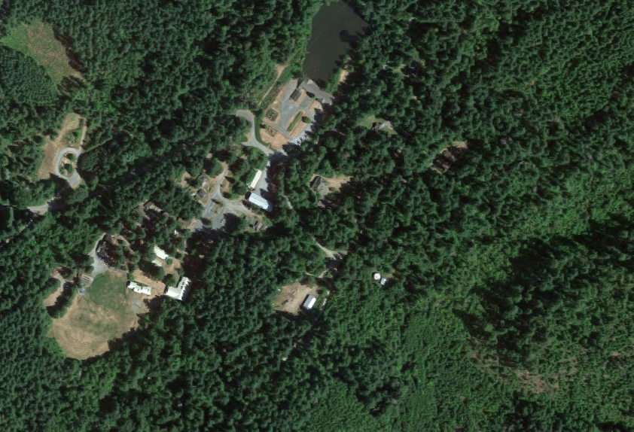

Slide 7
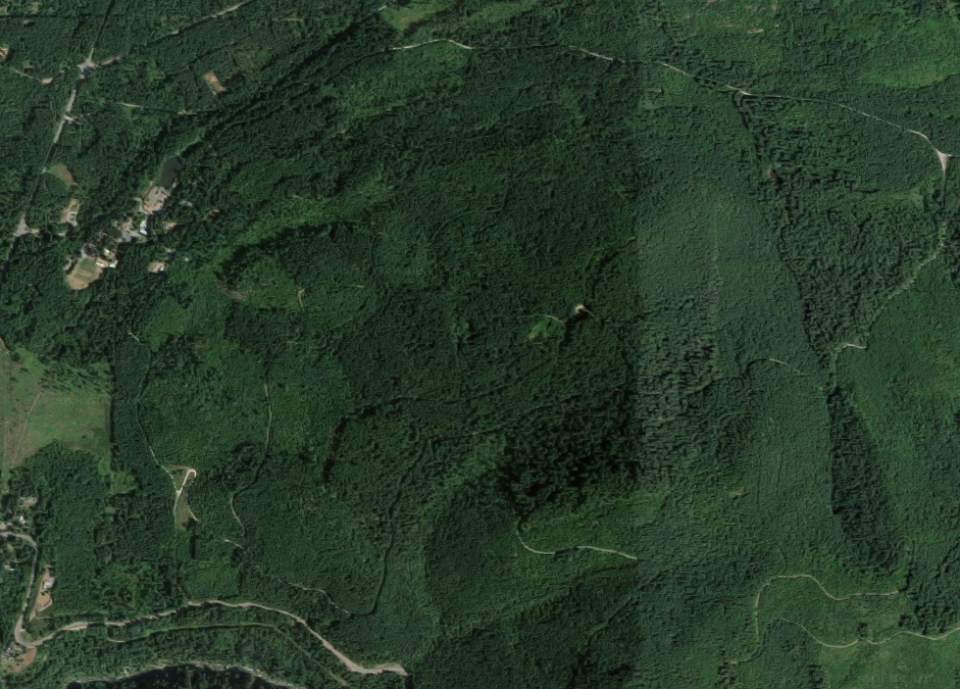
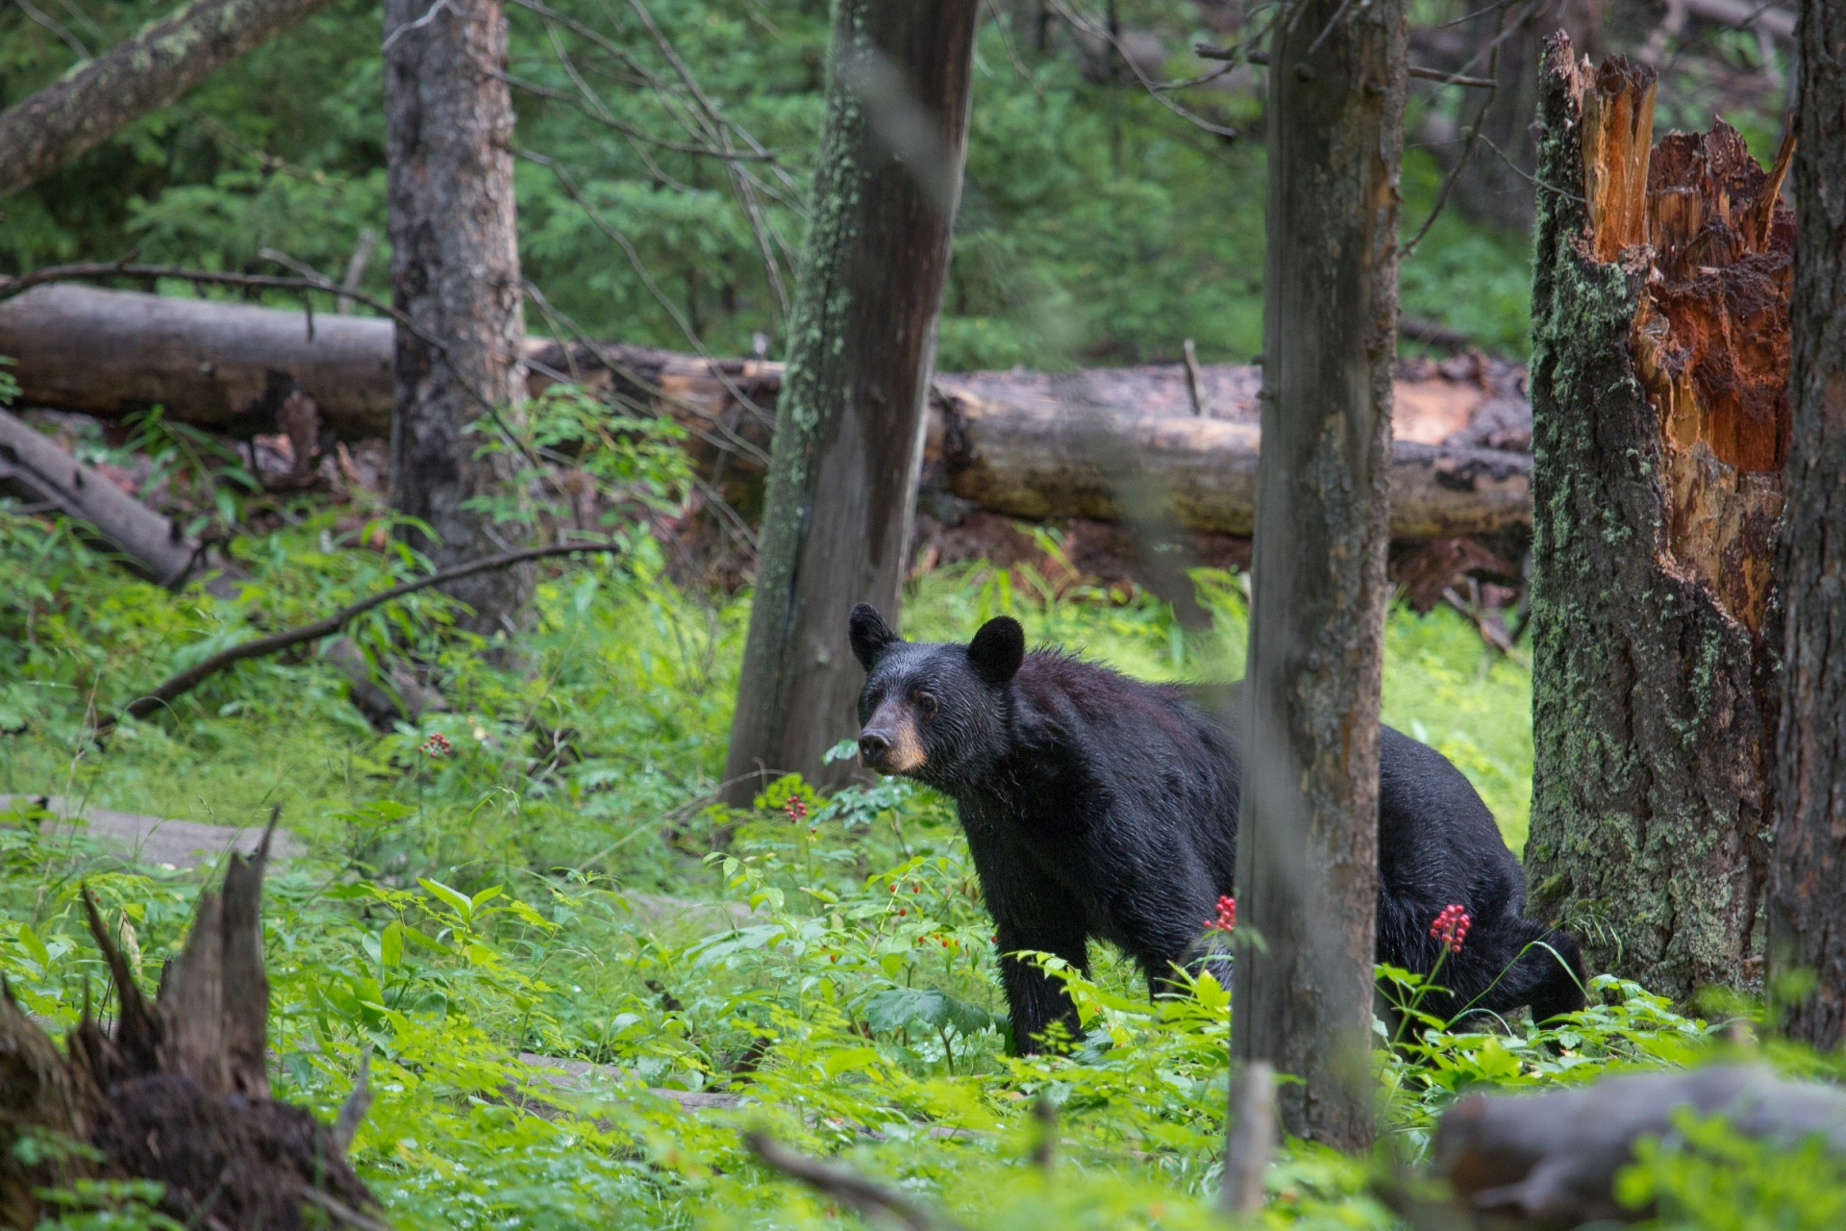

Slide 8

Why are you here?

Slide 9
Introduction to Makerspaces
Objective #1: Participants will understand the characteristics of Making and Makerspaces
Objective #2: Participants will understand the role of Design Thinking in Making
Objective #3: Participants will develop plans and strategies for implementing Making in their classroom or school

Slide 10
Introduction to Makerspaces

Slide 11
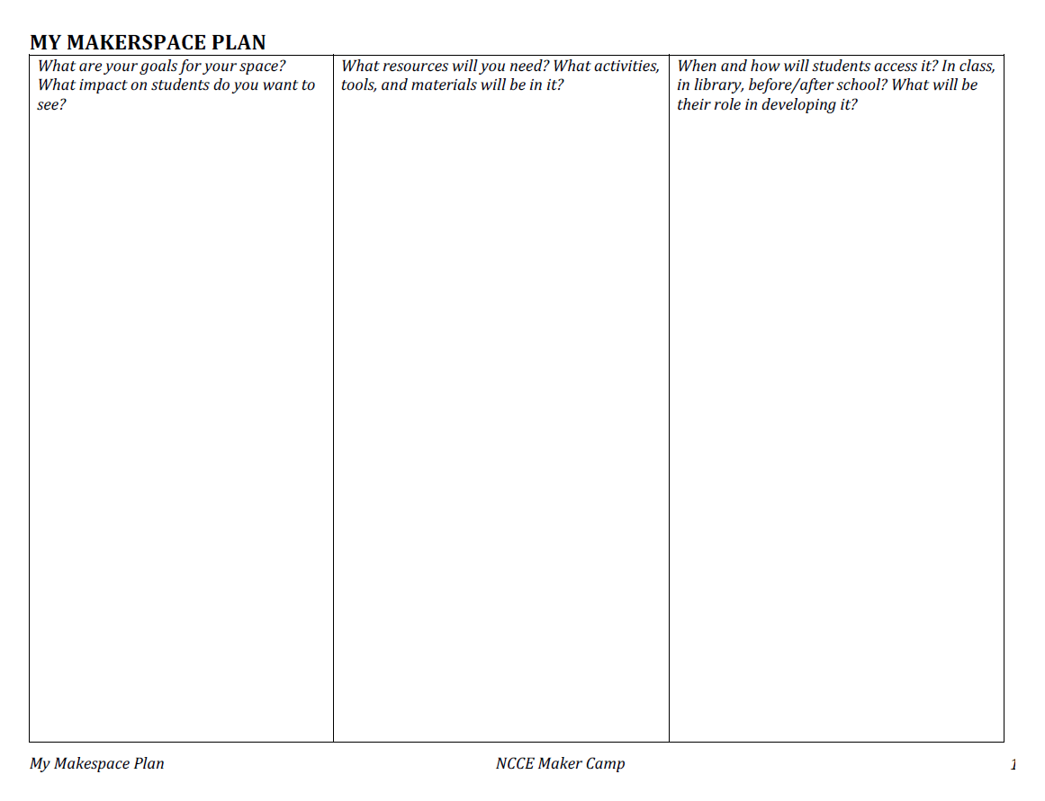

Slide 12
Introduction to Makerspaces
EVERYTHING-ITIS

Slide 13
Introduction to Makerspaces
X
Things will go wrong.
Differently than expected

Slide 14
Introduction to Makerspaces
Camp resources:
www.mcquinnable.com

Slide 15
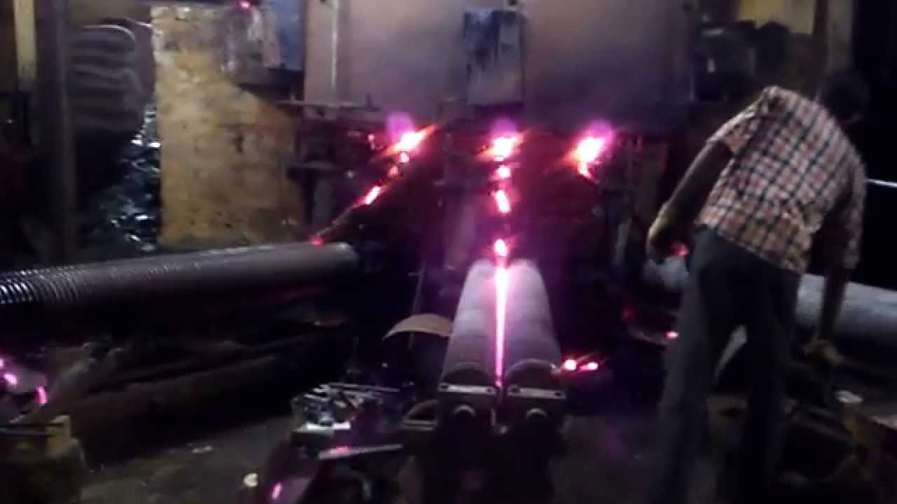

Slide 16
Accelerating Rate of Change
Notes:
This is a reflection of Moore’s Law, first coined in the 1960s by the research Gordon Moore. Roughly paraphrased, the power of computer you can buy for a dollar doubles every 18 months.

Slide 17

Notes:
This affects everything and everyone in our organization

Slide 18
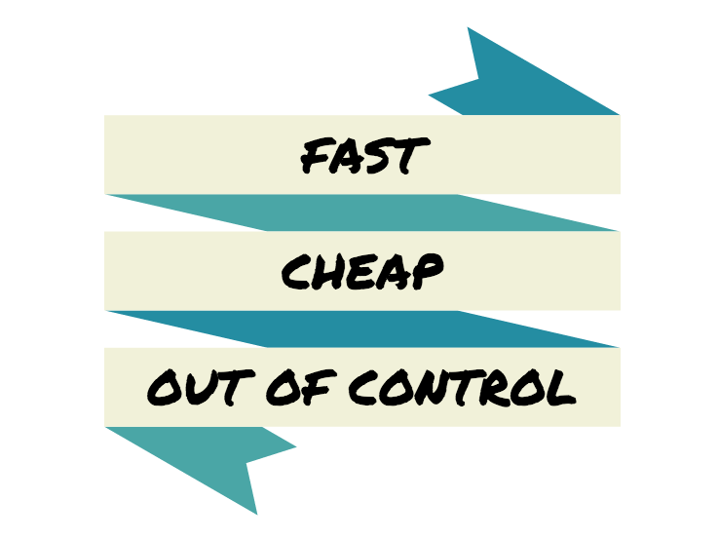

Slide 19
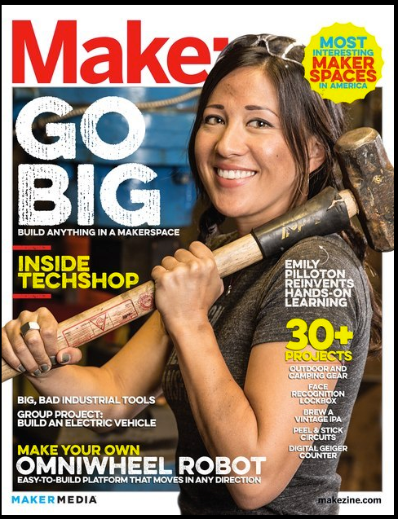

Slide 20
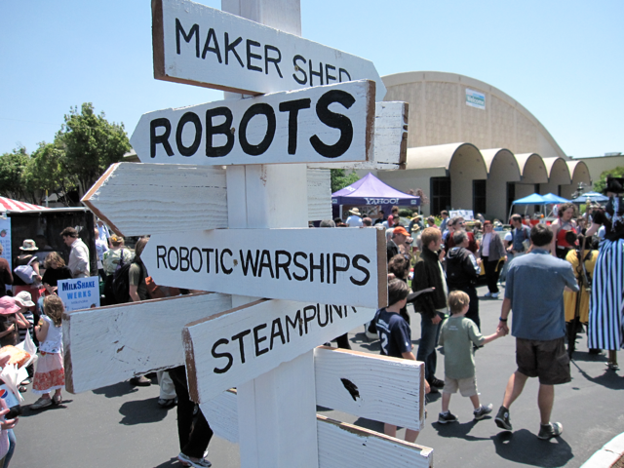
Notes:
The abundance of of open-source resources and relationships made accessible via the Internet is has created vast communities of tinkerers, inventors, and creators.

Slide 21
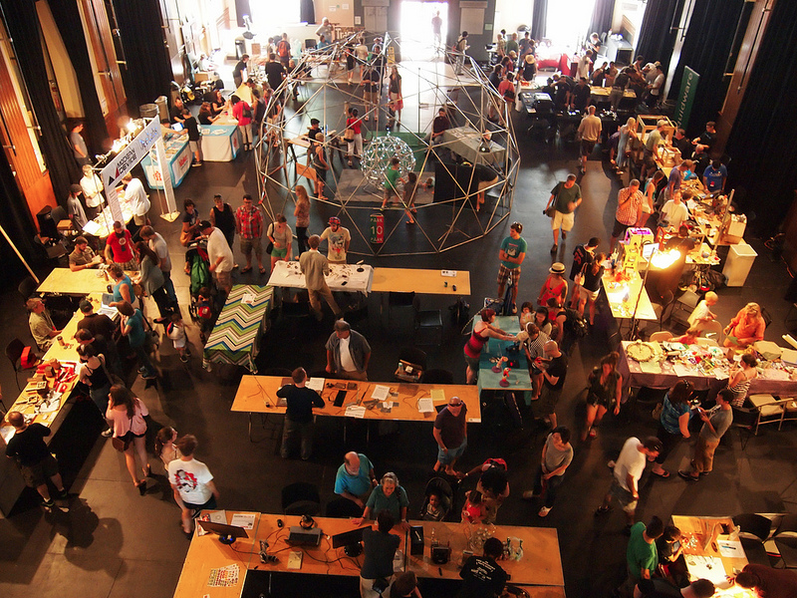

Slide 22
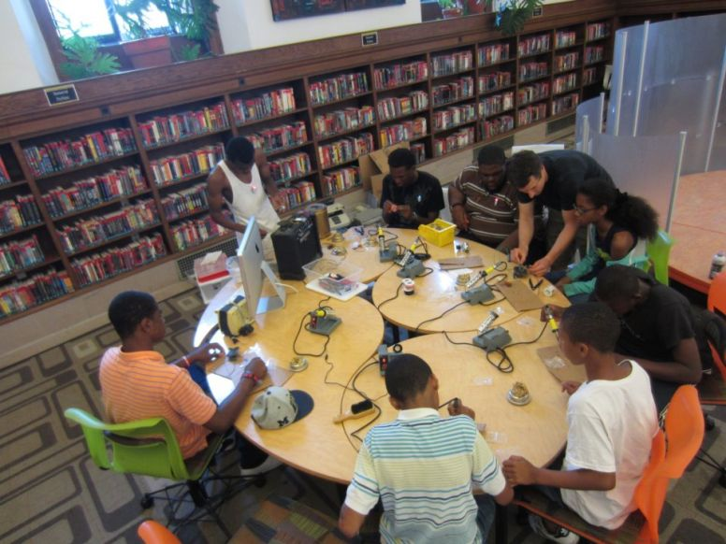
Notes:
http://corporate.blogs.proquest.com/wp-content/uploads/2013/11/11943090-teen-makerspace.jpg

Slide 23
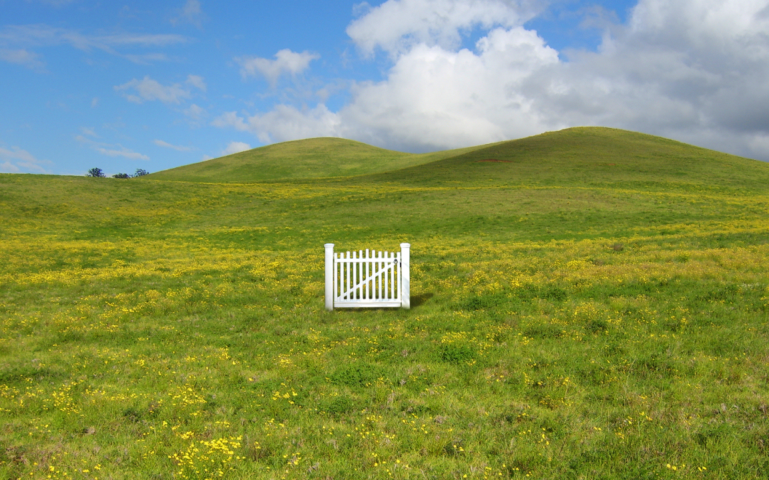


Slide 24




Slide 25
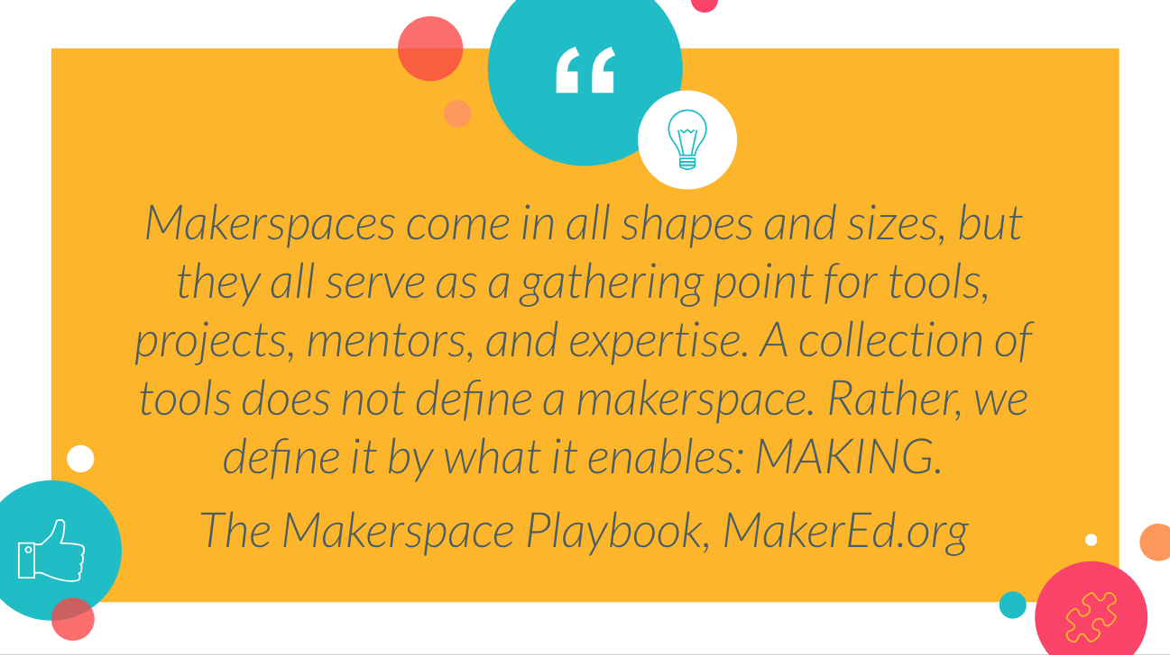

Slide 26
What Goes in a Maker Space?
People
Stuff
Tools
Enthusiasm
Freedom to Tinker
Problems to Solve
Design Thinking
Notes:
Abstraction
Activity
Communication
Exactness
Exploration
Manipulation (of the environment)
Order
Orientation
Repetition
Self-Perfection
Work (also described as "purposeful activity")

Slide 27
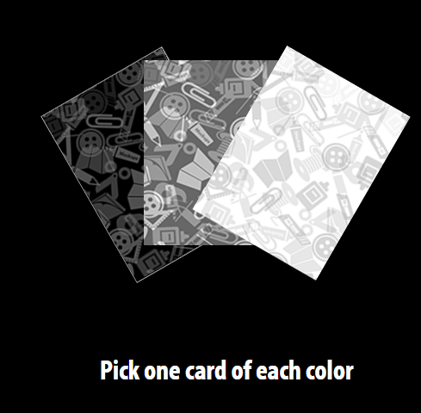

Slide 28
Take two minutes to discuss
your design challenges

Slide 29
Take two minutes to build
a prototype

Slide 30
Take four minutes to describe
your prototype with another pair

Slide 31
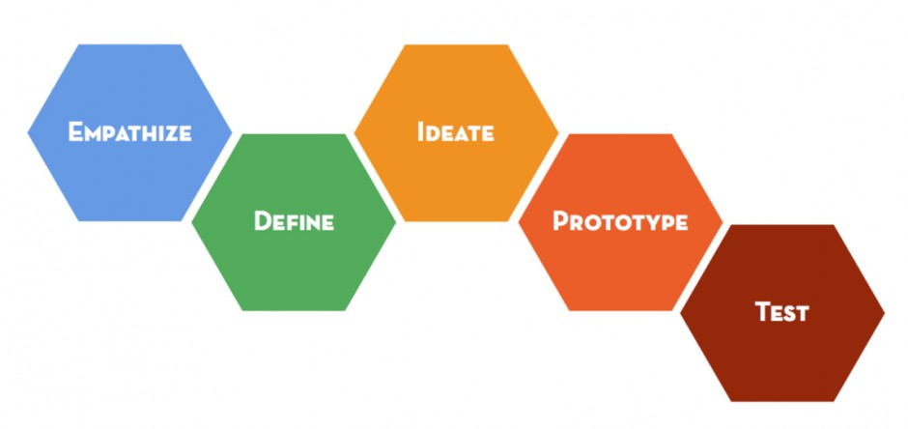
Introduction to Makerspaces
d.school Design Process
Notes:
Abstraction
Activity
Communication
Exactness
Exploration
Manipulation (of the environment)
Order
Orientation
Repetition
Self-Perfection
Work (also described as "purposeful activity")

Slide 32
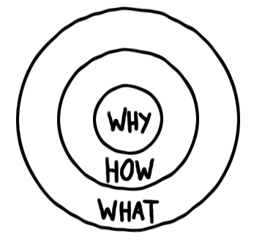
Introduction to Makerspaces
Notes:
Abstraction
Activity
Communication
Exactness
Exploration
Manipulation (of the environment)
Order
Orientation
Repetition
Self-Perfection
Work (also described as "purposeful activity")

Slide 33

Introduction to Makerspaces
Why are you
implementing
Making?

Slide 34
Introduction to Makerspaces
NGSS - Science and Engineering Practices
Asking Questions and Defining Problems
Developing and Using Models
Planning and Carrying Out Investigations
Using Mathematics and Computational Thinking
Constructing Explanations and Designing Solutions

Slide 35
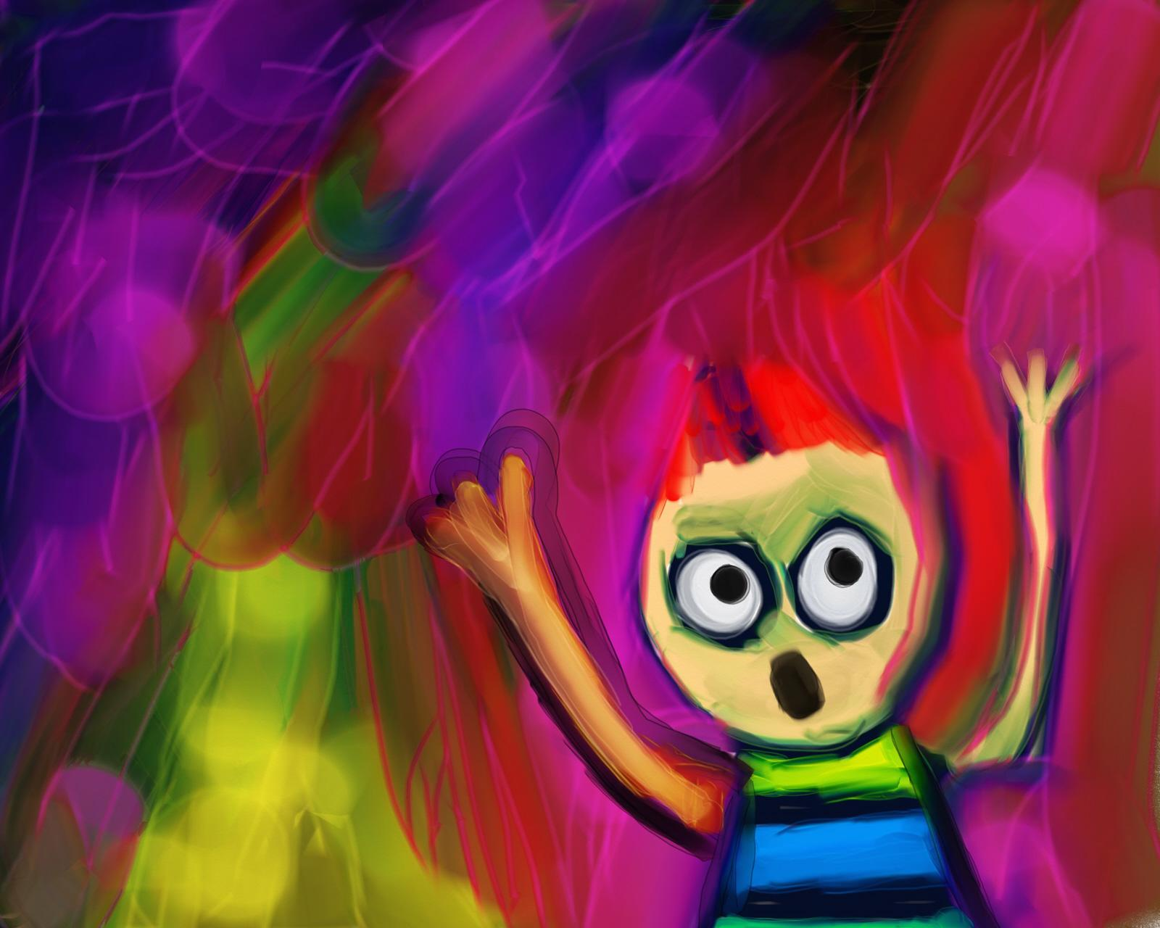
There’s more to learning than
just the standards!
Notes:
https://morguefile.com/search/morguefile/3/scream/pop

Slide 36
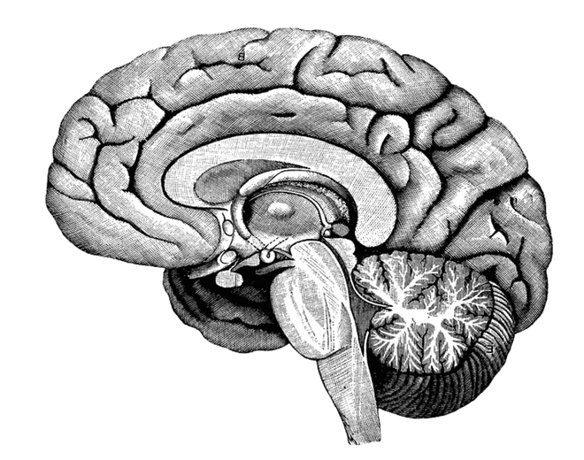
Persistence
Mindset
Failure
Focus
Creativity
Self-direction

Slide 37
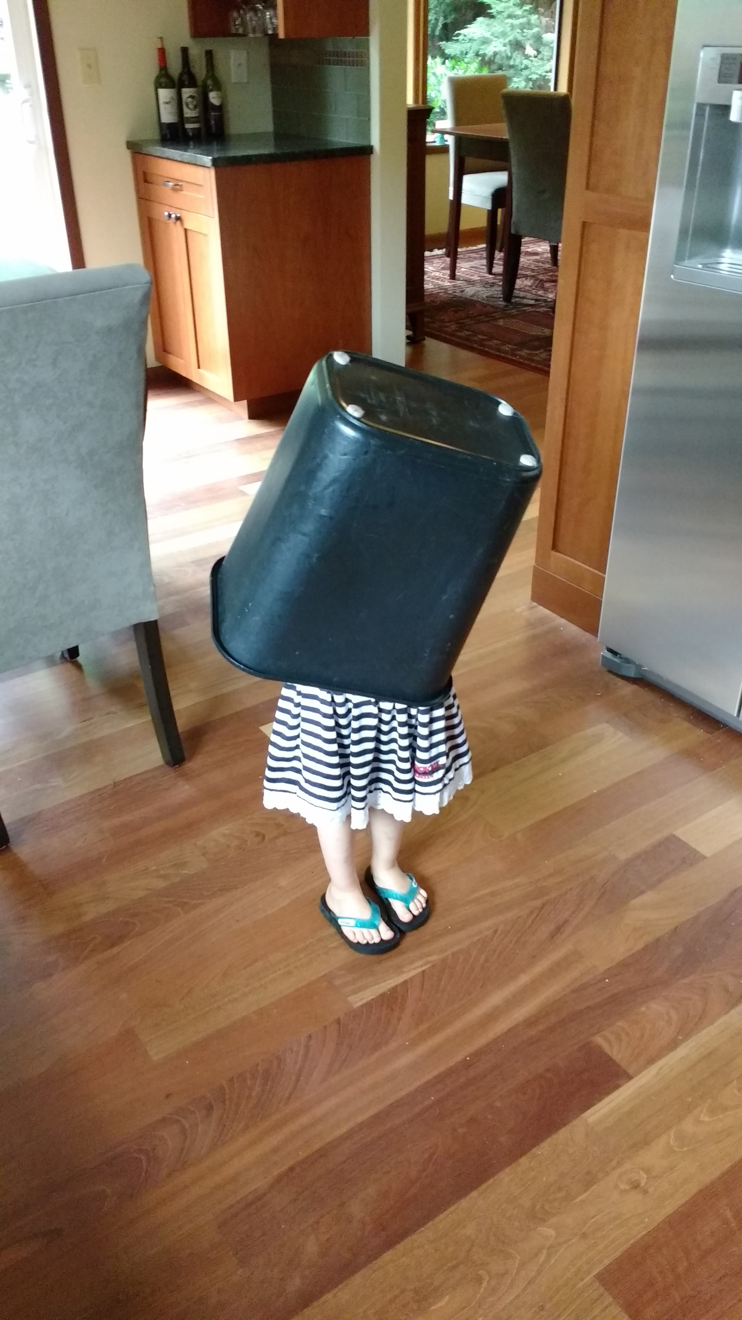

Slide 38
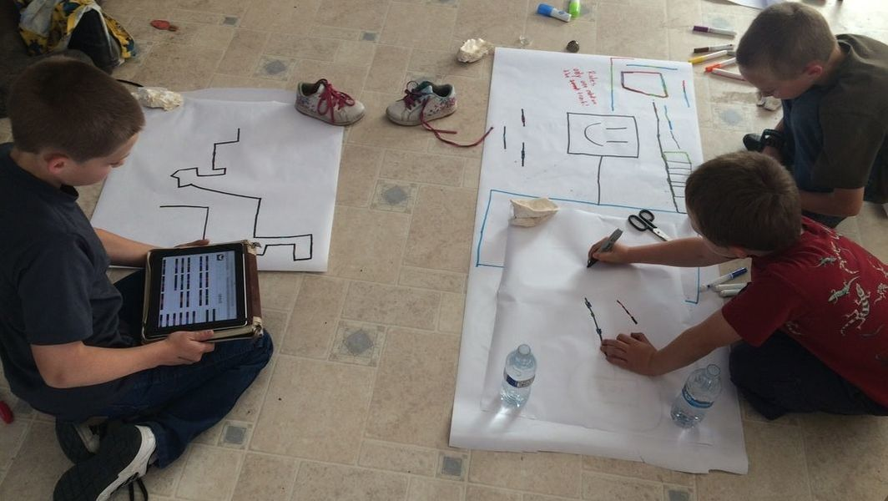

Slide 39
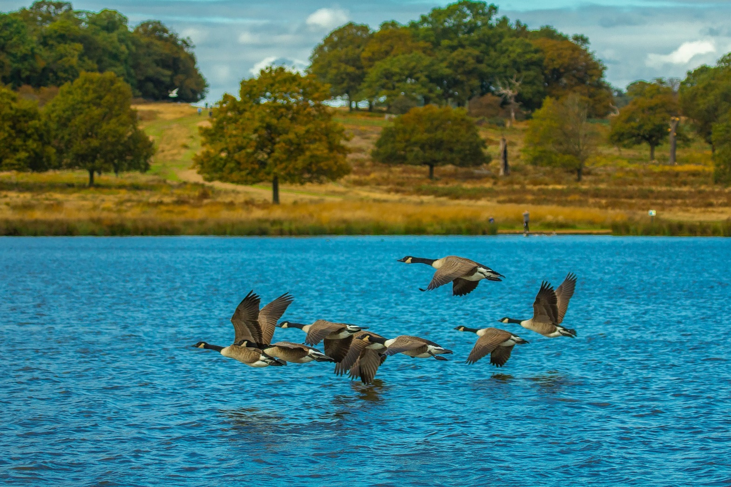
The need to belong and feel connected
Notes:
We also need to keep aware that stress can be caused by the lack of something, not just the presence of something negative. We all share three sets of basic needs. We need to feel that we belong and feel connected to others.

Slide 40
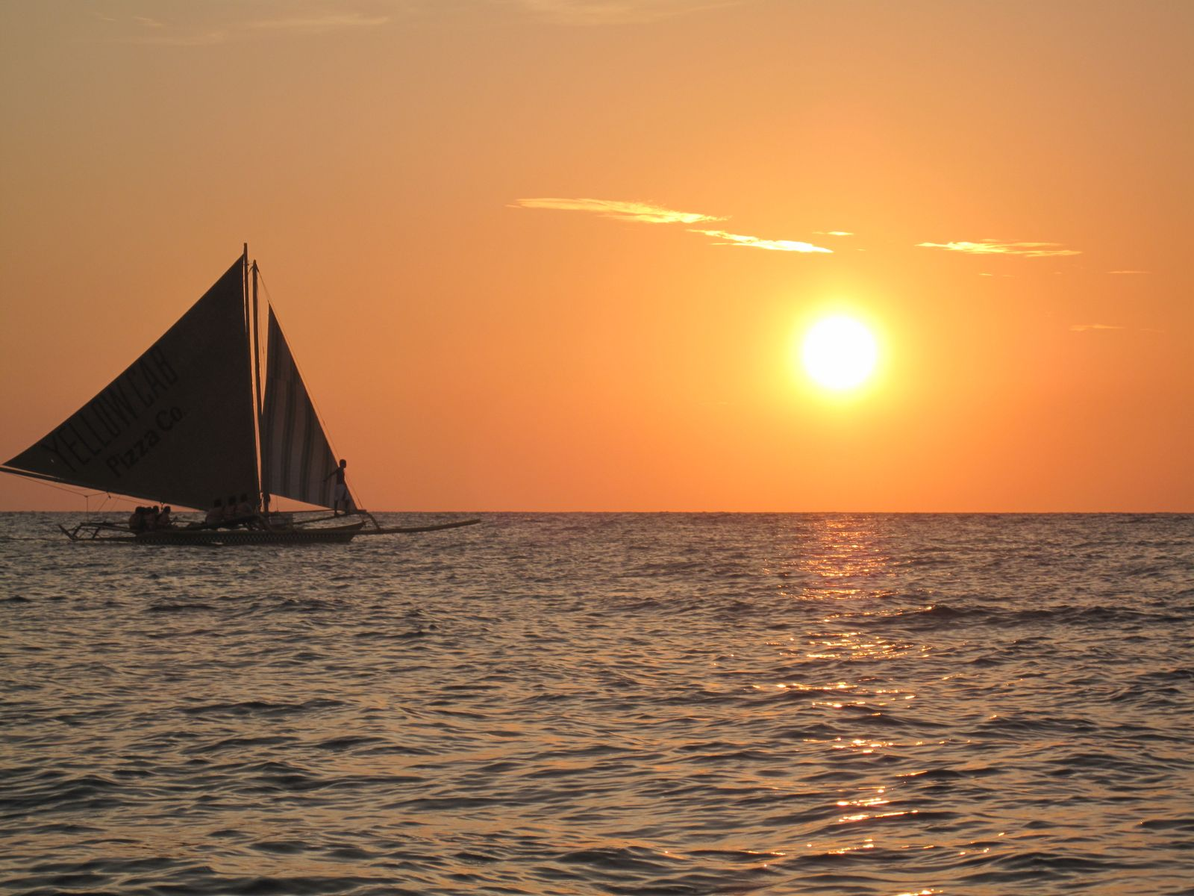
The need for self-determination and autonomy
Notes:
We have a need to have autonomy and ability to make choices. https://commons.wikimedia.org/wiki/File:Boracay_Sailing_Paraw.jpg

Slide 41
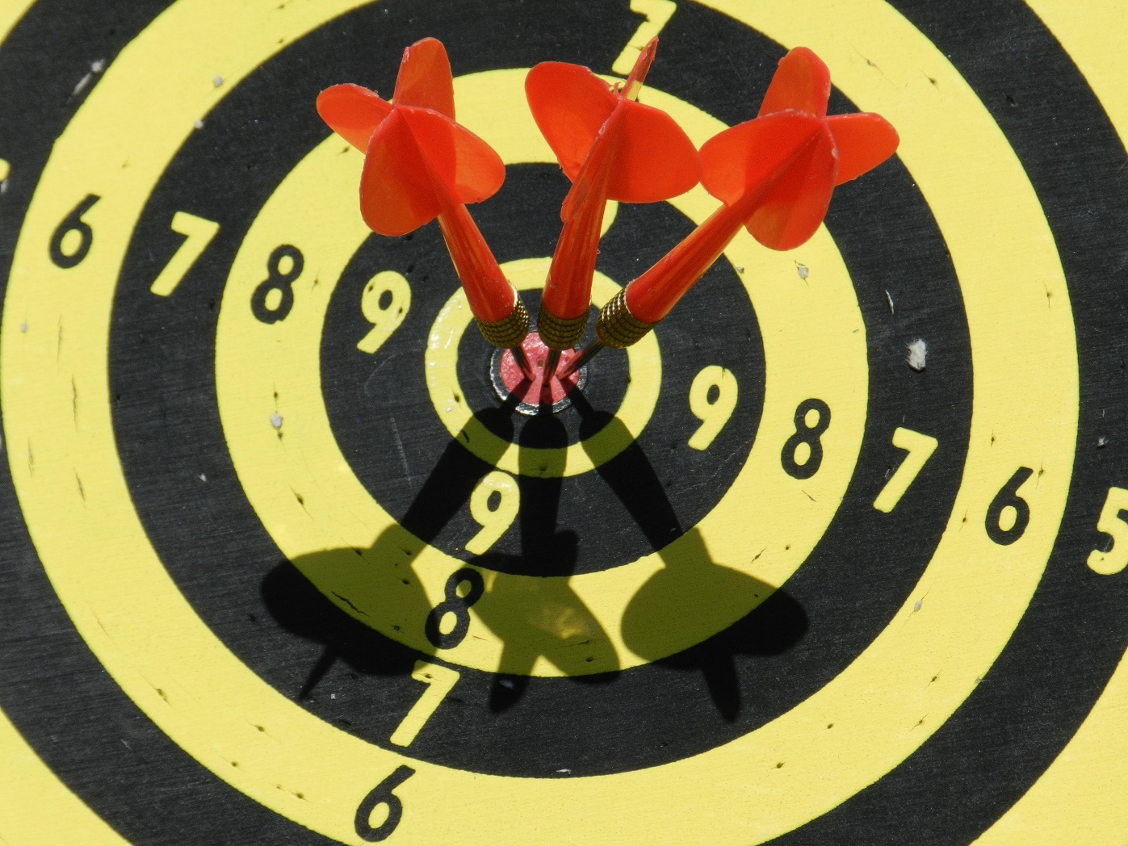
The need to feel competent
Notes:
We need to feel a sense of competence, and that what we do has meaning.

Slide 42
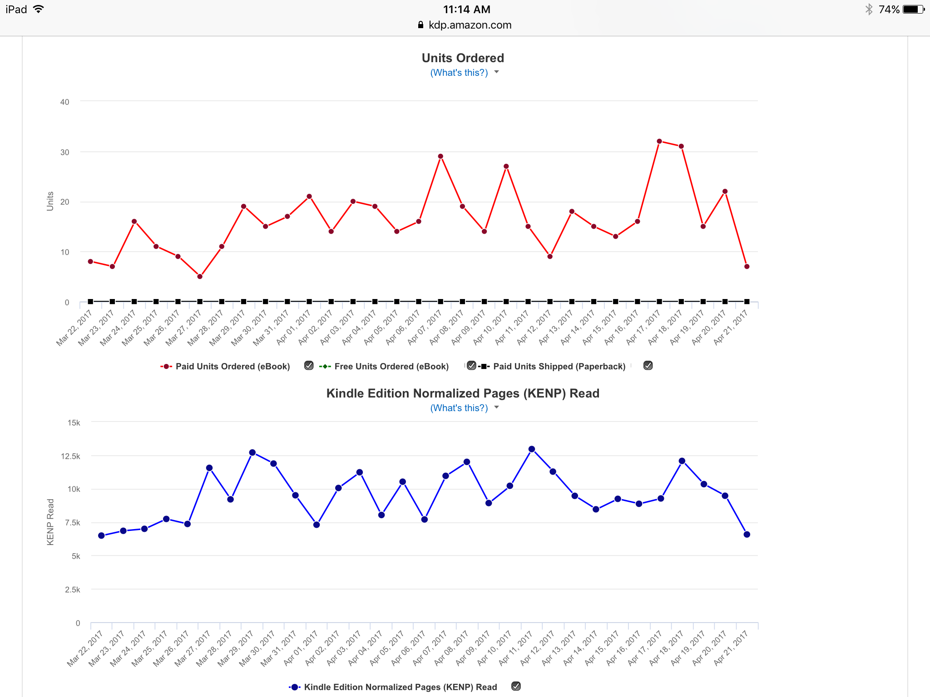

Slide 43
The Future Belongs to
Innovators
Notes:
And children of color and low-income families are the least likely to be engaged in these classes in school.

Slide 44







Notes:
Publish on demand
Create on demand
Technology as a mindset
Dad’s book

Slide 45
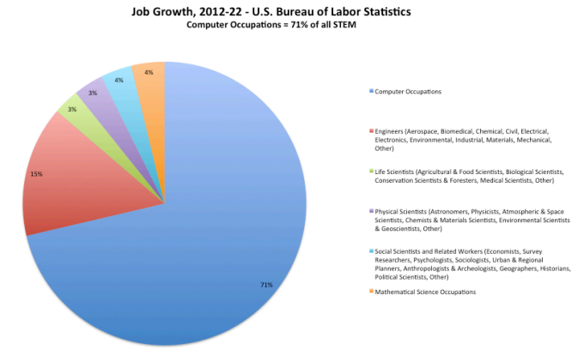
Notes:
And children of color and low-income families are the least likely to be engaged in these classes in school.
http://lazowska.cs.washington.edu/Lazowska.for.CNN.pdf

Slide 46
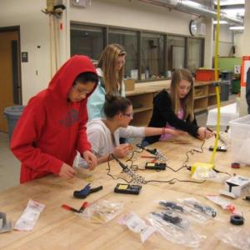
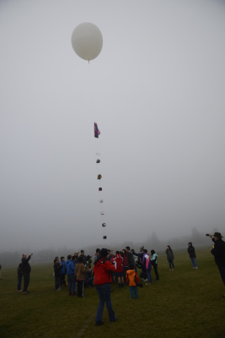
Notes:
Tyee Satellite Club from Bellevue, images from DonorsChoose site.

Slide 47
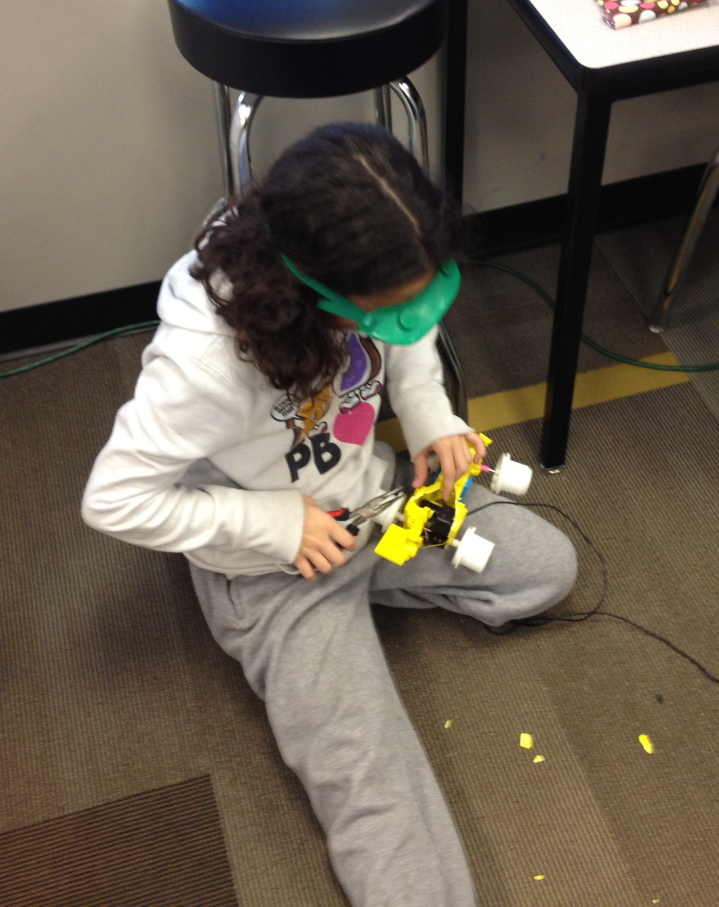
Instead of asking kids what they want to be when they grow up, we should be asking them what problems they want to solve.
    George Couros

Slide 48
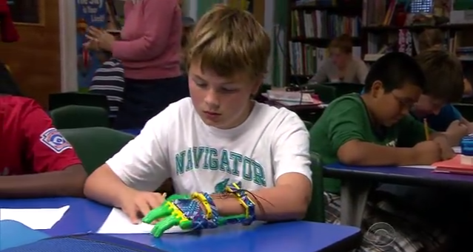
DIY on Steroids
Notes:
http://youtu.be/FGSo_I86_lQ

Slide 50
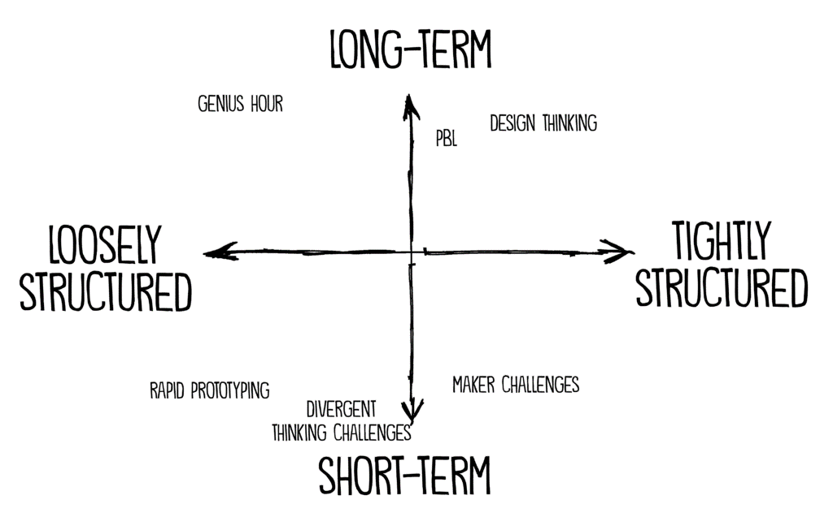
Introduction to Makerspaces
Notes:
http://www.spencerauthor.com/maker-projects-look-like-subject-area/

Slide 51
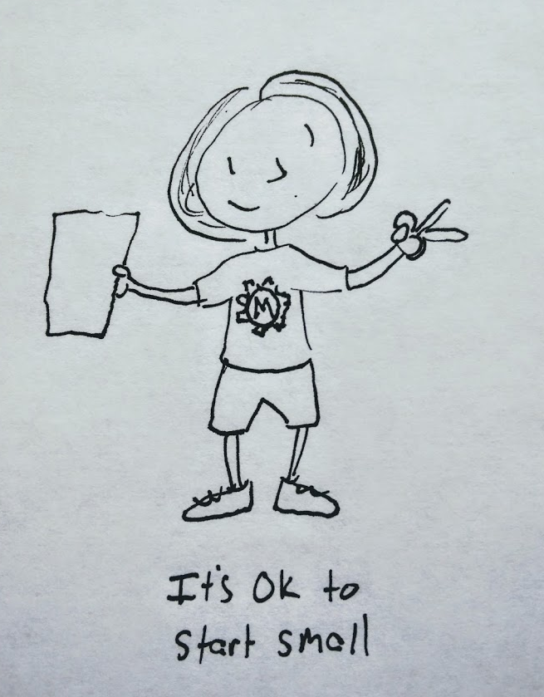

Slide 52
Introduction to Makerspaces

